Slide 1



Introduction to SPARC-Lab
A. Mostacci
SPARC in Frascati is a high brightness photo-injector used to drive Free Electron Laser experiments and explore advanced beam manipulation techniques. The R&D effort made for the optimization of the beam parameters will be presented here, together with the major experimental results achieved. In particular, we will focus on the generation of sub-picosecond, high brightness electron bunch trains via velocity bunching technique (the so called comb beam). Such bunch trains can be used to drive tunable and narrow band THz sources, FELs and plasma wake field accelerators.
FLAME is a 250 TW, 30 fs pulse duration laser. At the moment the laser FLAME has been focused on a 4 mm gas-jet with the goal of producing sub-GeV electron bunches from laser–plasma interactions. The present installation will allow to the laser wake-field acceleration of externally injected electron bunches.

Slide 2
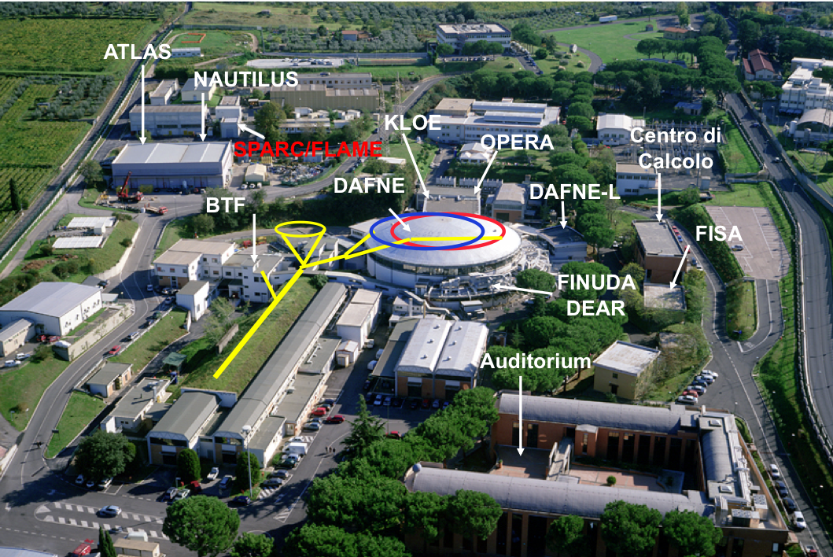
INFN - Laboratori nazionali di frascati

Slide 3
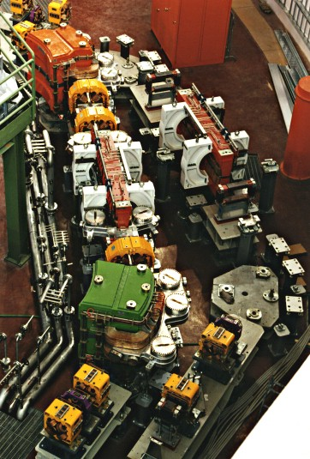
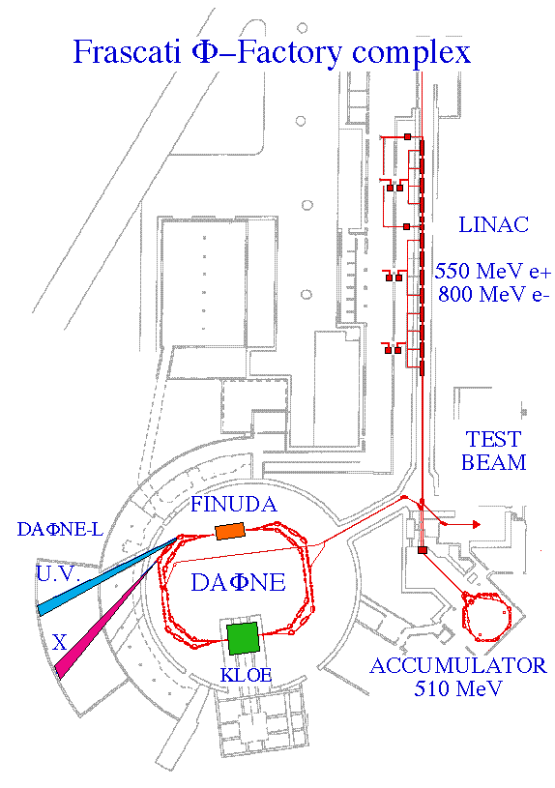
DAFNE

Slide 4
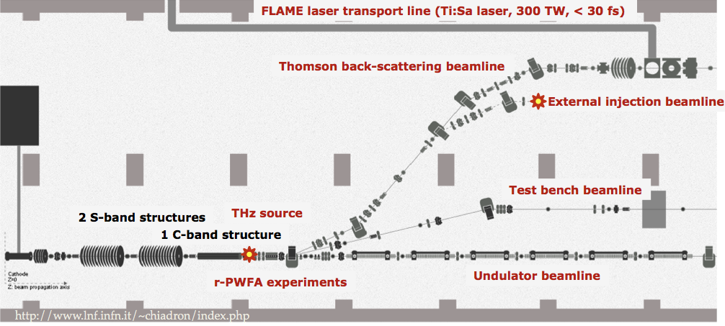
Sparc-LAB
Sources for Plasma Accelerators and Radiation Compton with Lasers And Beams

Slide 5
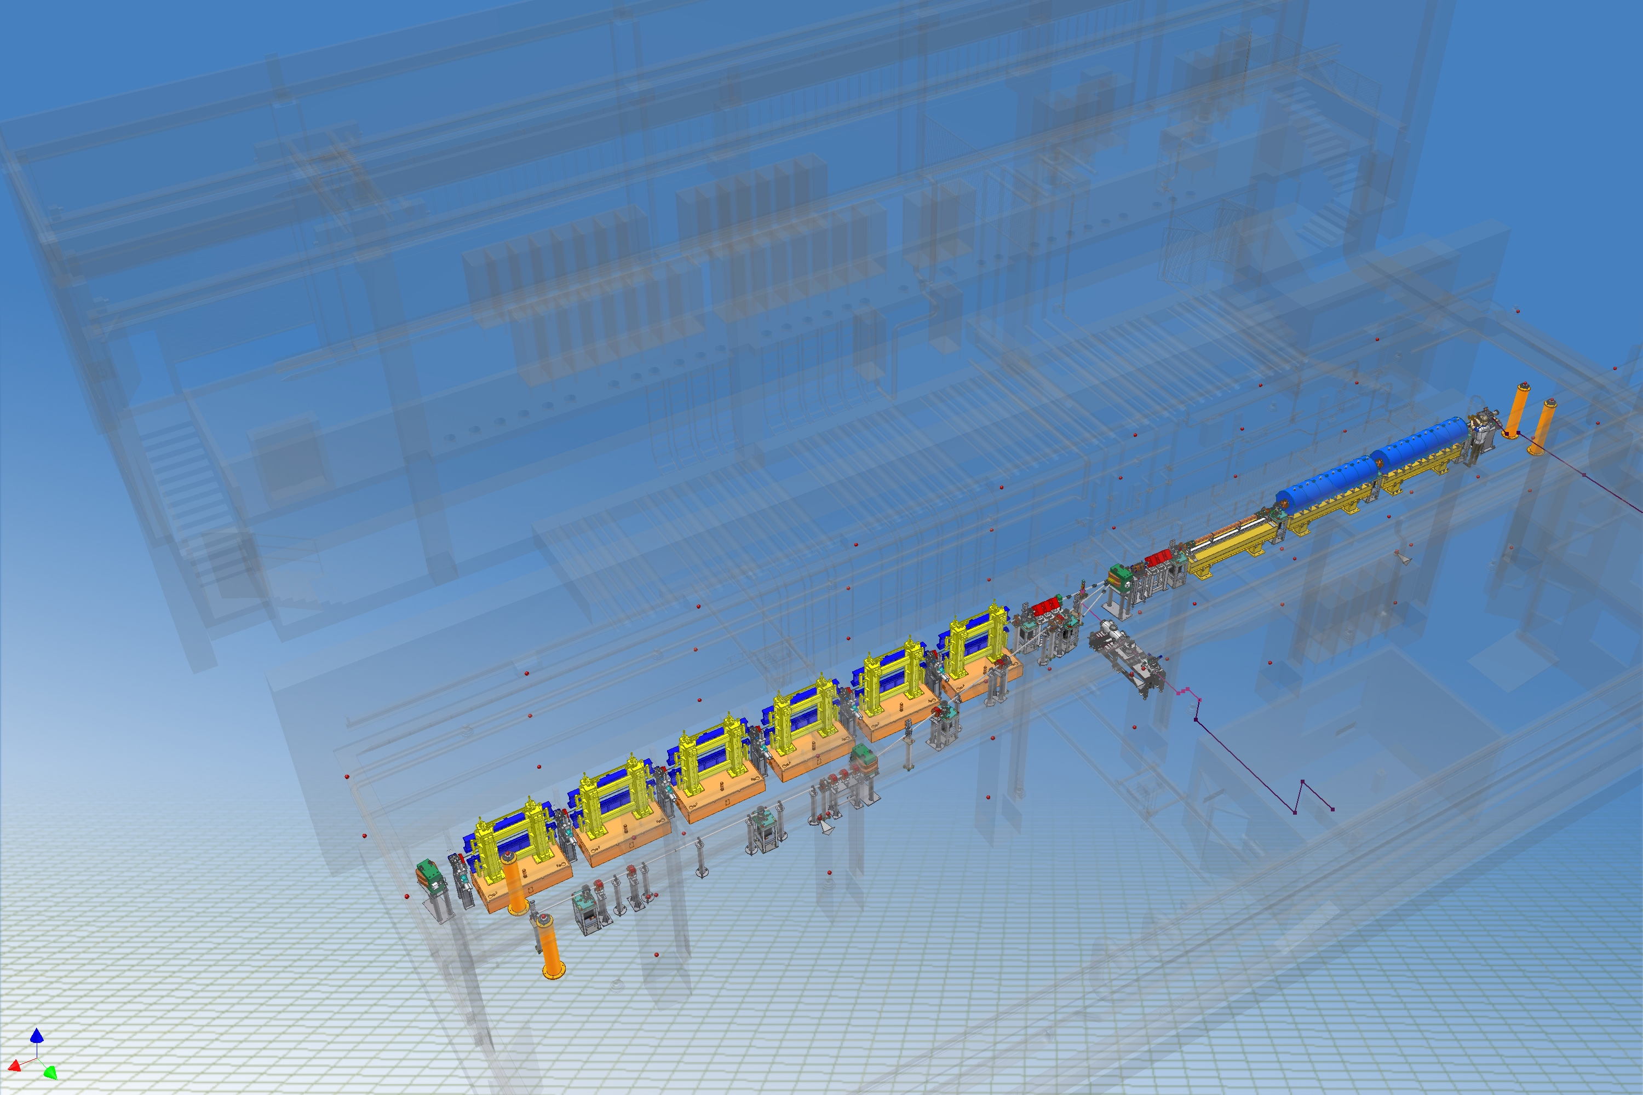


Sparc
180 MeV
S-band linac
Diagnostics and Matching
12 m
S-band Gun
Long Solenoids
Undulators
λ_{r} = 500 nm
15 m
Seeding
THz Source

Slide 6
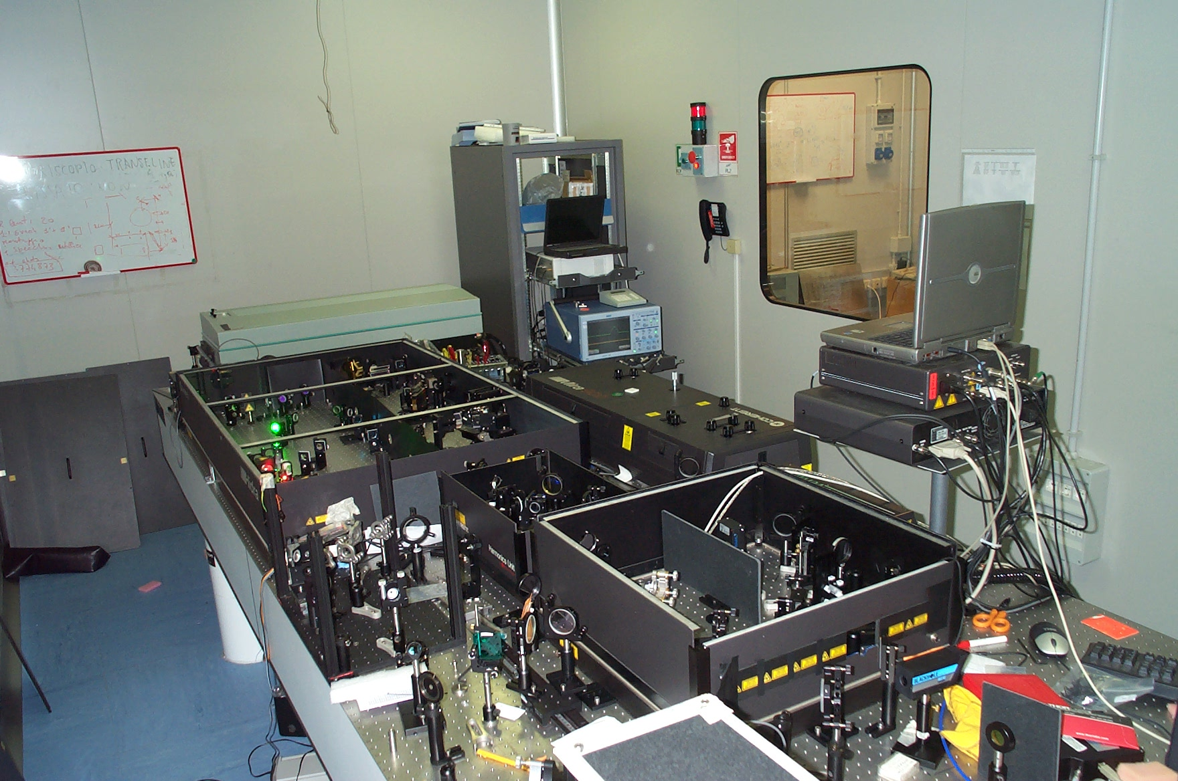
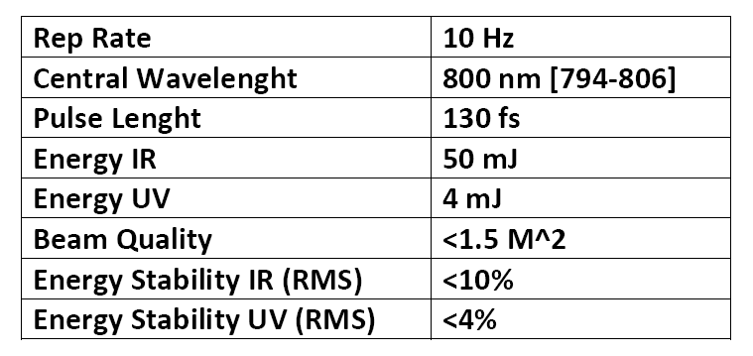
Sparc layout: Laser system
SPARC Laser system
(Ti:Sa) 0.5 TW
Oscillator
Diagnostic and Matching
Amplifier
UV stretcher
Amplifier
Seeding
Third Harmonic Generation
UV light to cathode

Slide 7
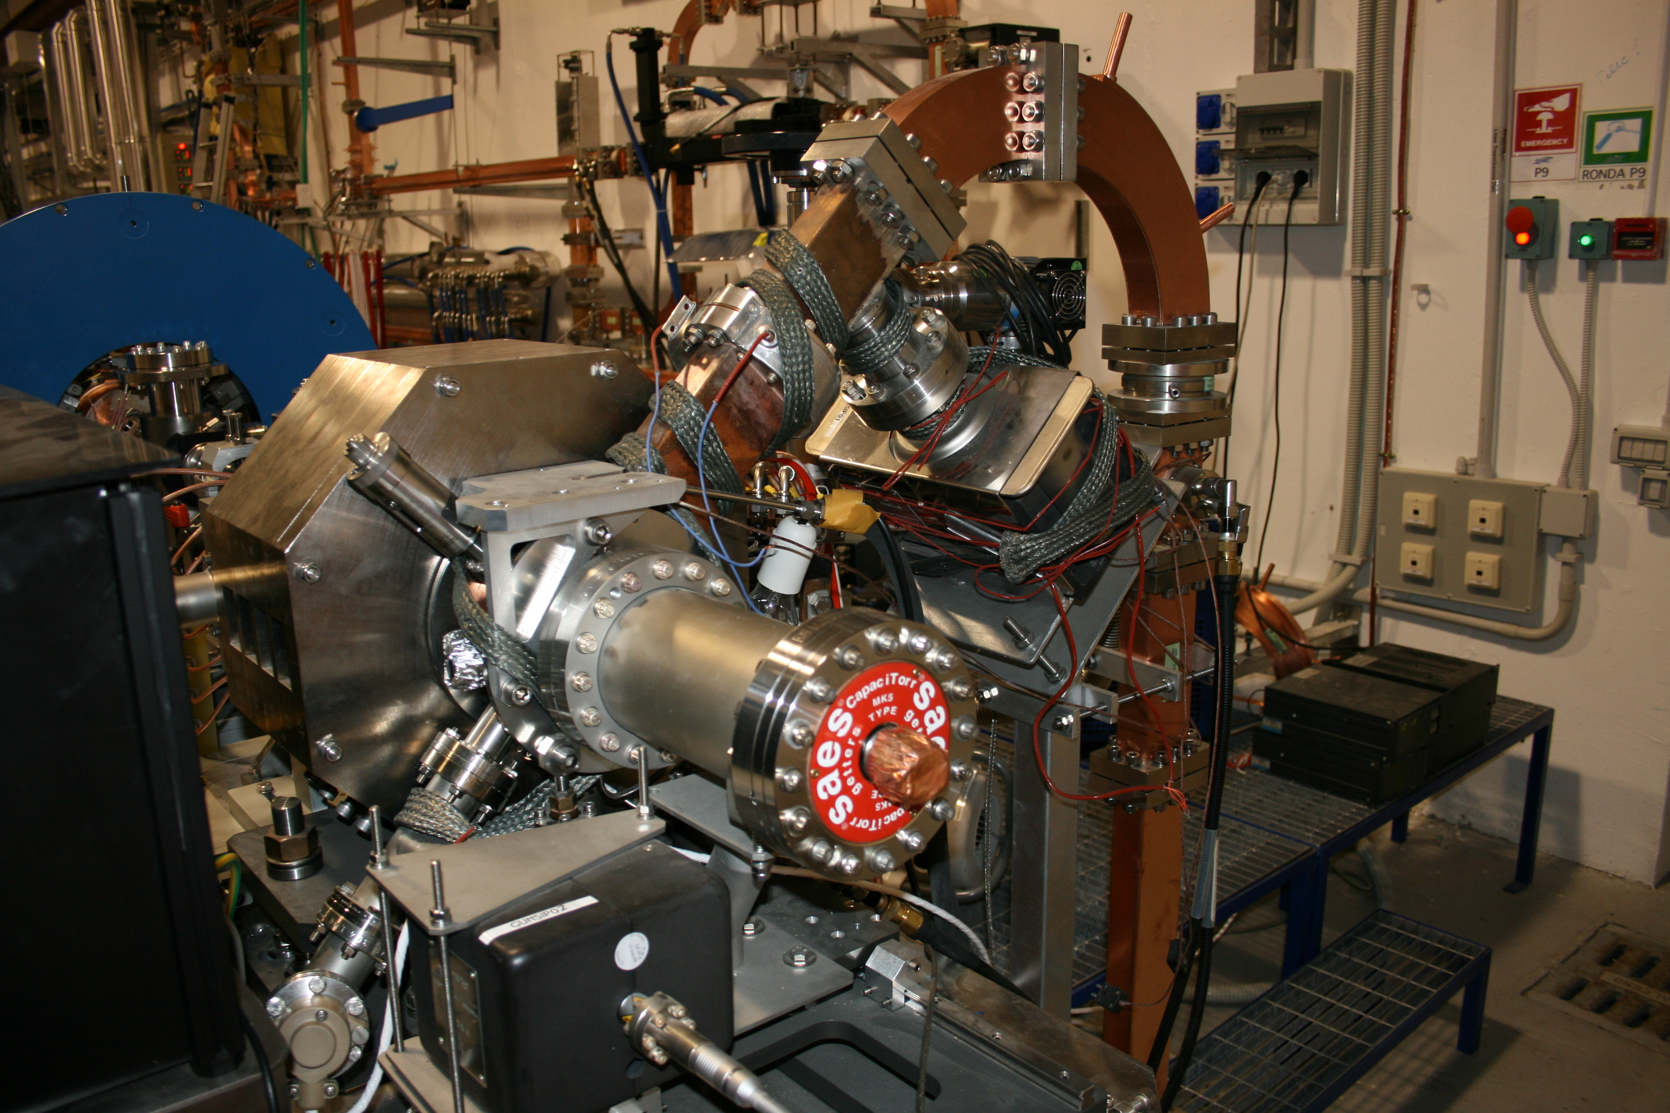
Sparc layout: S-BAND GUN
Laser Port
RF power
Diagnostic and Matching
S-band Gun
Long Solenoids
Undulators
λ_{r} = 500 nm
15 m
Cathode
Seeding
Gun
Solenoid
UCLA/BNL design
Solenoid ~3 kG
Input Power 14 MW
Max Acc. Field @ cathode
~130 MV/m
THz Source

Slide 8
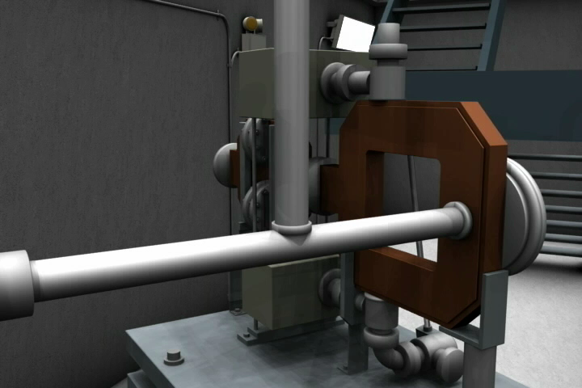
Sparc layout: S-BAND GUN
Laser Port
RF power
Diagnostic and Matching
S-band Gun
Long Solenoids
Undulators
λ_{r} = 500 nm
15 m
Cathode
Seeding
Gun
Solenoid
UCLA/BNL design
Solenoid ~3 kG
Input Power 14 MW
Max Acc. Field @ cathode
~130 MV/m
THz Source

Slide 9
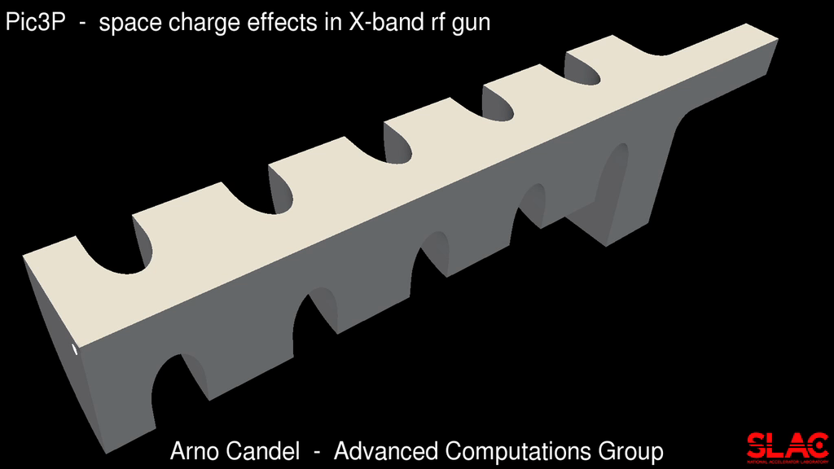
RF GUNS
Courtesy of Cho Ng, SLAC

Slide 10
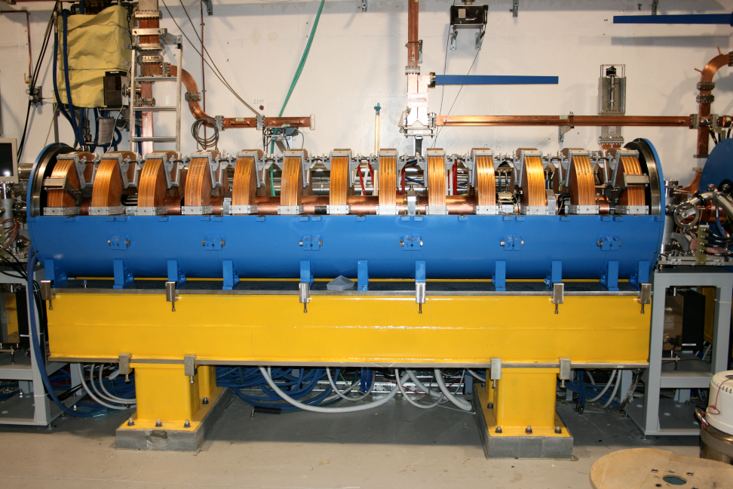
Sparc layout: S-BAND LINAC
180 MeV
S-band linac
12 m
Focusing solenoid
Long Solenoids
Undulators
λ_{r} = 500 nm
15 m
Seeding
Beam axis
THz Source
SLAC constant gradient design
Solenoid ~300 G
Accelerating field ~20 MV/m

Slide 11
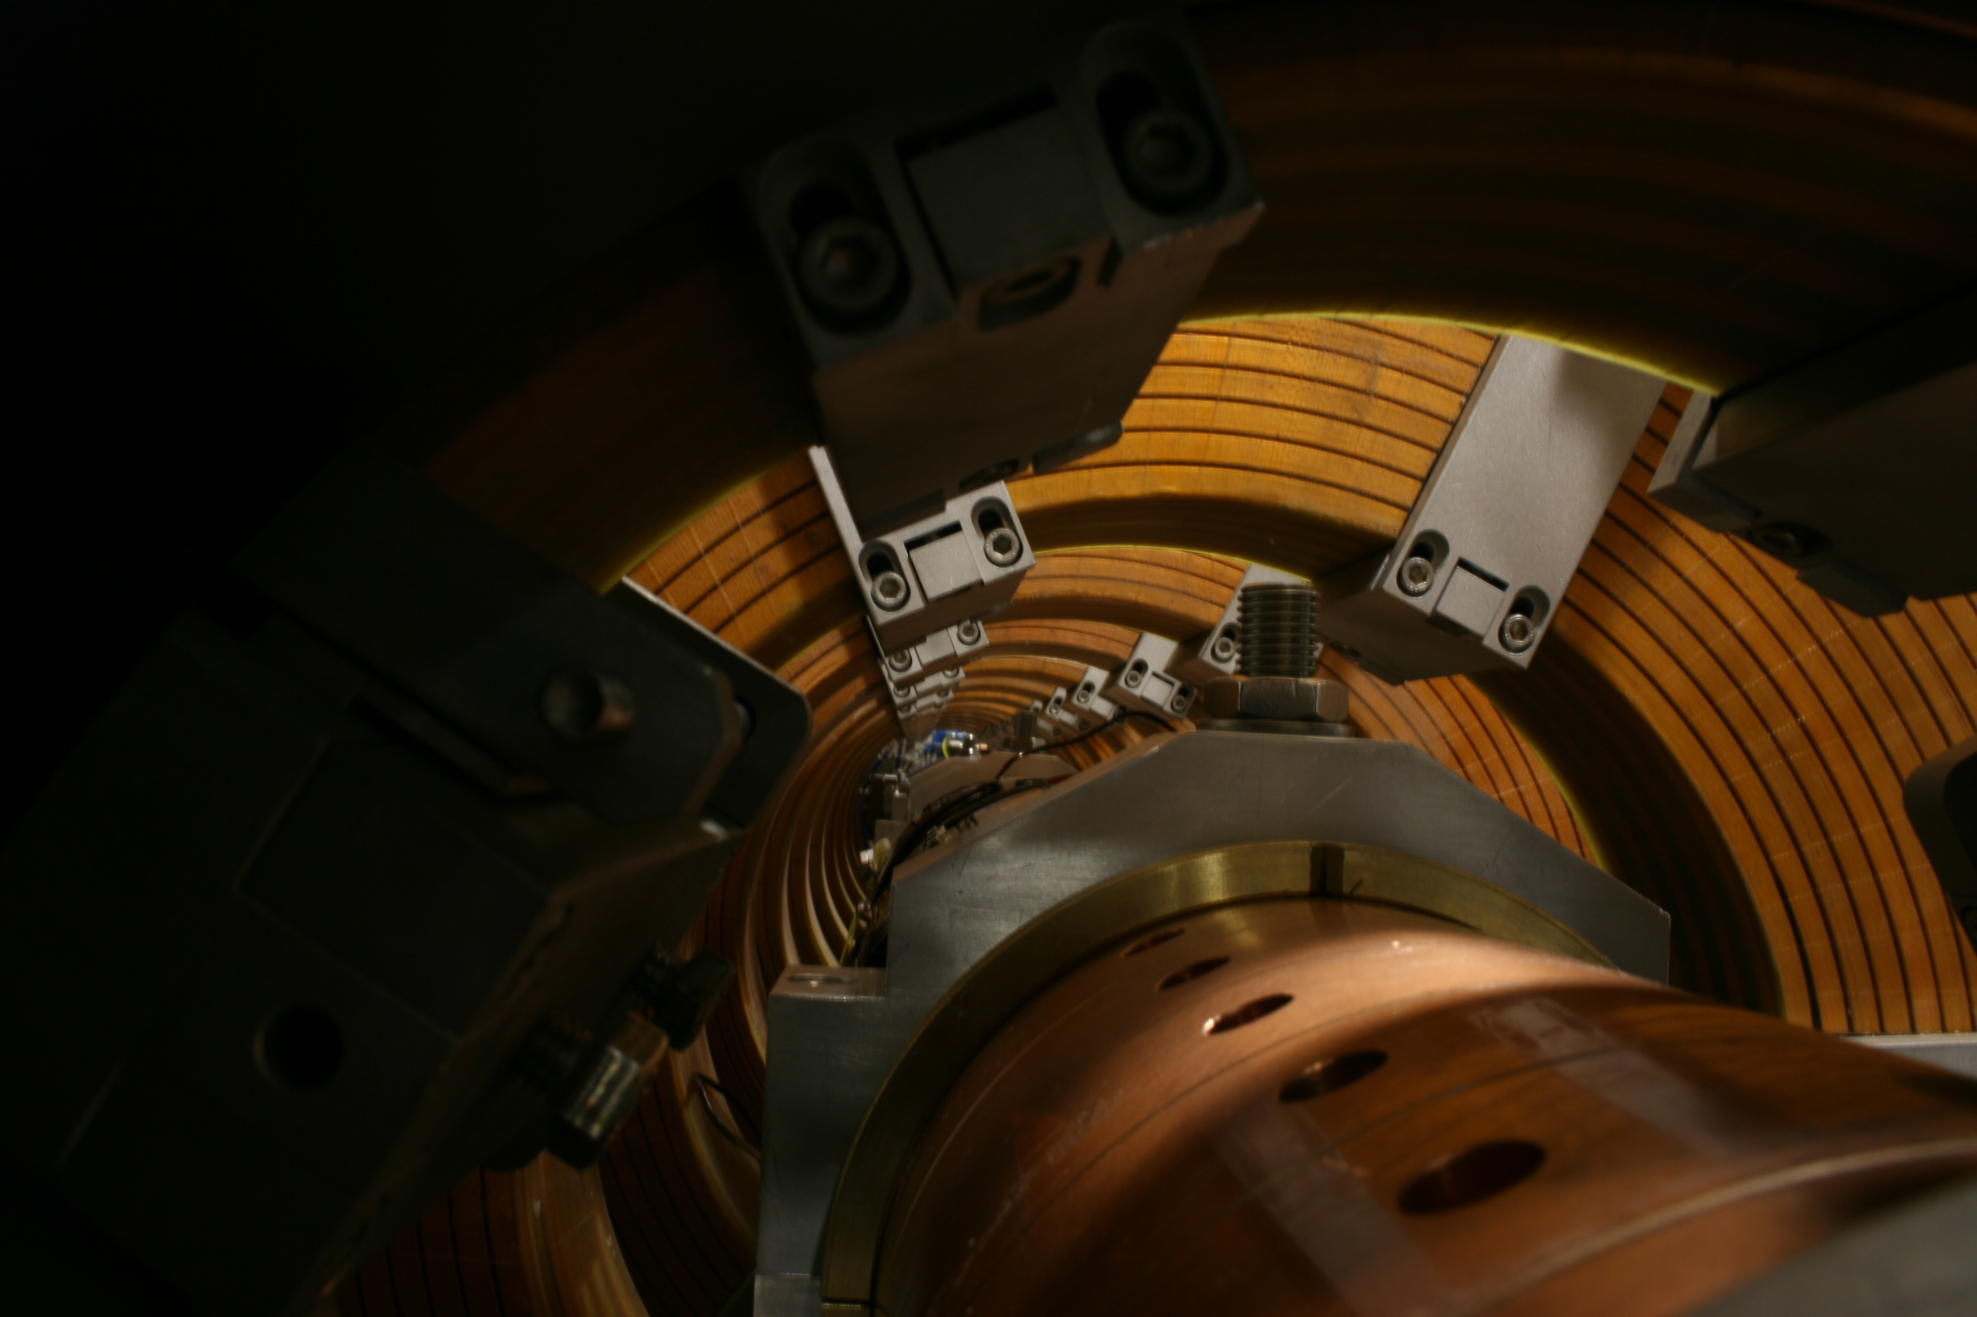
Sparc layout: S-BAND LINAC
180 MeV
S-band linac
12 m
Long Solenoids
Undulators
λ_{r} = 500 nm
15 m
Seeding
THz Source
SLAC constant gradient design
Solenoid ~300 G
Accelerating field ~20 MV/m

Slide 12
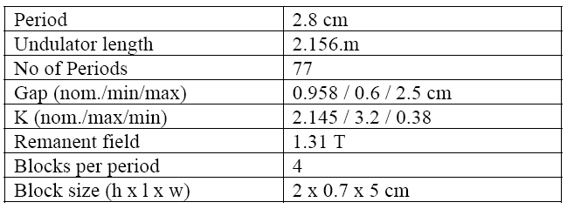
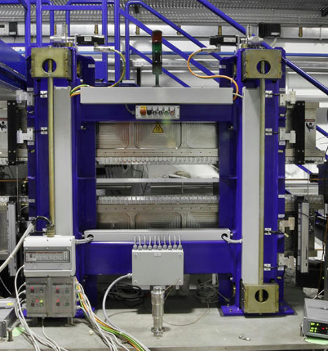
Sparc layout: UNDULATORS
180 MeV
S-band linac
12 m
S-band Gun
Long Solenoids
Undulators
λ_{r} = 500 nm
15 m
Beam
Seeding
Variable gap undulator
Halbach type

Slide 13
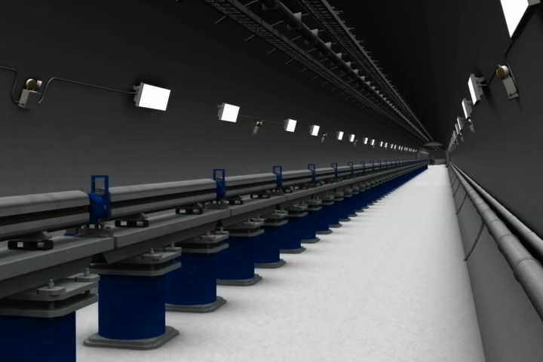
Sparc layout: UNDULATORS
180 MeV
S-band linac
12 m
S-band Gun
Long Solenoids
Undulators
λ_{r} = 500 nm
15 m
Beam
Seeding
Variable gap undulator
Halbach type

Slide 14
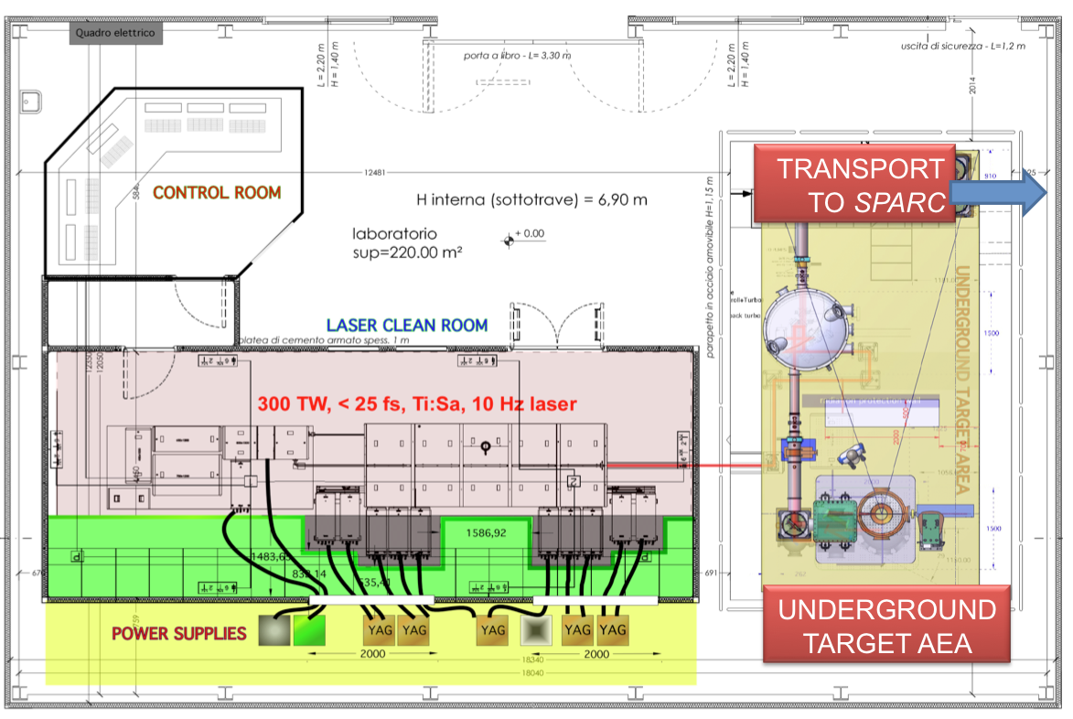
Flame: a 300 TW Ti:Sa laser

Slide 15
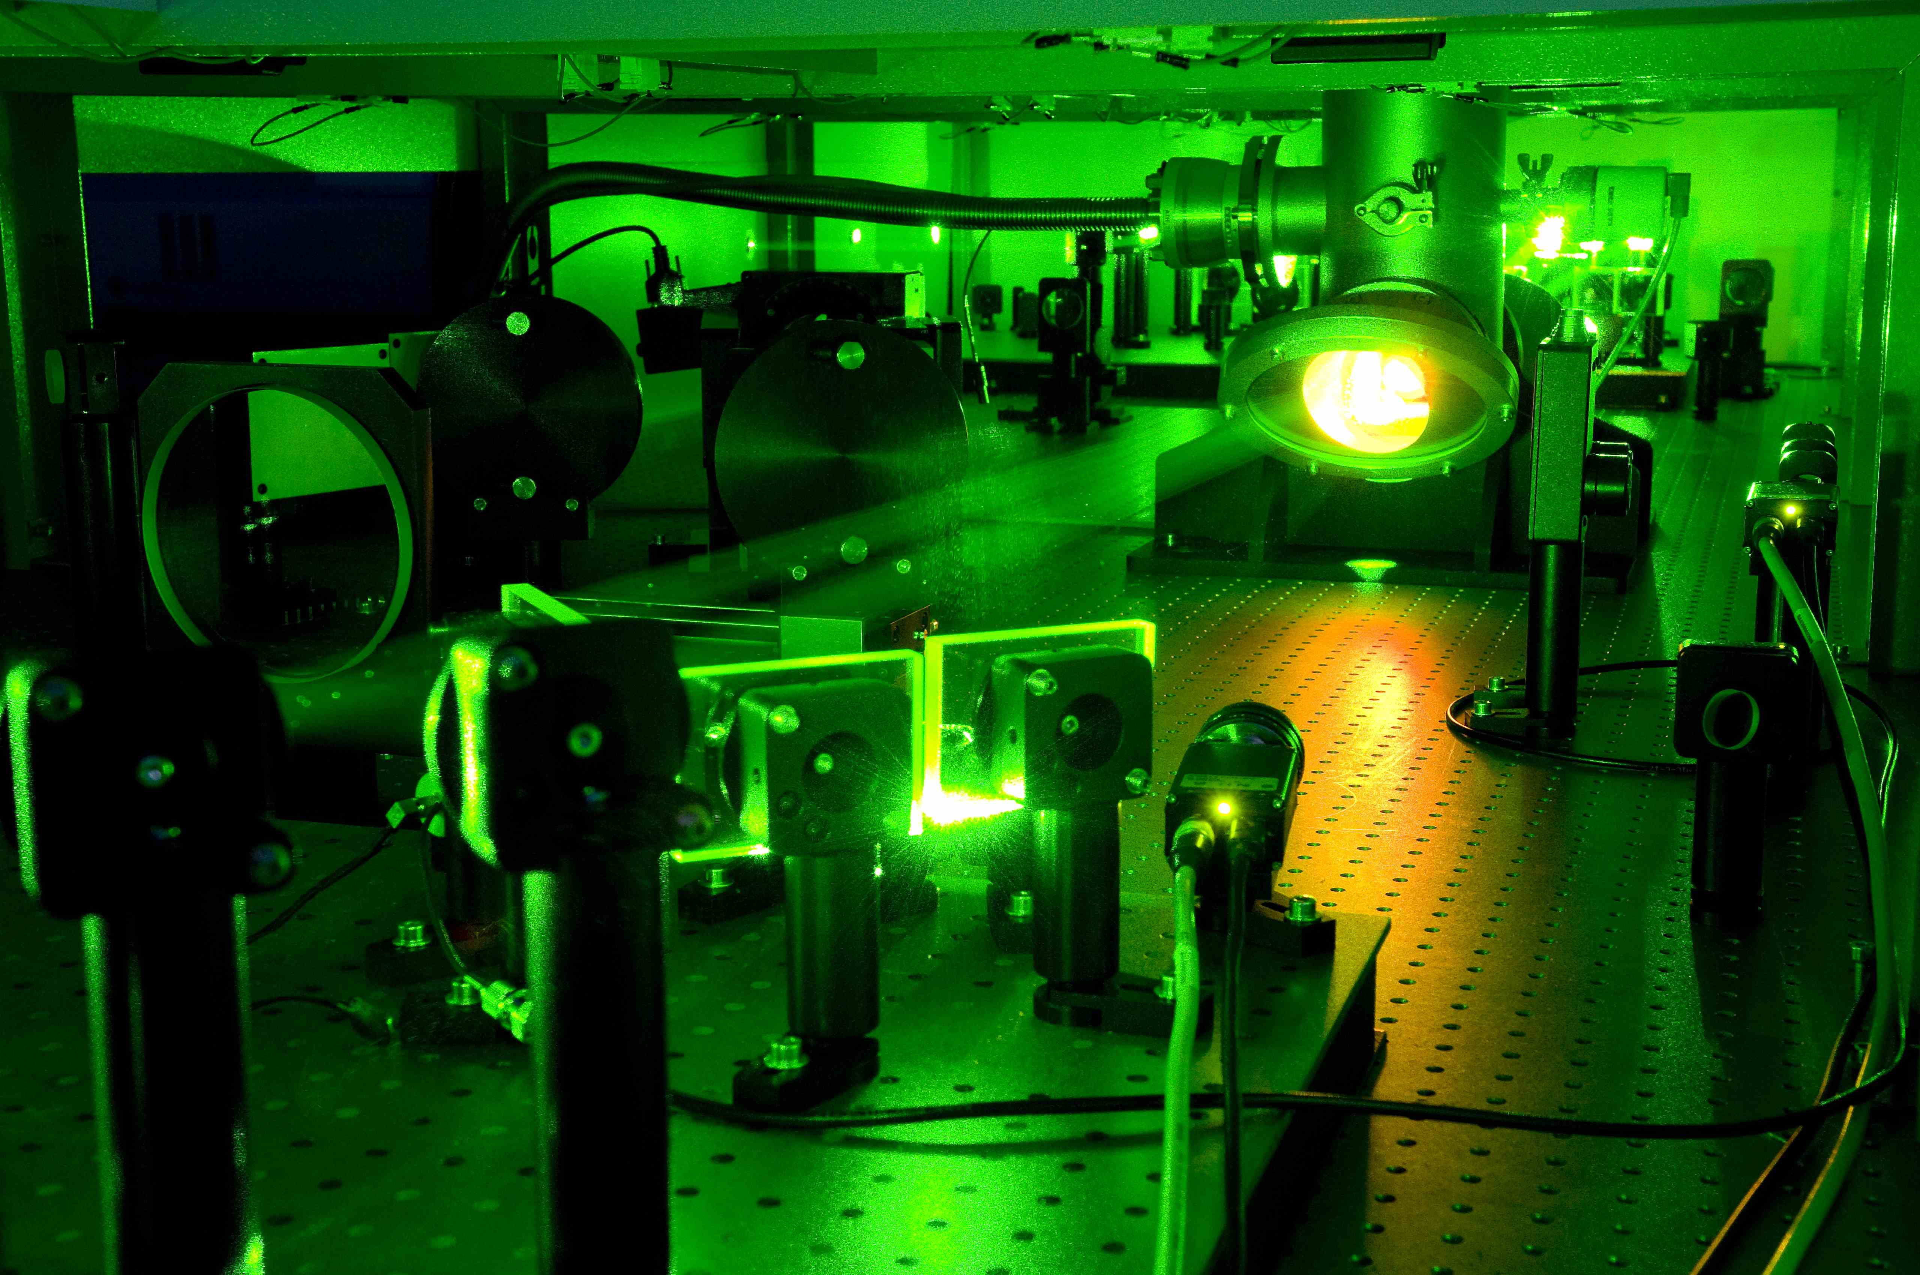
Flame: a 300 TW Ti:Sa laser
Final amplification stage
from ~600 mJ to 6J

Slide 16
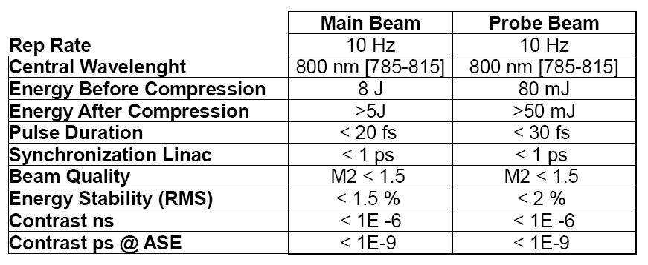
Flame: a 300 TW Ti:Sa laser

Slide 17
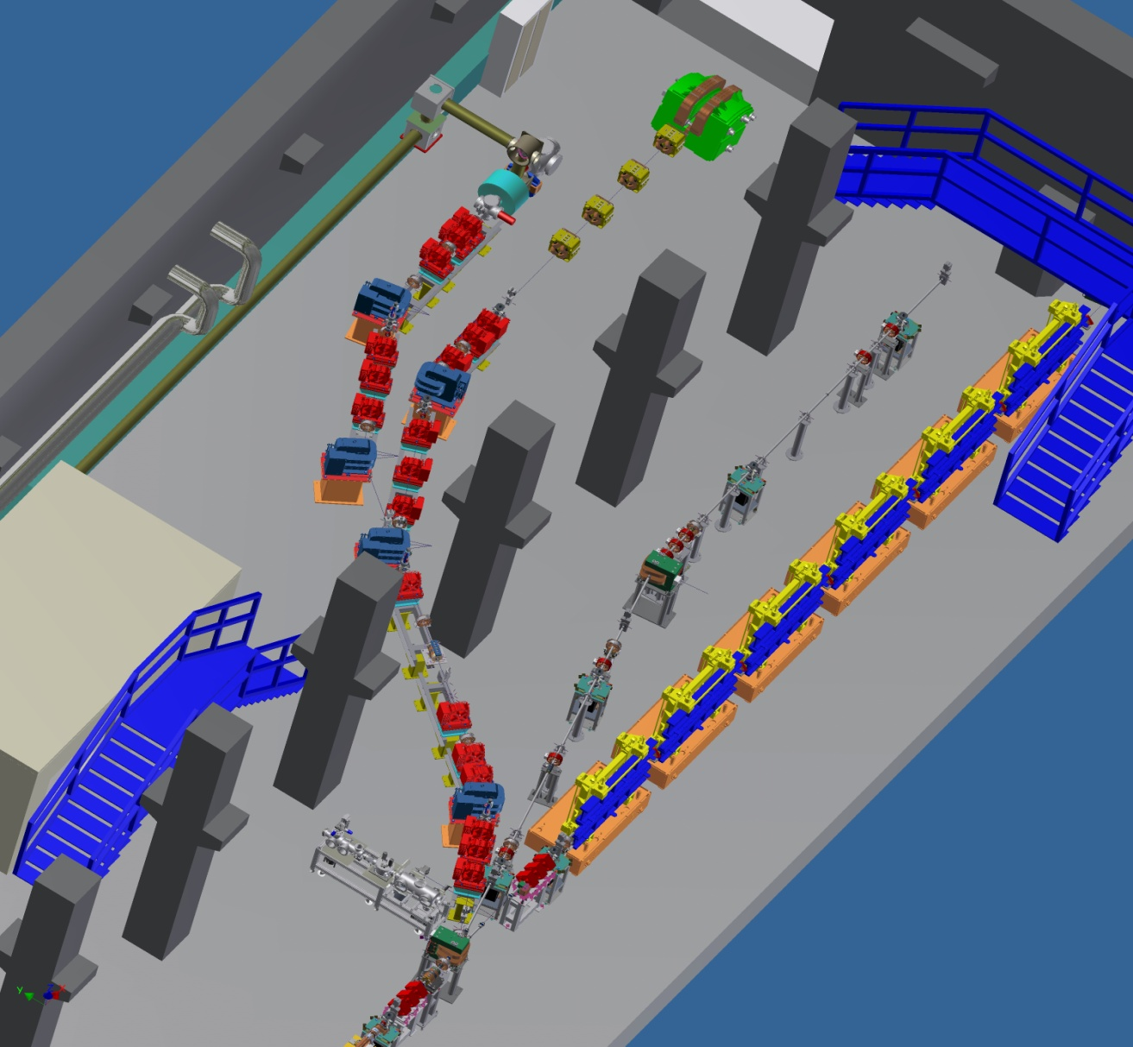

PLASMA ACCELERATION @ SPARC-LAB
External Injection into plasma
laser input line
300 TW, < 25 fs
Ti:Sa laser
Plasma Wakefield
Acceleration (COMB beams)
High Brightness electron beam
from SPARC

Slide 18
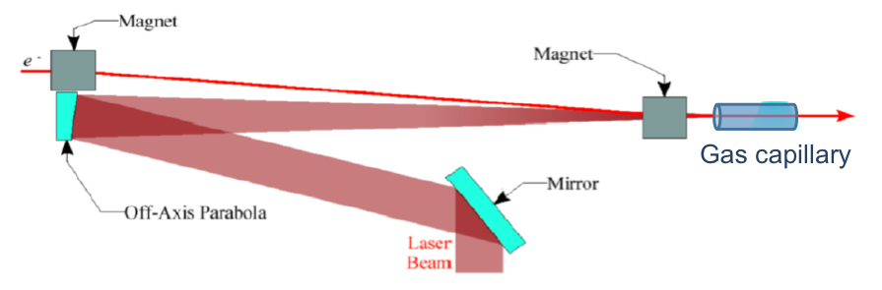
PLASMA ACCELERATION @ SPARC-LAB
External Injection into plasma
laser input line
300 TW, < 25 fs
Ti:Sa laser
Plasma Wakefield
Acceleration (COMB beams)
High Brightness electron beam
from SPARC

Slide 19
PLASMA ACCELERATION @ SPARC-LAB
External Injection into plasma
laser input line
300 TW, < 25 fs
Ti:Sa laser
Plasma Wakefield
Acceleration (COMB beams)
High Brightness electron beam
from SPARC

Slide 20
Sparc-LAB
Sources for Plasma Accelerators and Radiation Compton with Lasers And Beams

Slide 21
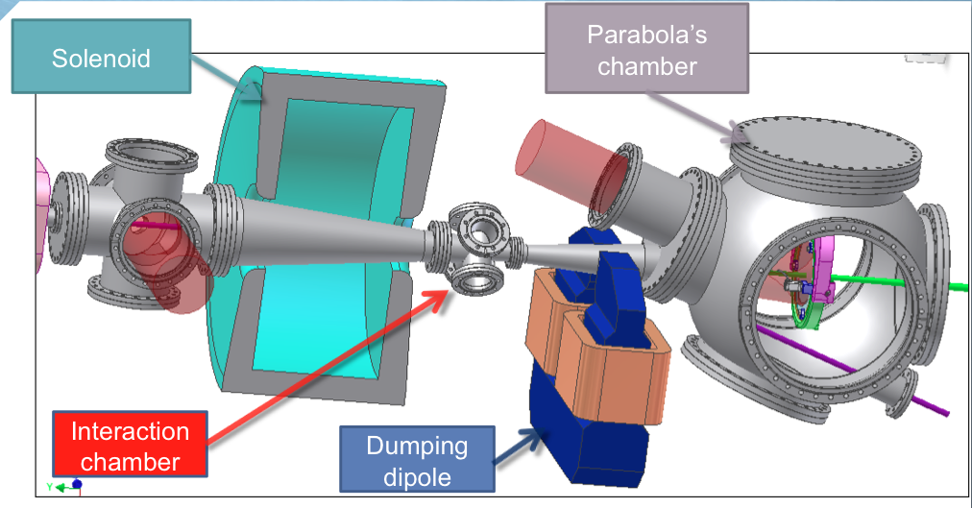
THOMSON SOURCE
C. Vaccarezza

Slide 22
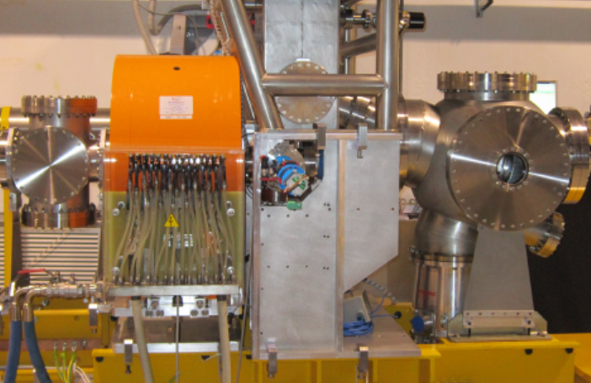
THOMSON SOURCE
C. Vaccarezza

Slide 23
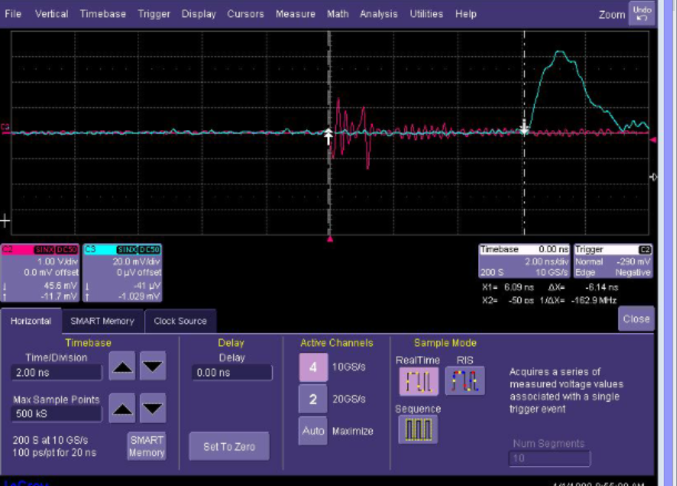
THOMSON SOURCE: SYNCHRONISATION
C. Vaccarezza

Slide 24
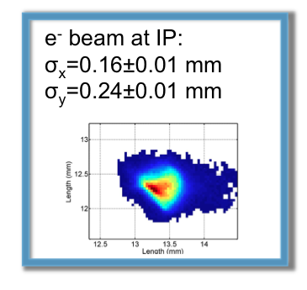
THOMSON SOURCE: RESULTS
C. Vaccarezza

Slide 25
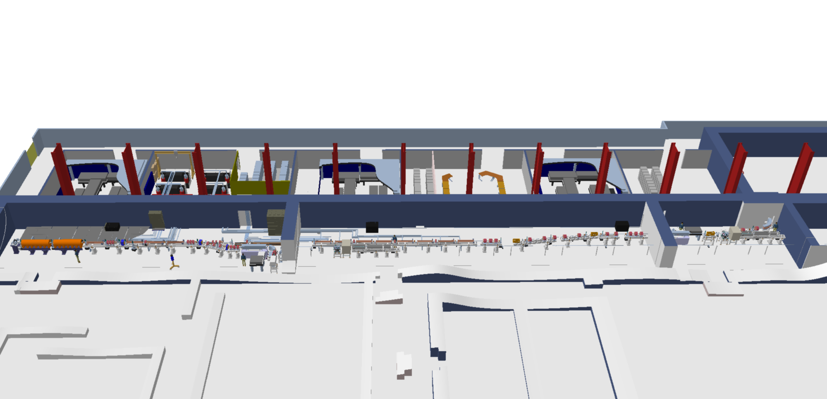
GAMMA SOURCES FOR ELI
Courtesy of STFC

Slide 26
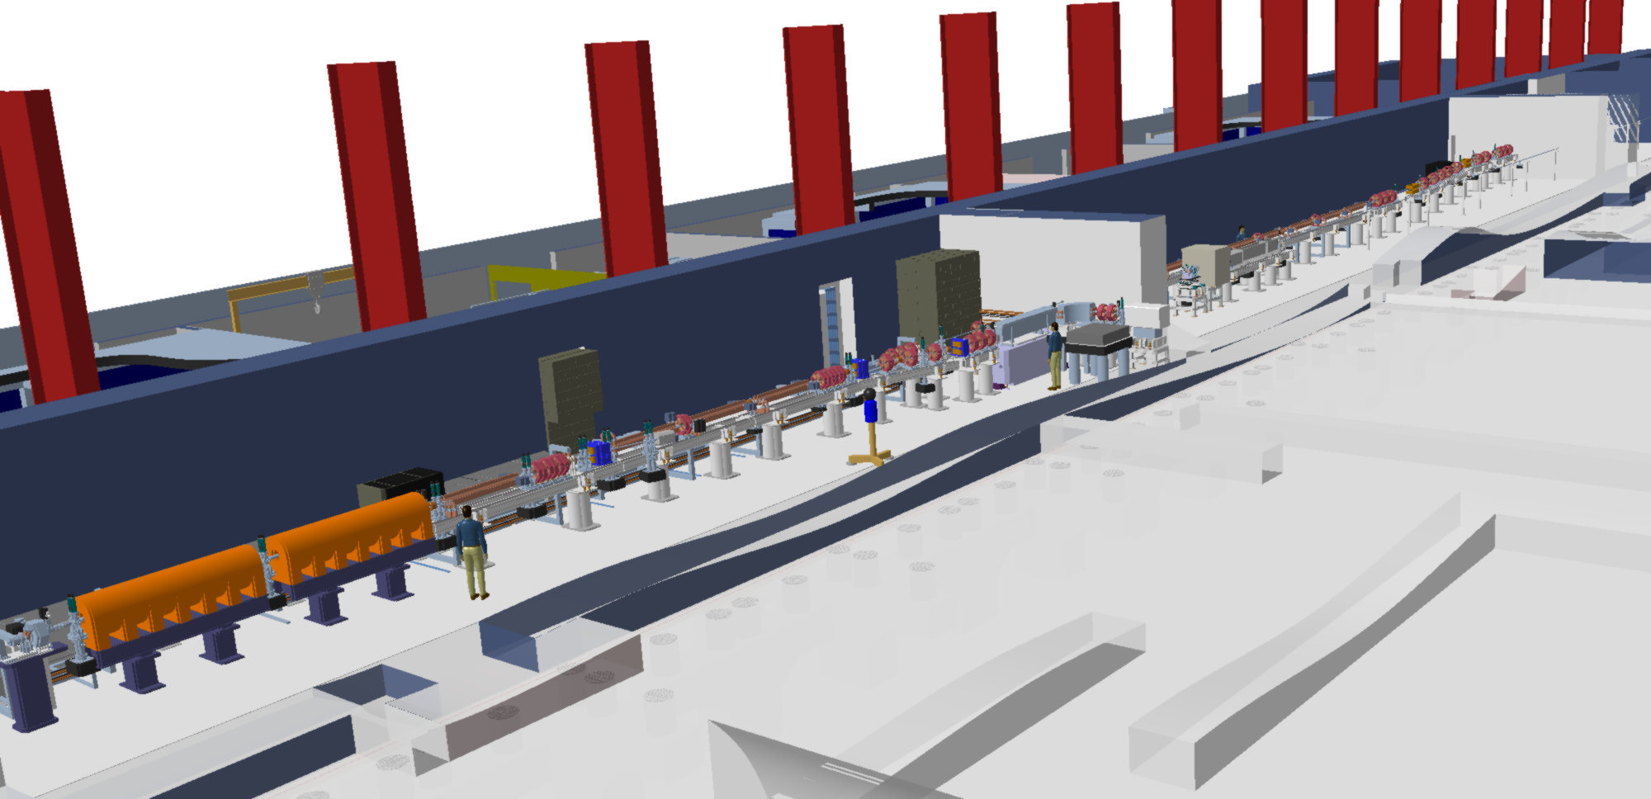
GAMMA SOURCES FOR ELI
Courtesy of STFC

Slide 27
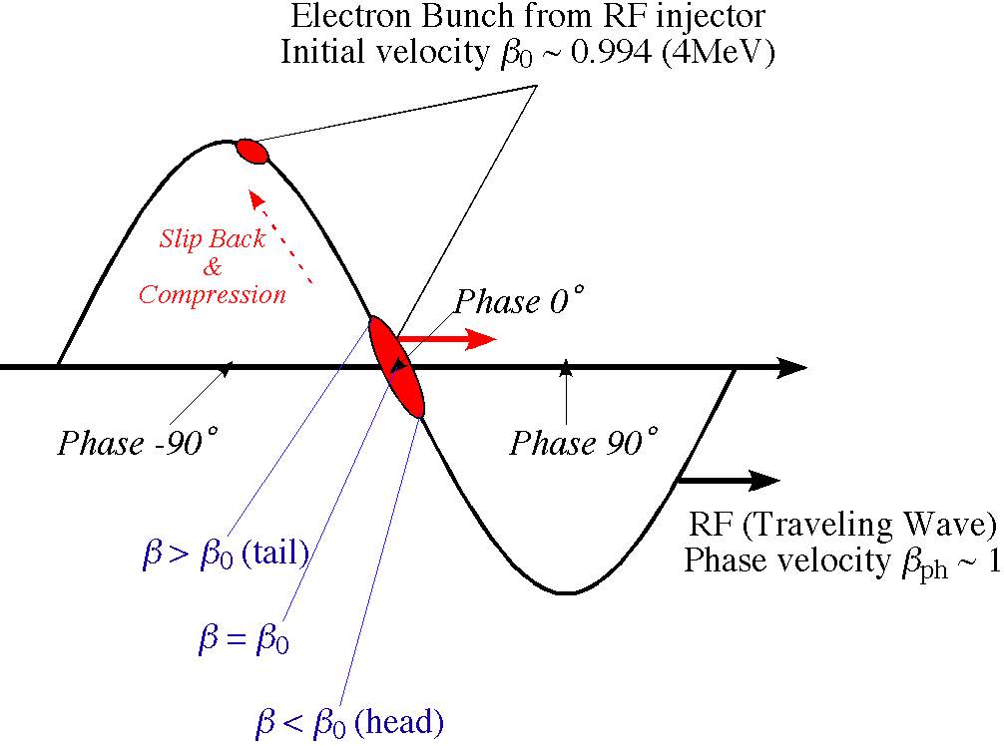
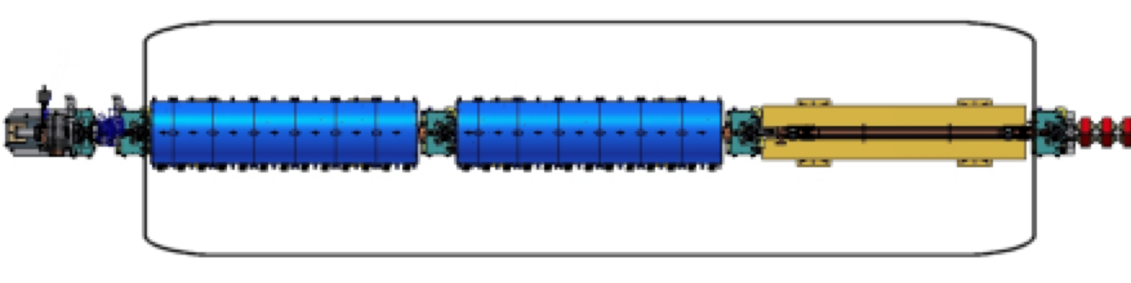
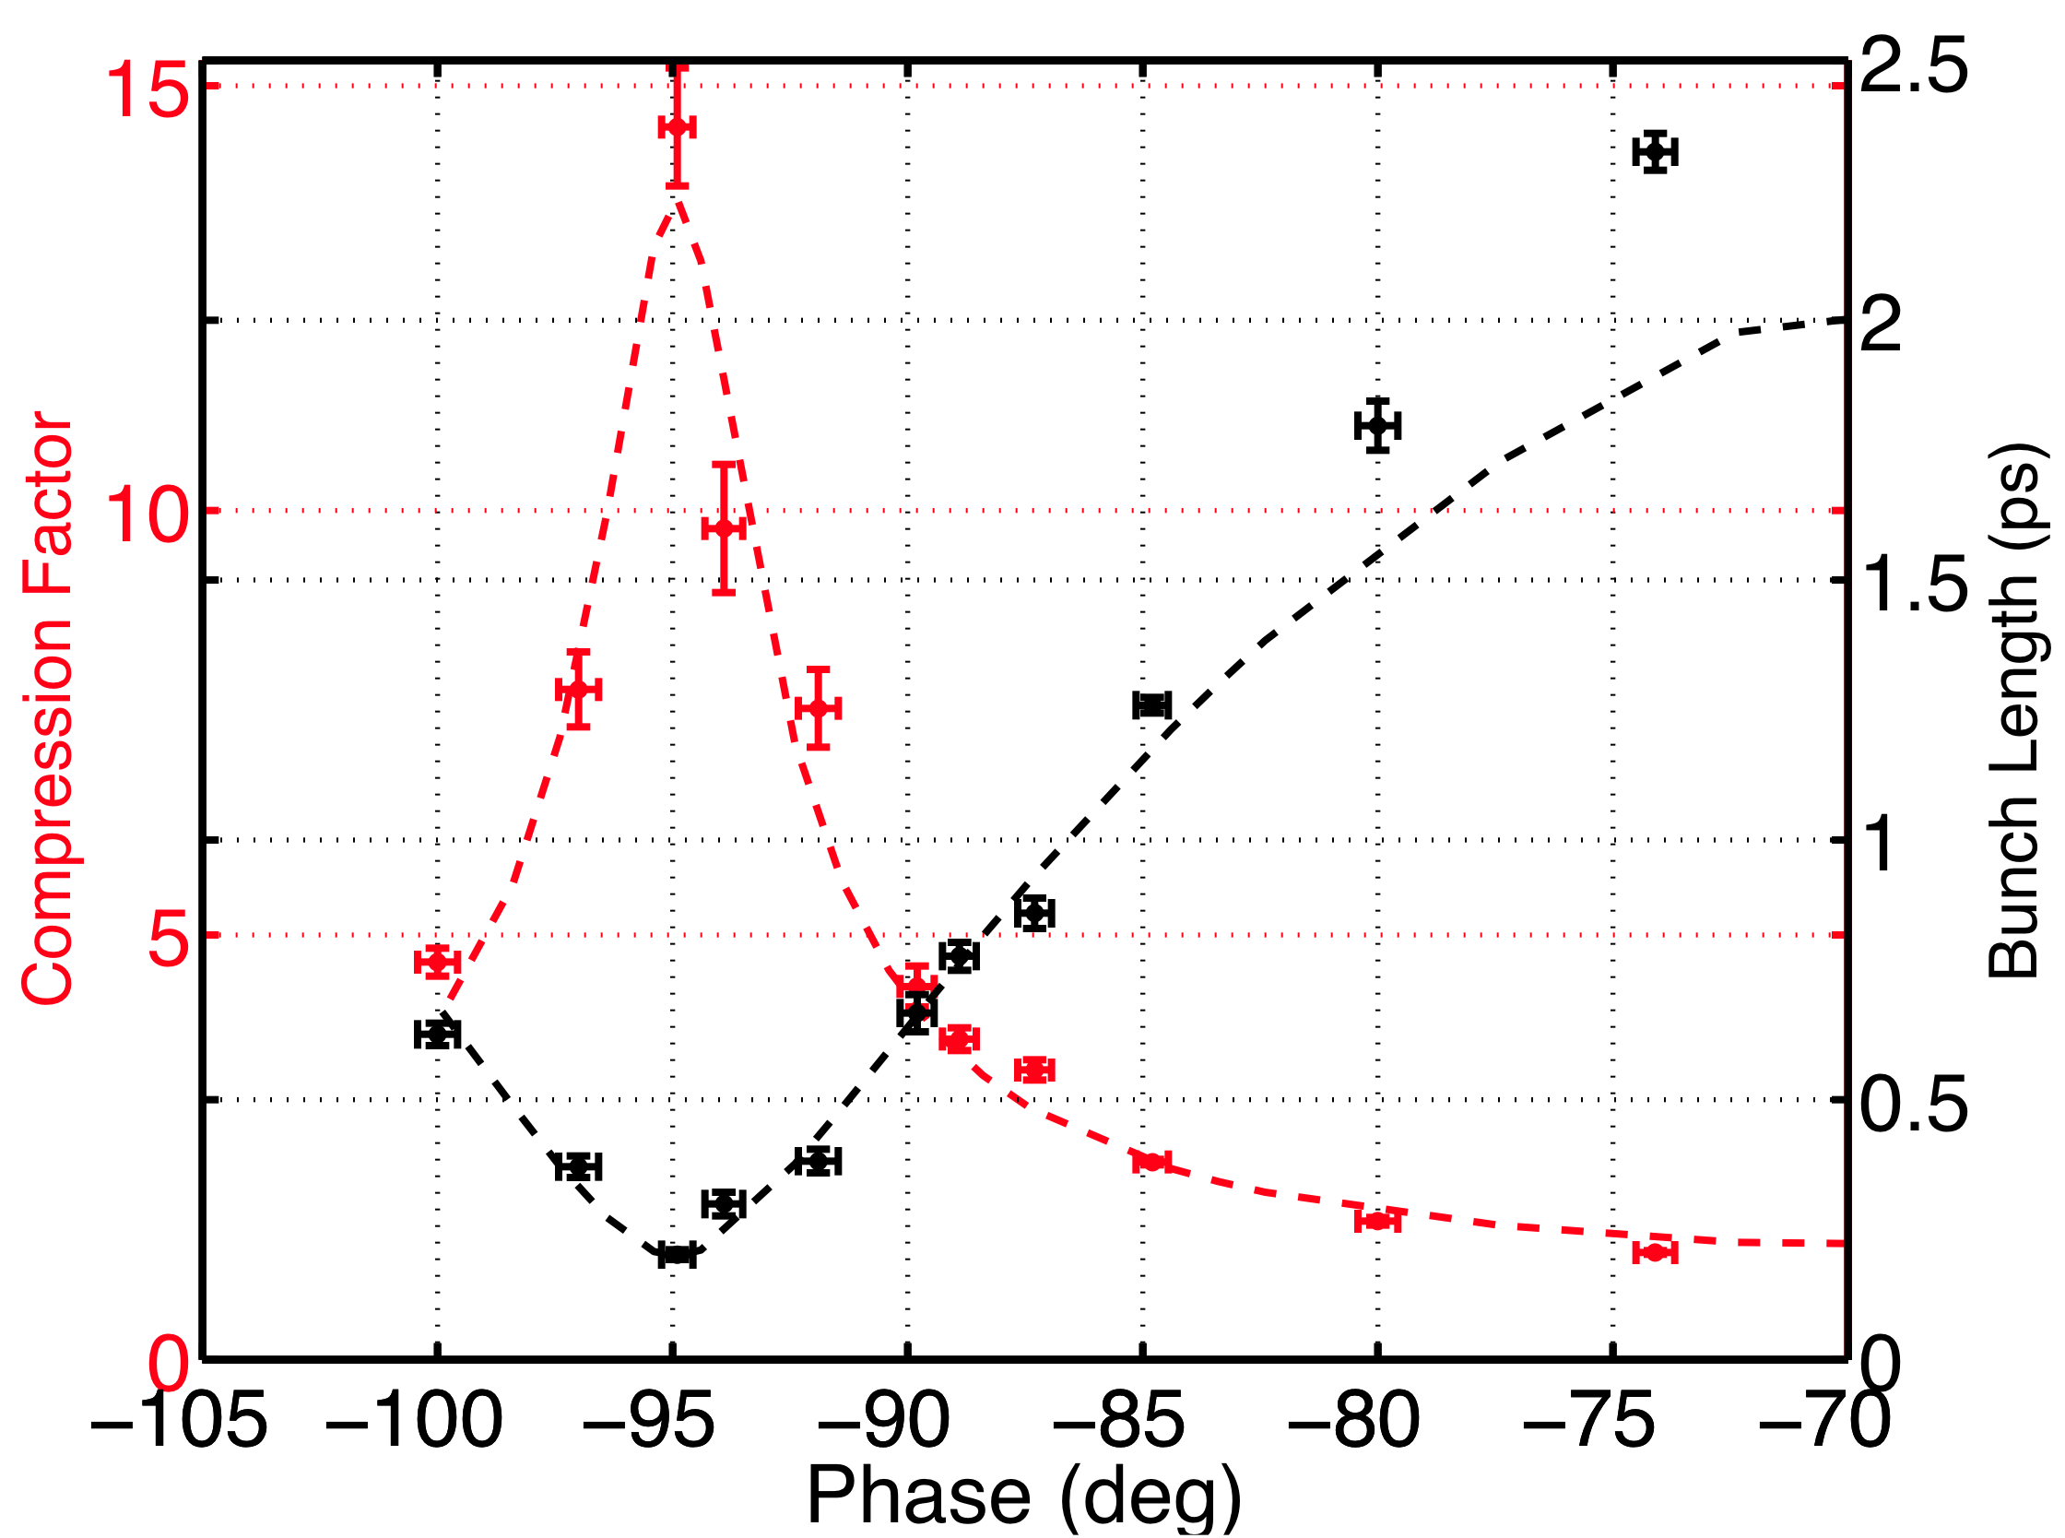
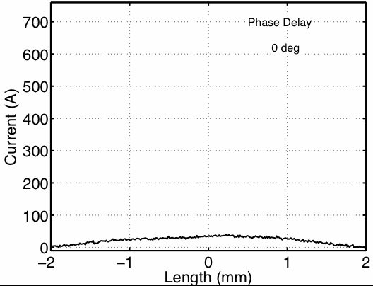
the velocity bunching
First section
By shifting phase of the first accelerating section, one can modify the bunch length and current profile.

Slide 28
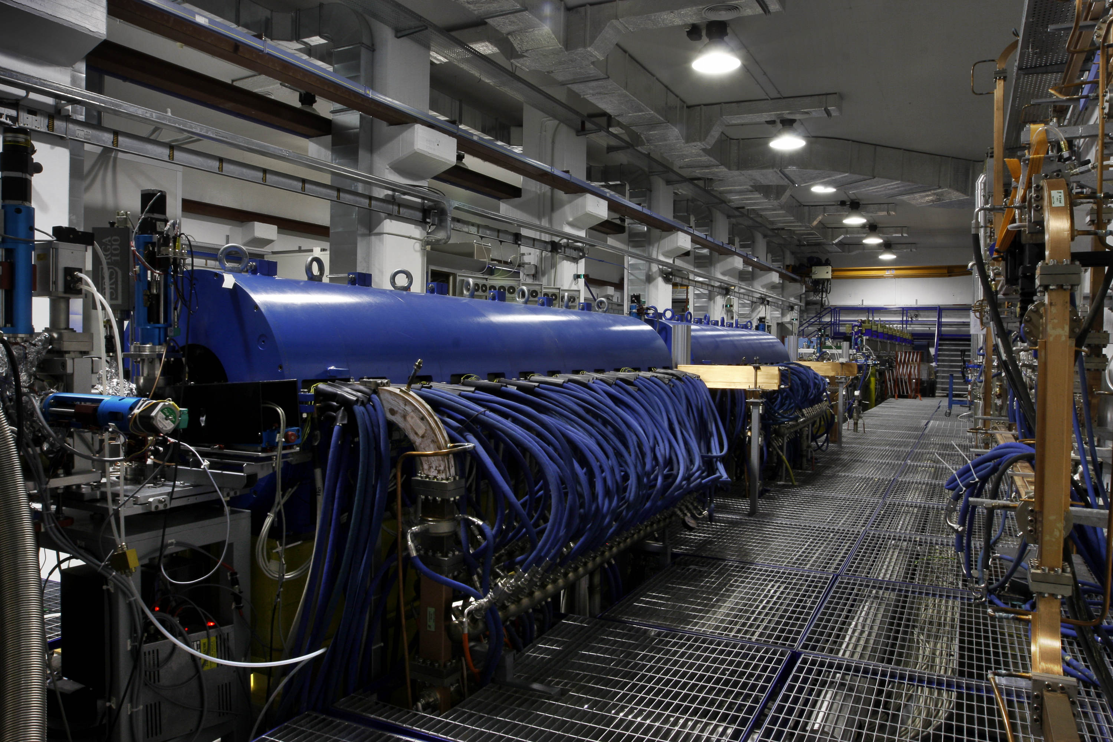
Frontiers in modern accelerator physics
C_Band driver
THz Radiation
Velocity Bunching
LWFA_ext
THz Radiation
LASER COMB
PWFA
DWFA
FEL
Thomson
FEL Single Spike

Slide 29
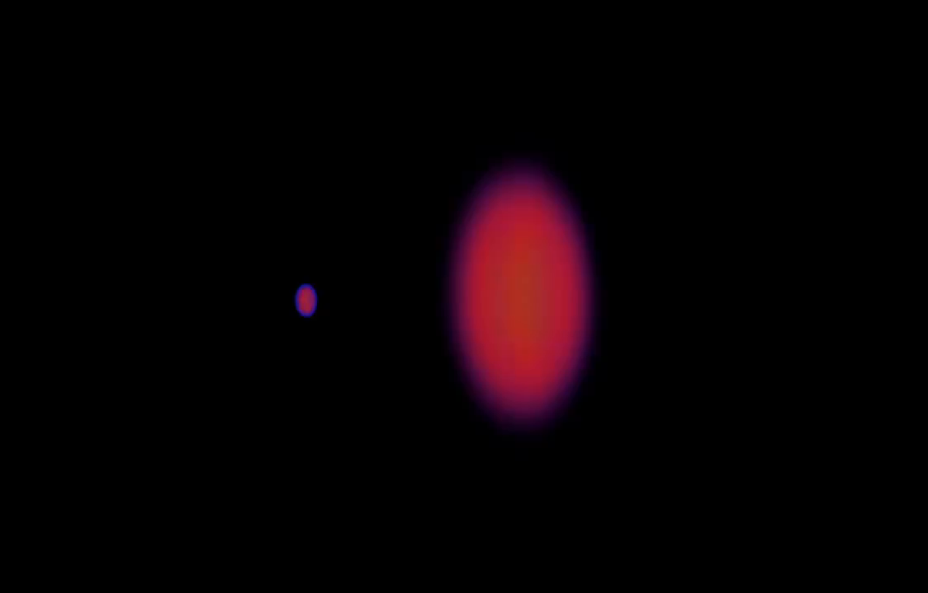
EXTERNAL INJECTION (LWFA or PWFA)

Slide 30
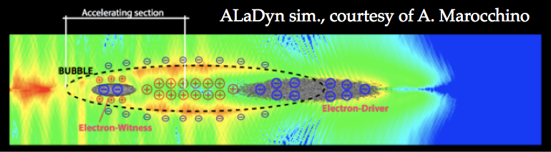
EXTERNAL INJECTION (PWFA)

Slide 31
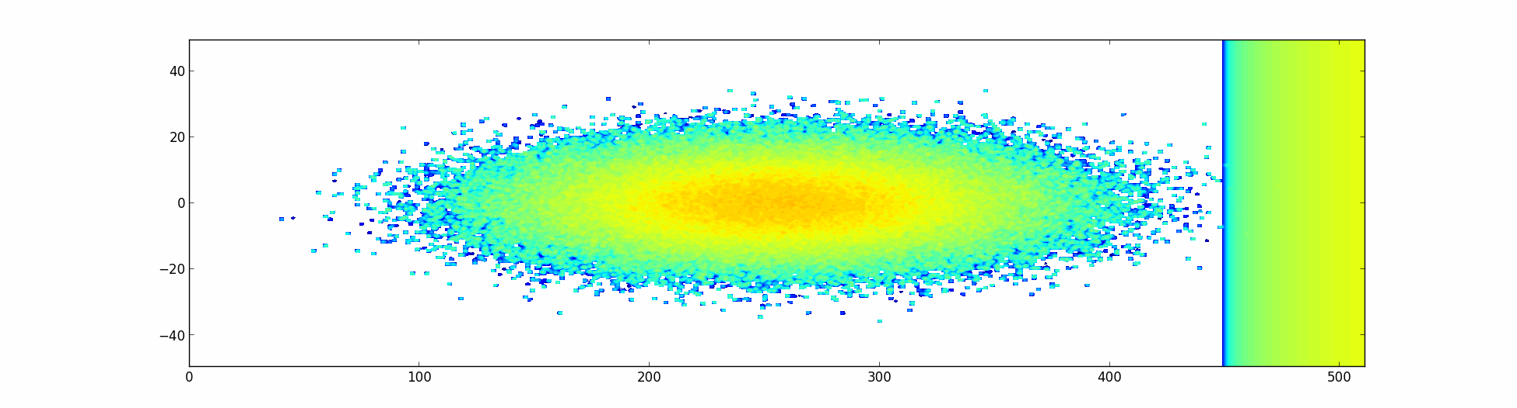
EXTERNAL INJECTION (PWFA)

Slide 32
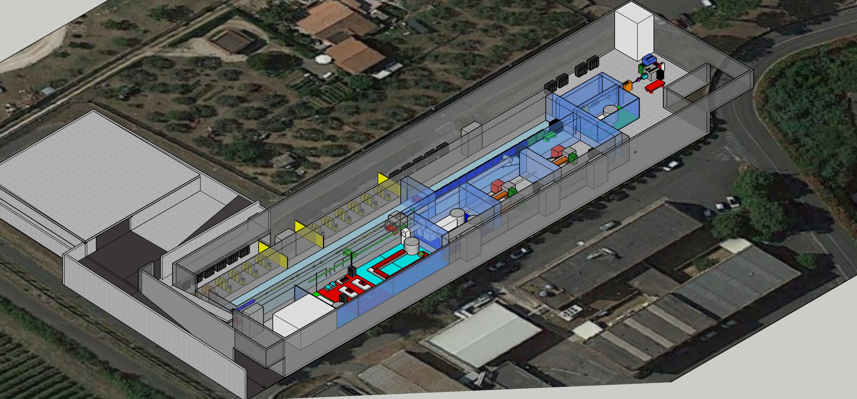
EuPRAXIA@SPARC_LAB

Slide 33
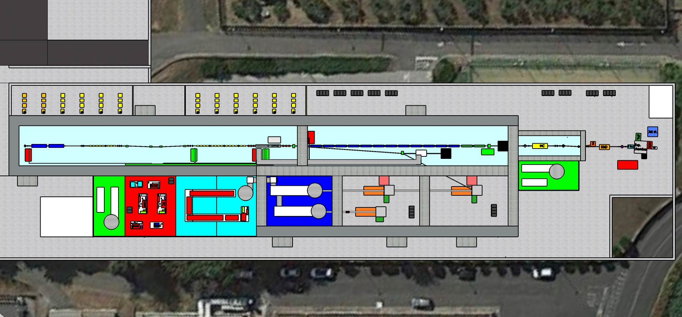
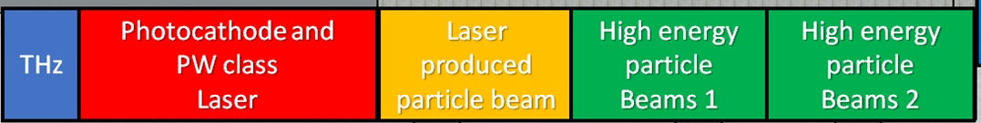
Candidate LNF to host EuPRAXIA (1-5 GeV)
FEL user facility (1 GeV – 3nm)
Advanced Accelerator Test facility (LC) + CERN
6 m
24 m
55 m
40 m
31 m
12 m
32 m
52 m
132 m
500 MeV by RF Linac + 500 MeV by Plasma (LWFA or PWFA)
1 GeV by X-band RF Linac only
Final goal compact 5 GeV accelerator

Slide 34
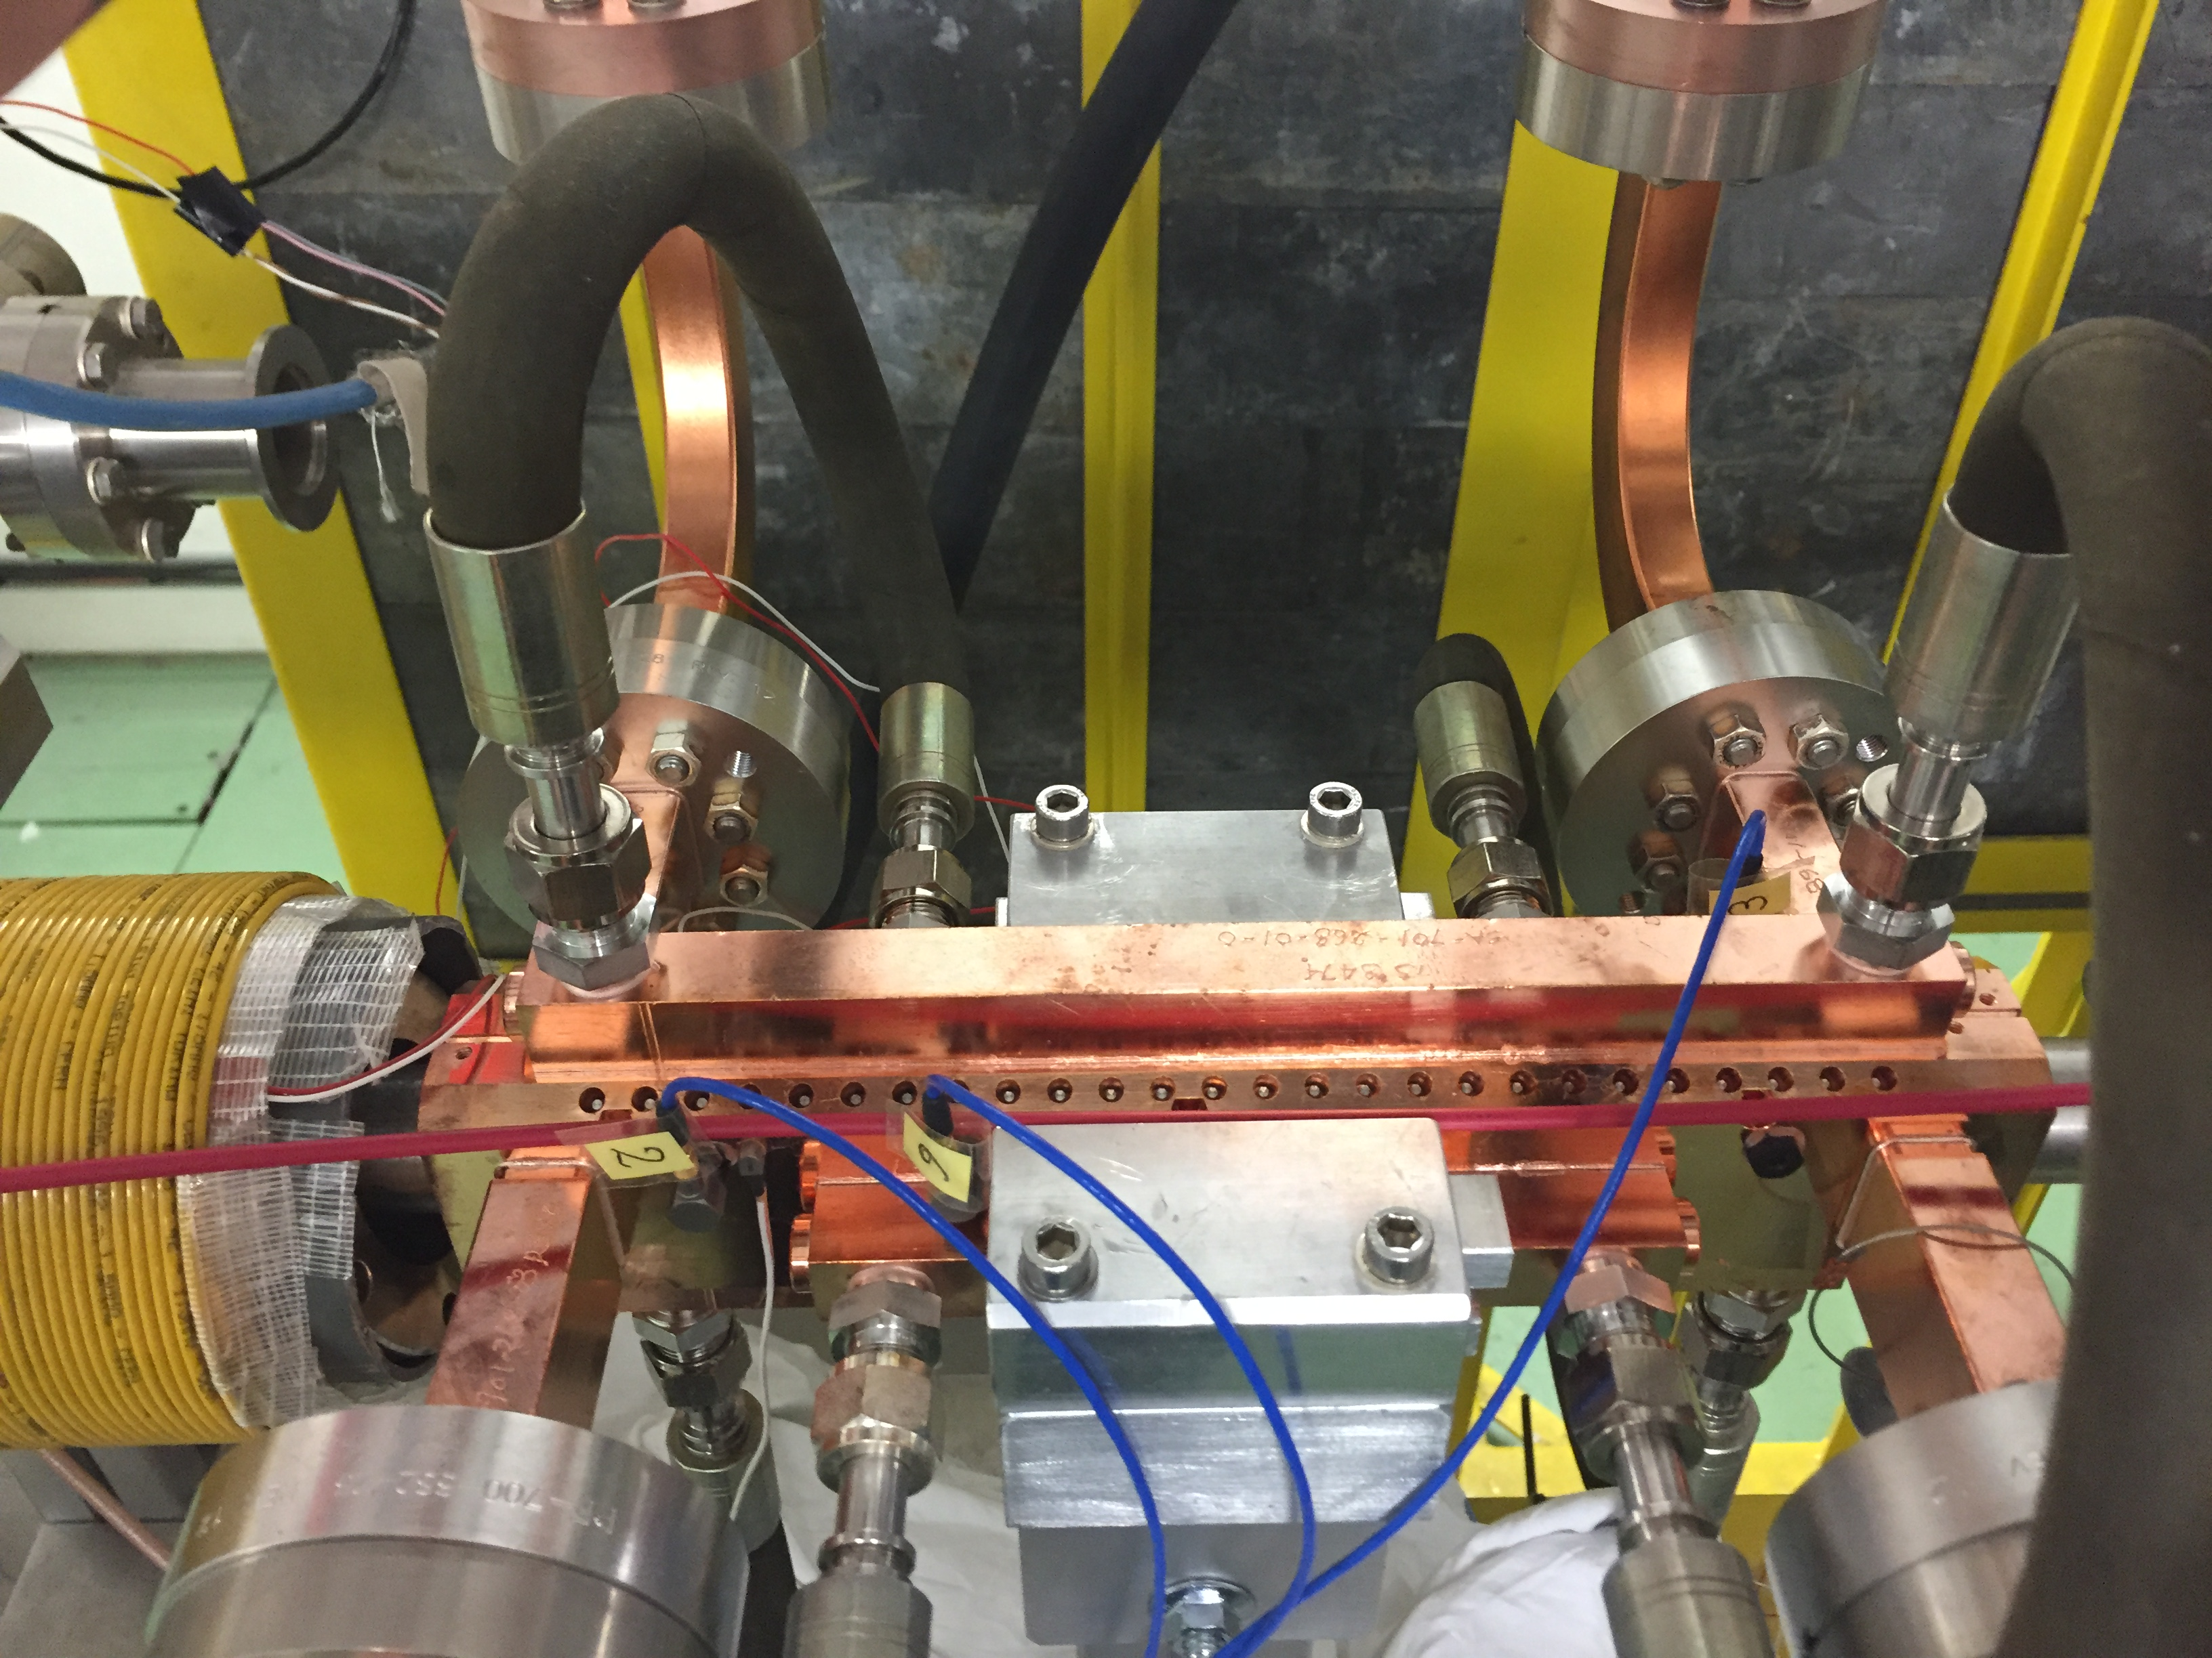
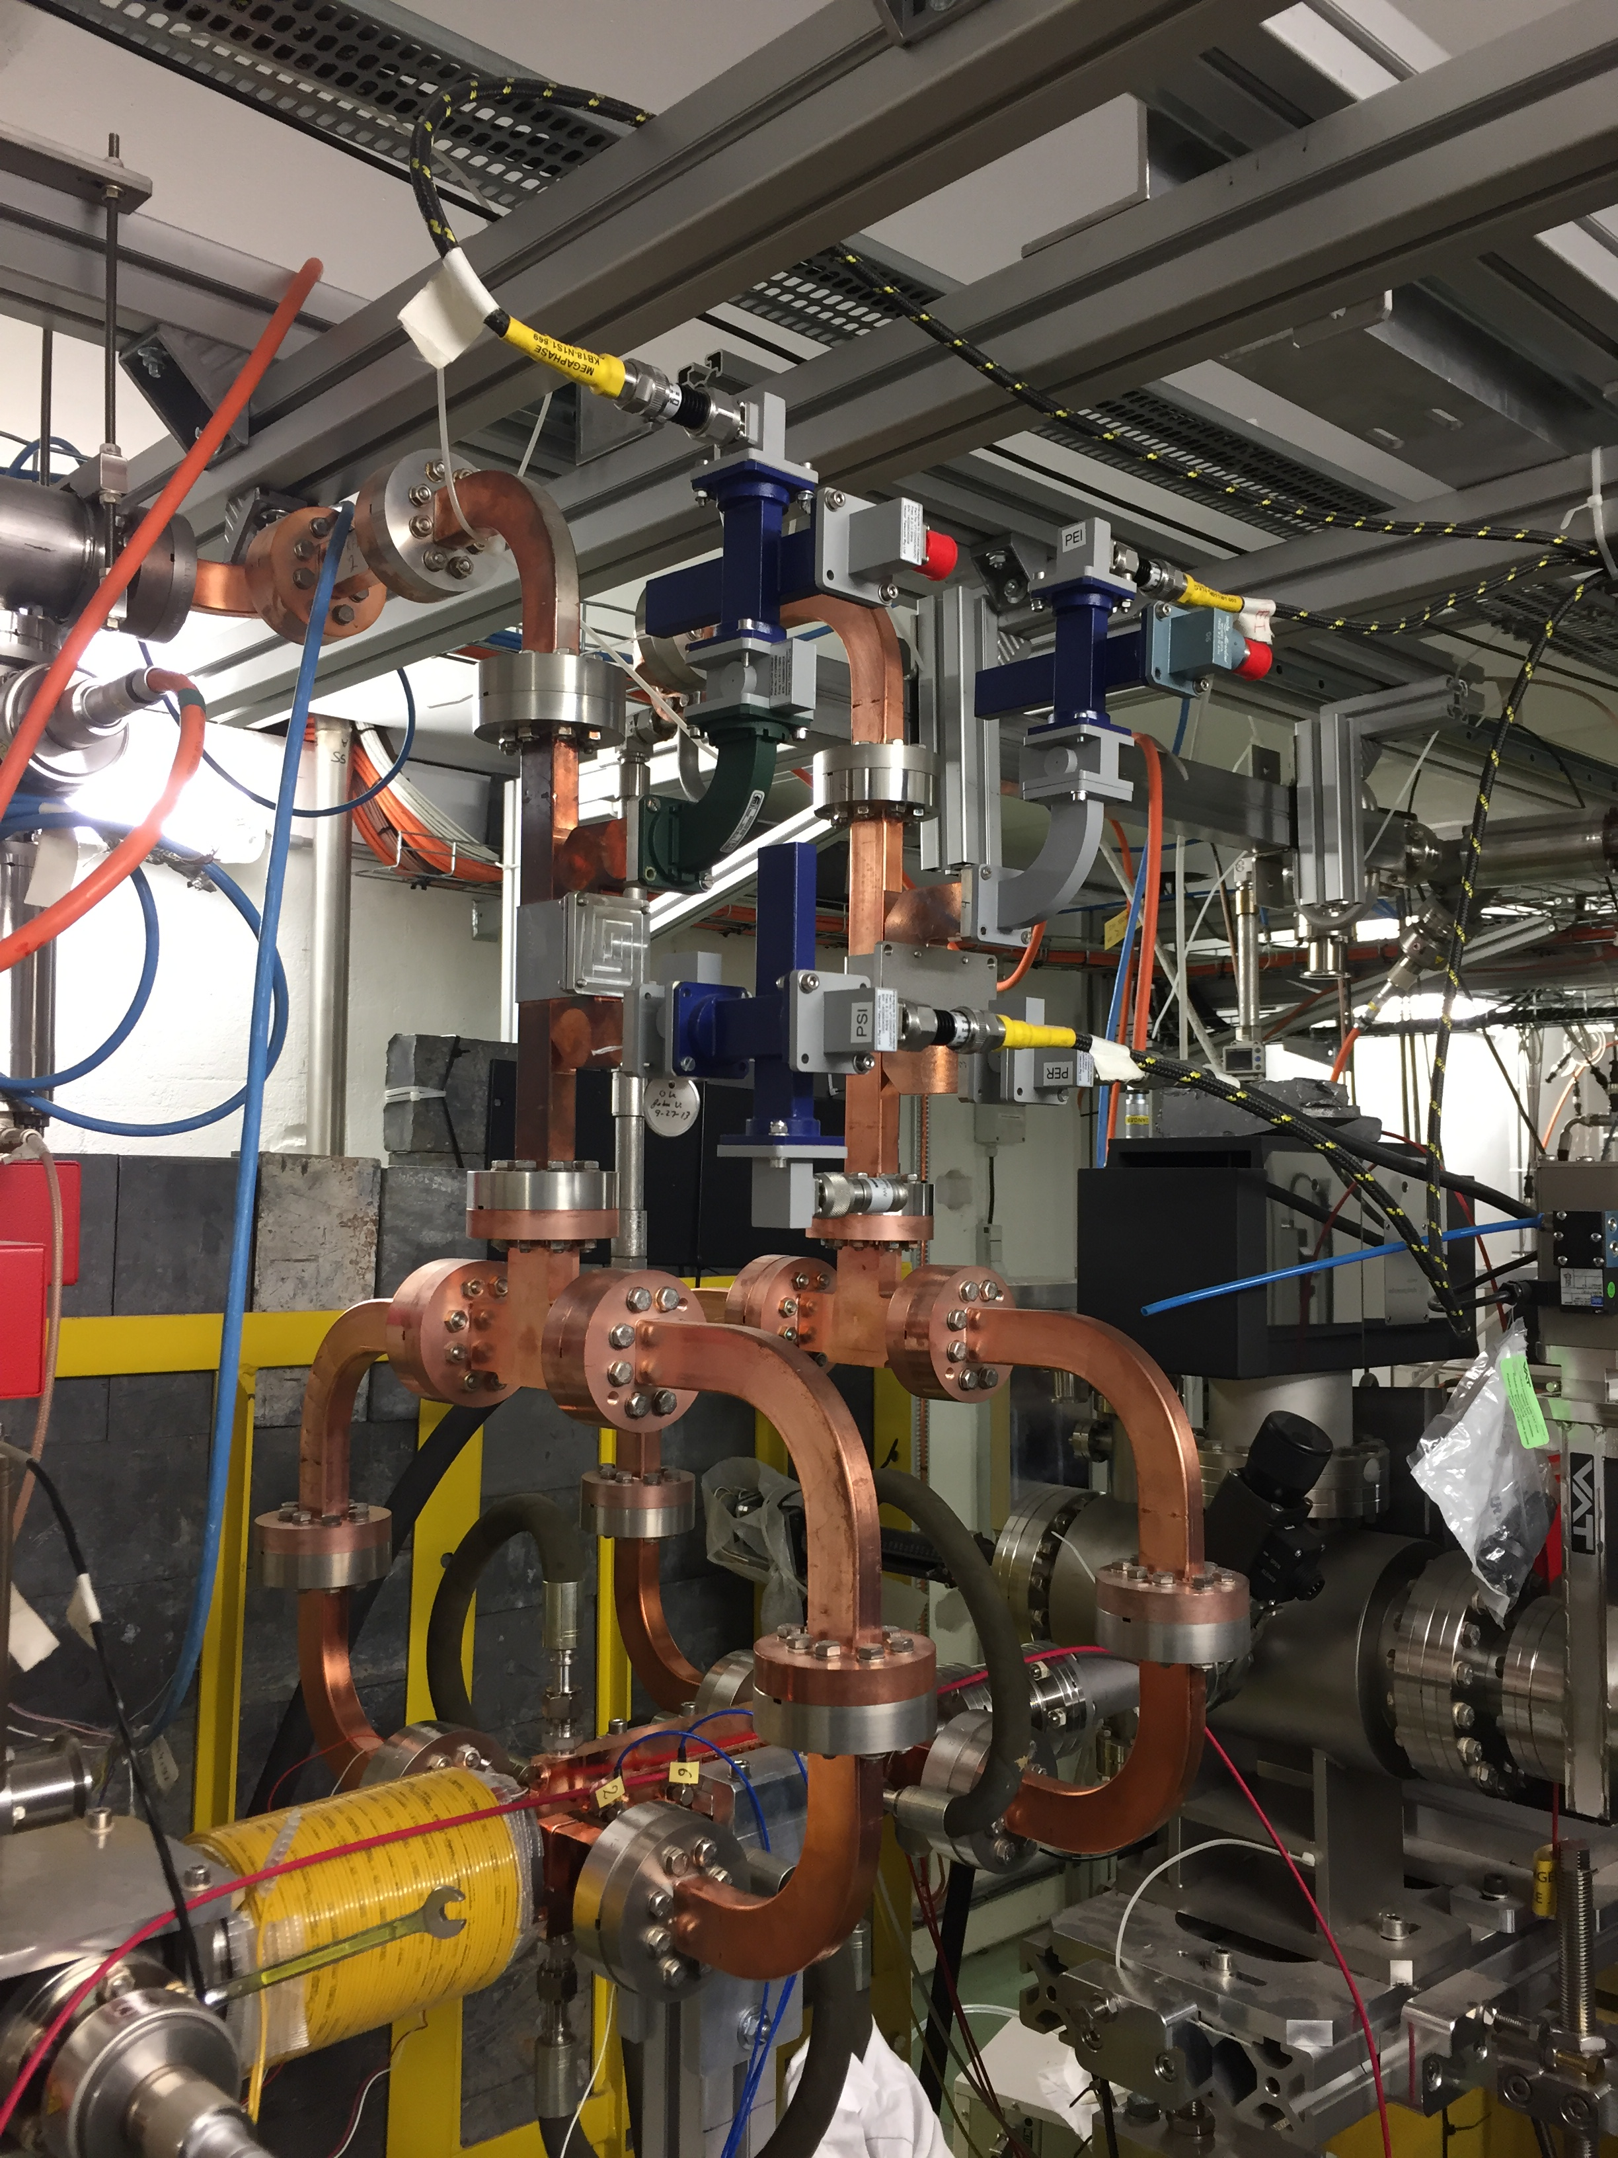
X-band Linac

Slide 35
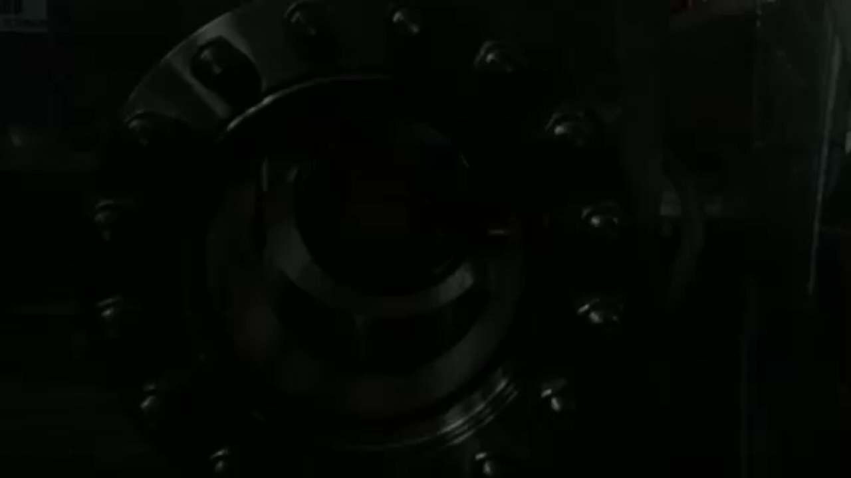
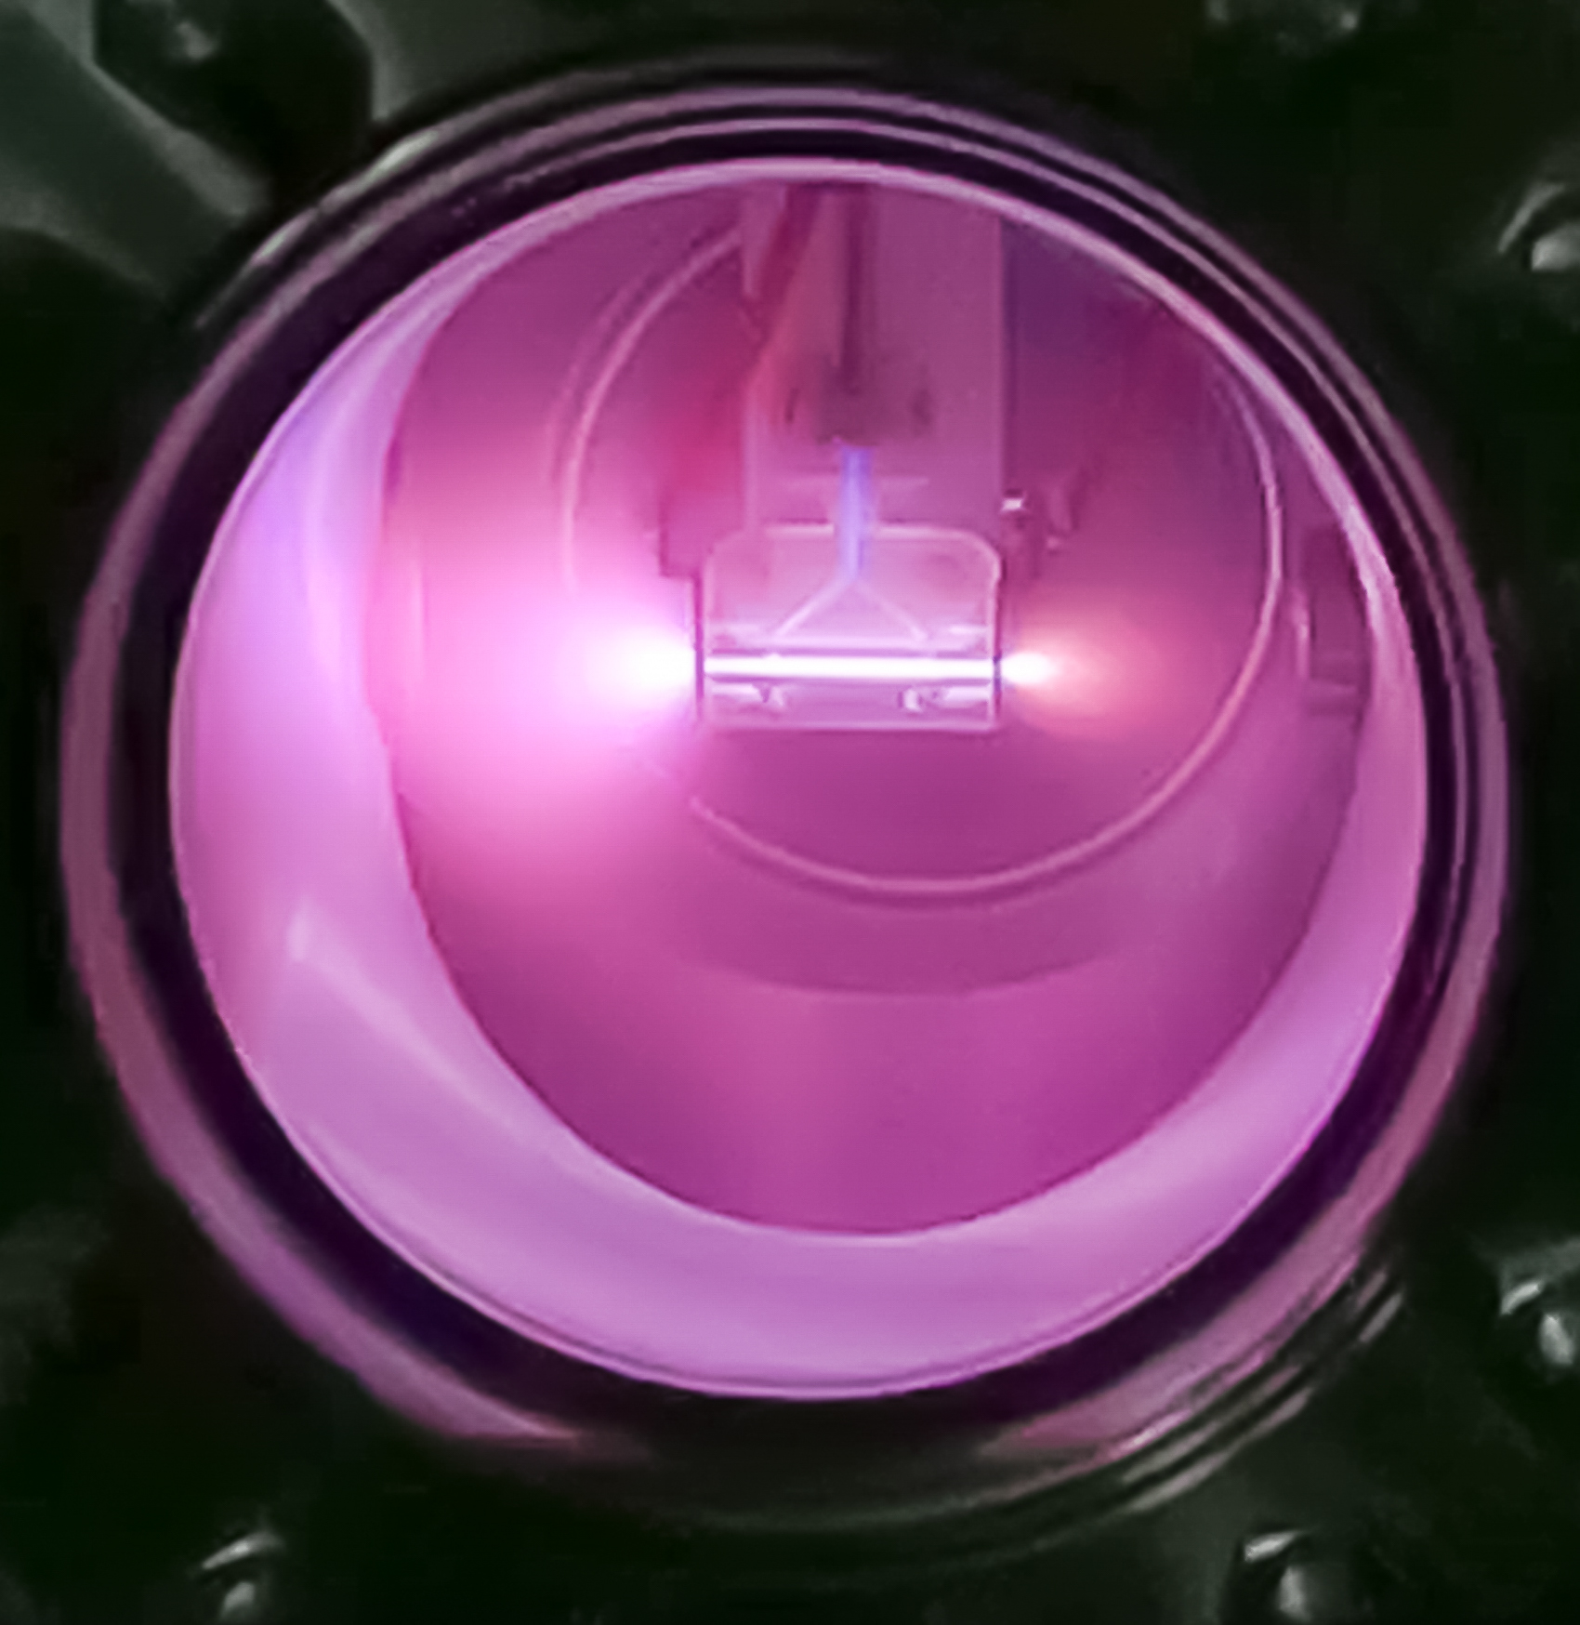
CAPILLARY DISCHARGE

Slide 36

CAPILLARY DISCHARGE
20 images separated by 100 ns => 2 µs
Gate: 10 ns
Area: 1000 x 500 pixel
velocity of plasma

Slide 37
EuPRAXIA@SPARC_LAB
Scientific goals
X-band RF technology implementation,➔ CompactLight
Science with short wavelength Free Electron Laser (FEL)
Physics with high power lasers and secondary particle source
Compact Neutron Source
R&D on compact radiation sources for medical applications
Detector development and test for X-ray FEL and HEP
Science with THz radiation sources
Nuclear photonics with γ-rays Compton sources
R&D on polarized positron sources
R&D in accelerator physics and industrial spin – off

Slide 38
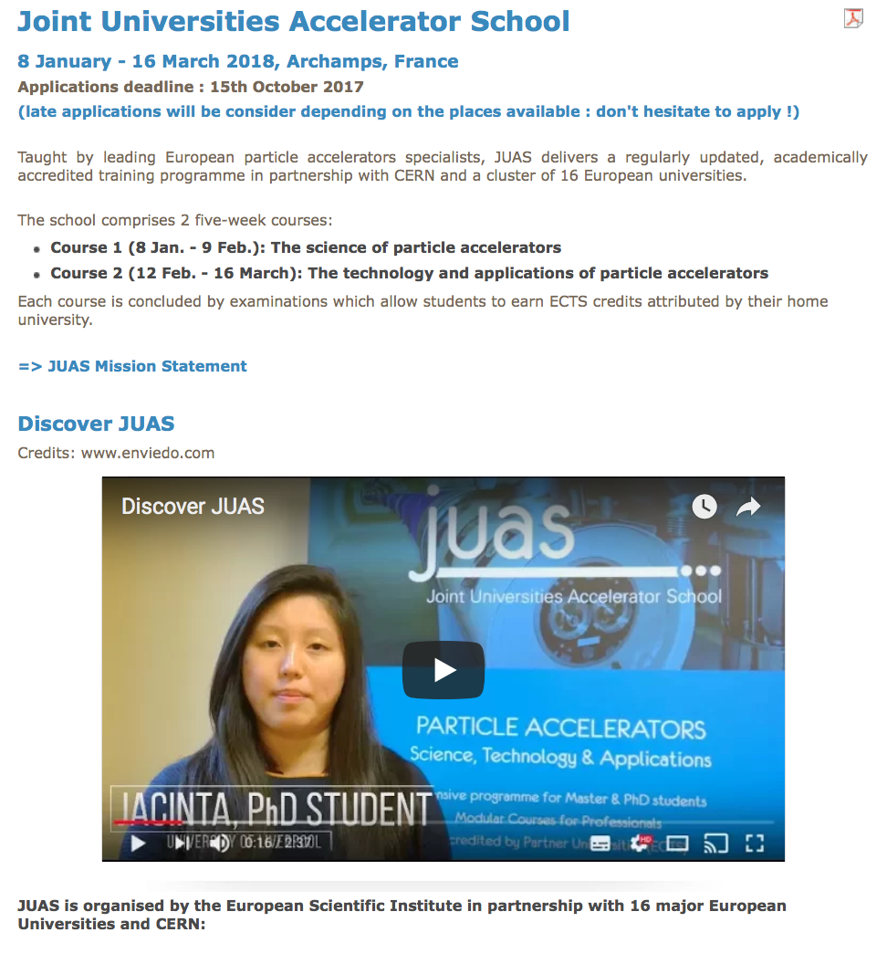
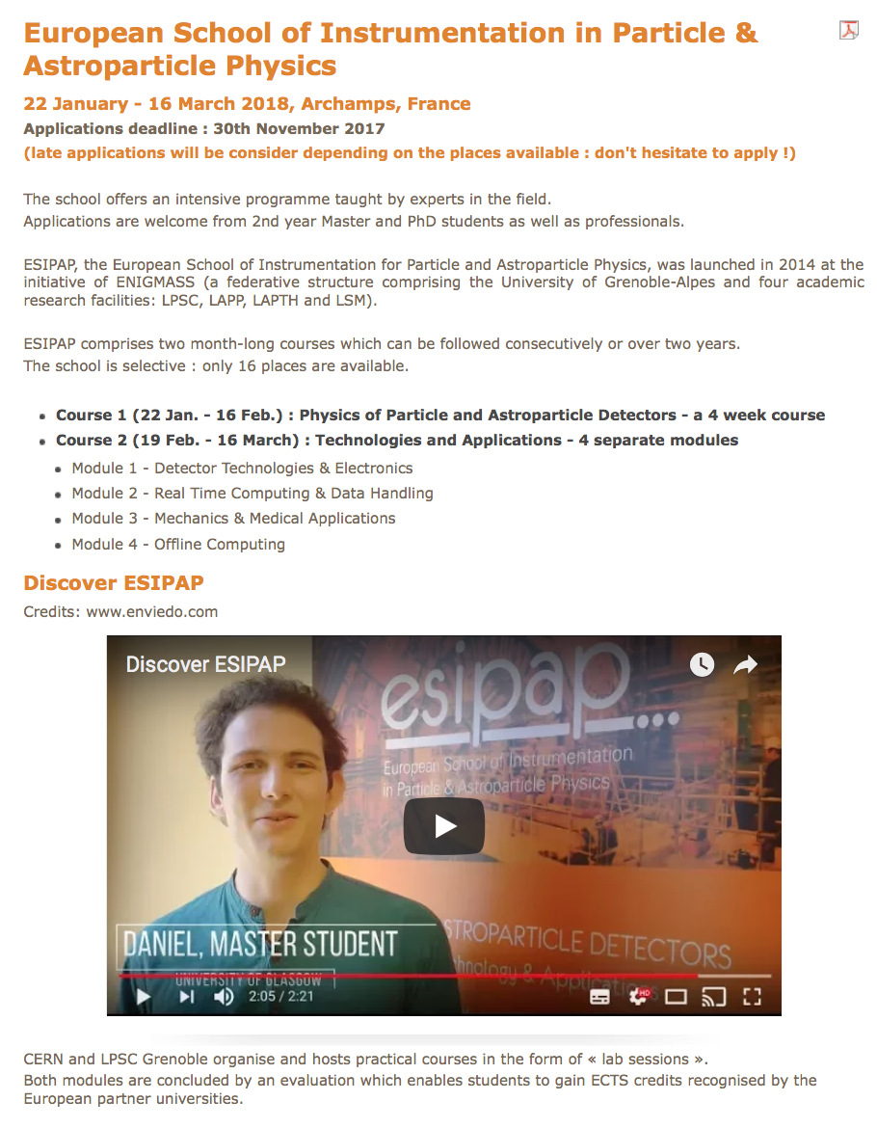
OPPORTUNITIES FOR STUDENTS

Slide 39


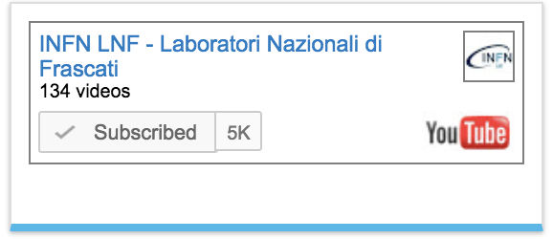

Slide 40
VISITA @ LNF
A. Vannozzi
IMPIANTI
POTENZA
SPARC
A. Mostacci
DAFNE
A. Gallo

