Slide 1
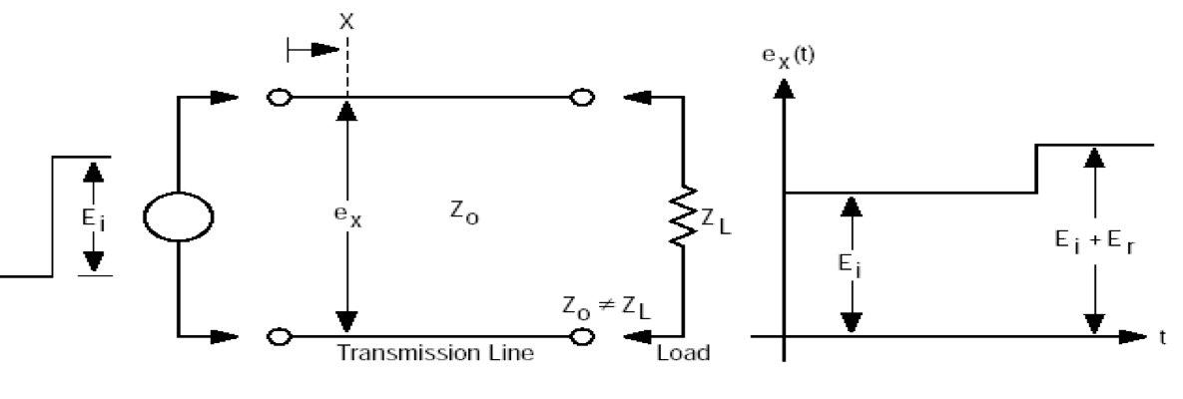
Time domain reflectometry
Echo measurement (similar to a radar)
Different times correspond to
different positions
Time domain measurement
I
0
I
I
0
L
Nature and amplitude of the mismatch
Localization of the mismatch

Slide 2
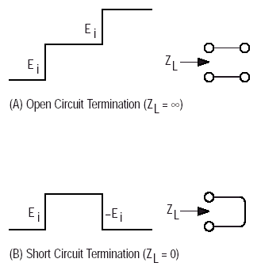
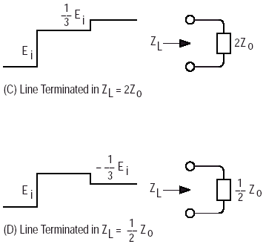

Slide 3
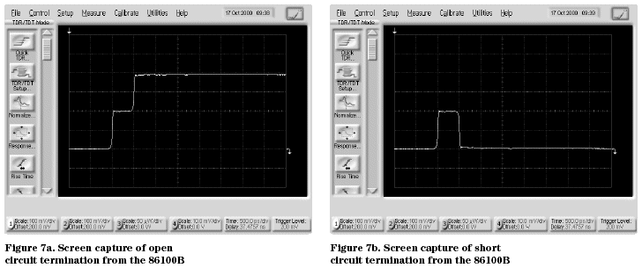

Slide 4
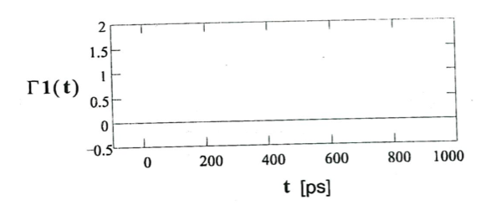
Matched termination

Slide 5
Open termination
1
0
-1
I
I
0
2T
time

Slide 6
Short termination
1
0
-1
I
I
0
2T
time

Slide 7
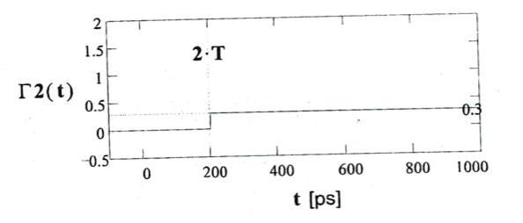
2 Z₀

Slide 8
Z₀ /2
1
0
-0.3
-1
I
I
0
2T
time

Slide 9
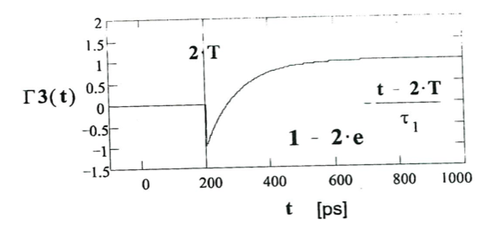
Capacitor

Slide 10
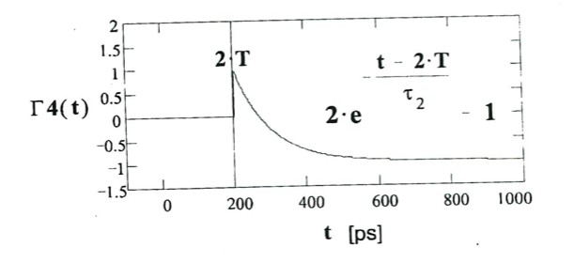
Inductor

Slide 11
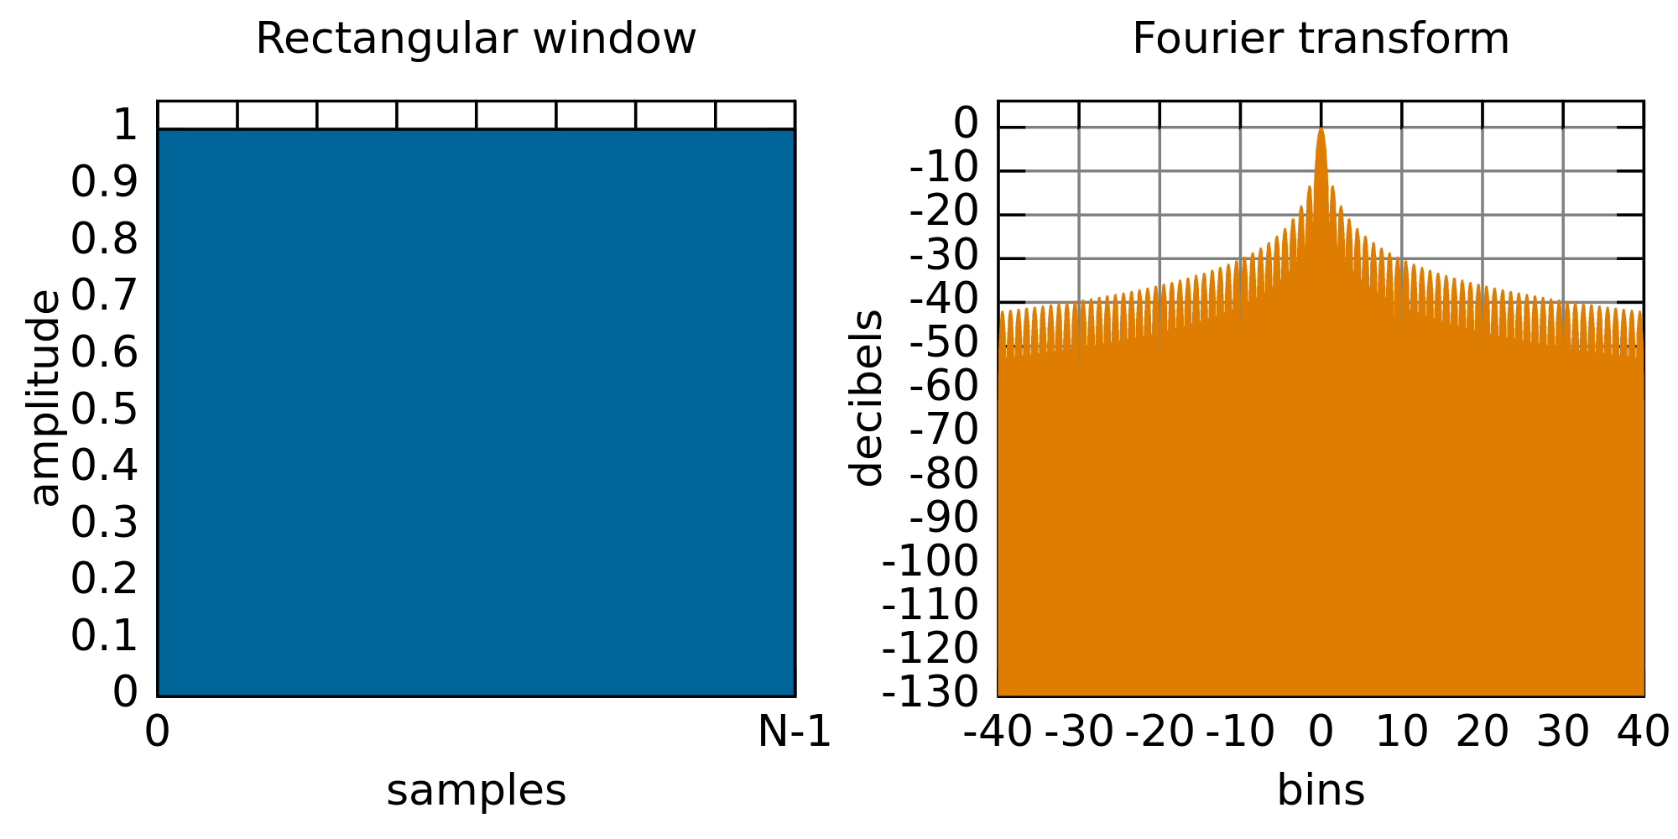

Slide 12
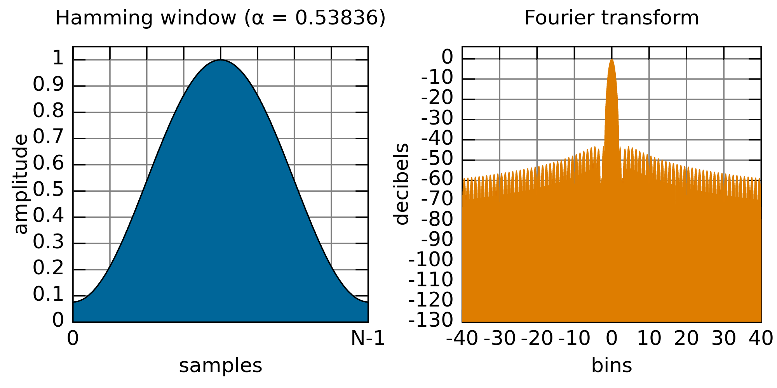

Slide 13
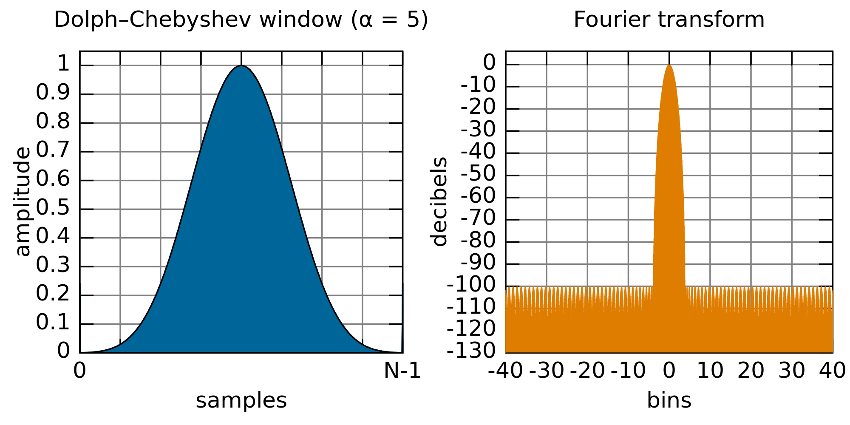

Slide 14
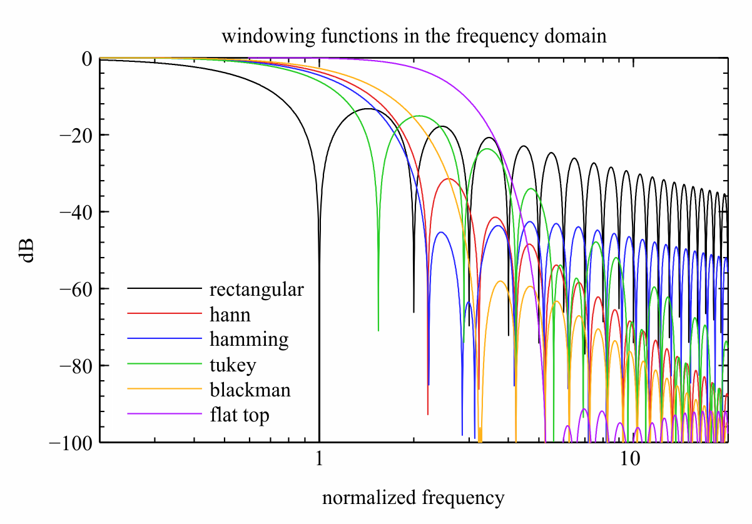

Slide 15
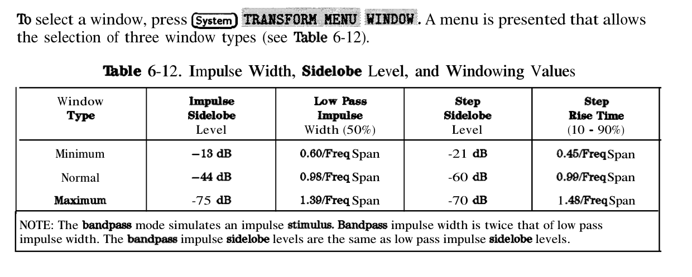

Slide 16
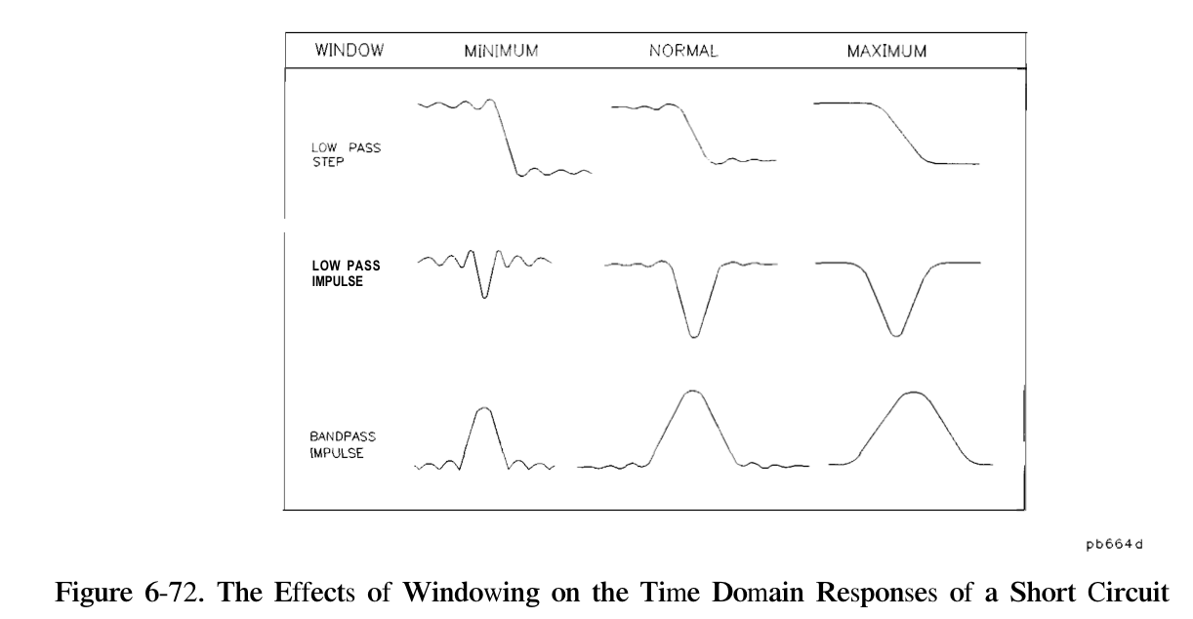

Slide 18
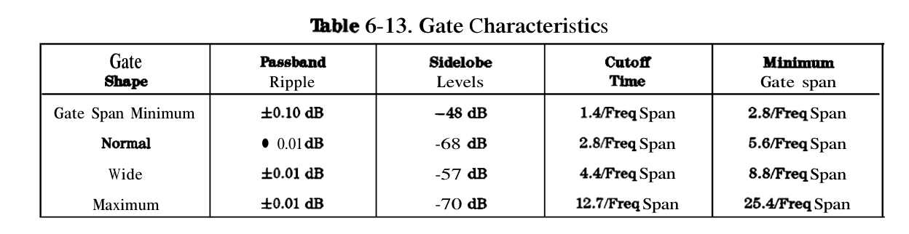

Slide 19
Ten Steps for Performing TDR (Low Pass Step)
Set up desired frequency range (need wide span for good spatial resolution)
2. Under SYSTEM, transform menu, press "set freq low pass“
3. Perform one- or two-port calibration
4. Select S11 measurement *
5. Turn on transform (low pass step) *
6. Set format to real *
7. Adjust transform window to trade off rise time with ringing and overshoot *
8. Adjust start and stop times if desired
9. For gating:
  set start and stop frequencies for gate
  turn gating on *
  adjust gate shape to trade off resolution with ripple *
10. To display gated response in frequency domain
  turn transform off (leave gating on) *
  change format to log-magnitude *
* If using two channels (even if coupled), these parameters must be set independently for second channel
Notes:
Slide 89
Here is a summary of how to perform TDR measurements. Without such a checklist, it is easy to overlook some of the more subtle steps, resulting in confusing or misleading measurements. A one-port calibration is all that is needed when characterizing connectors and the open, short and load standards. A two-port calibration is needed to characterize the reflection or line impedance of the thru standard.

Slide 20
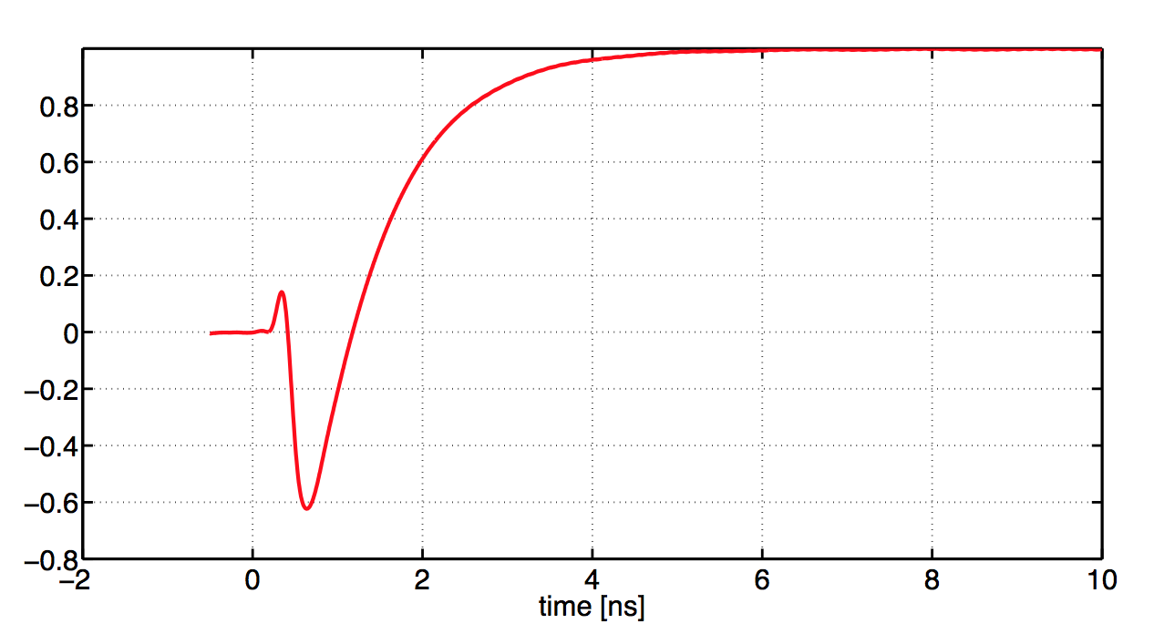
20 pF capacitor

Slide 21
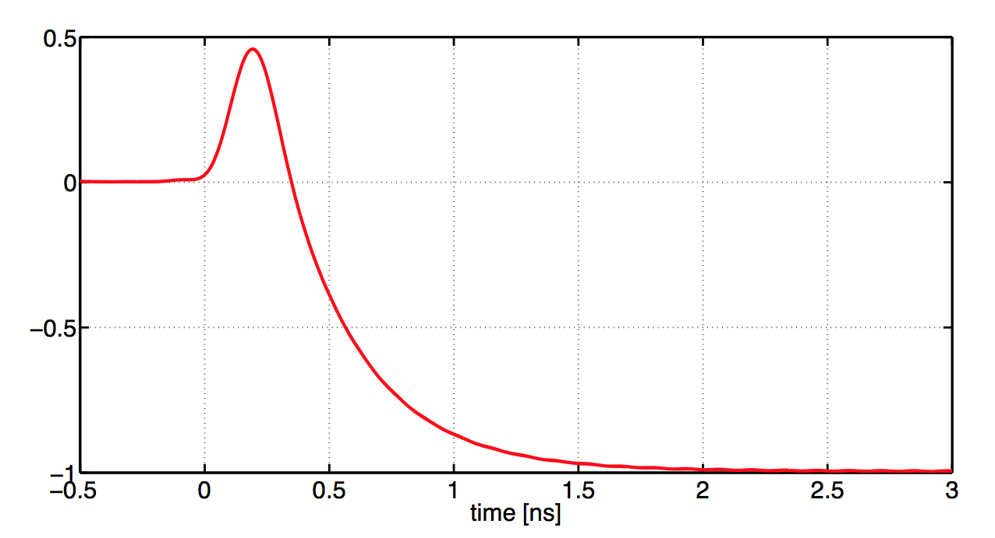
19 nH inductance

Slide 22
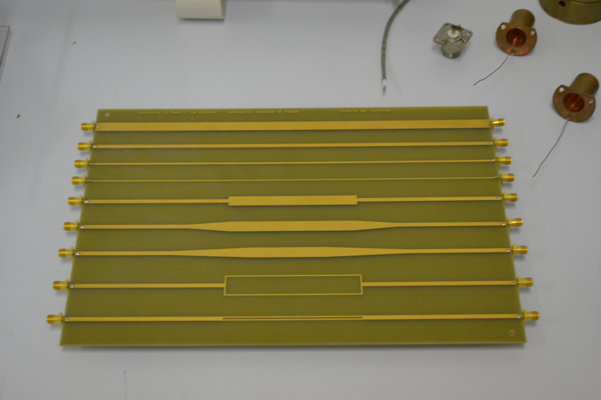

Slide 23
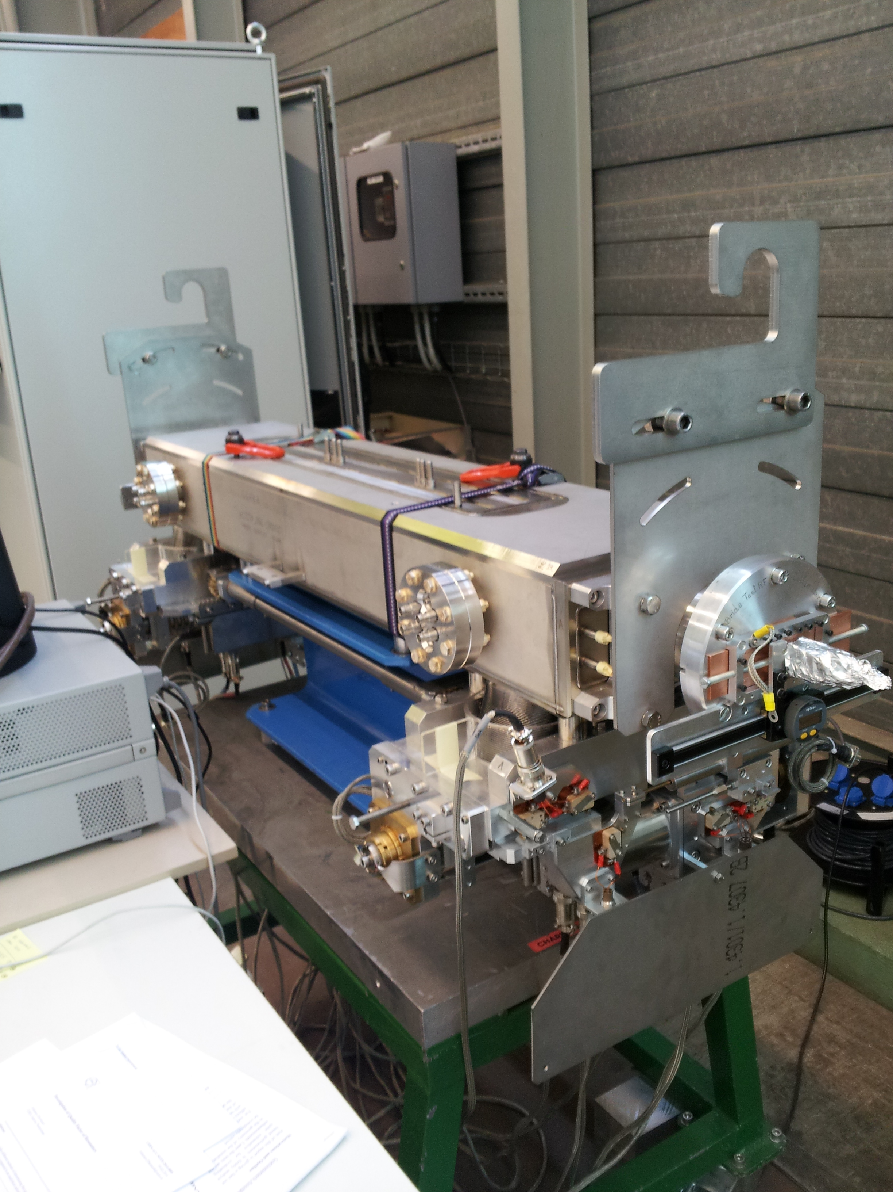
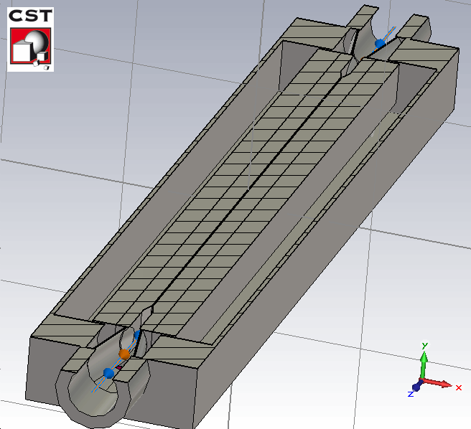
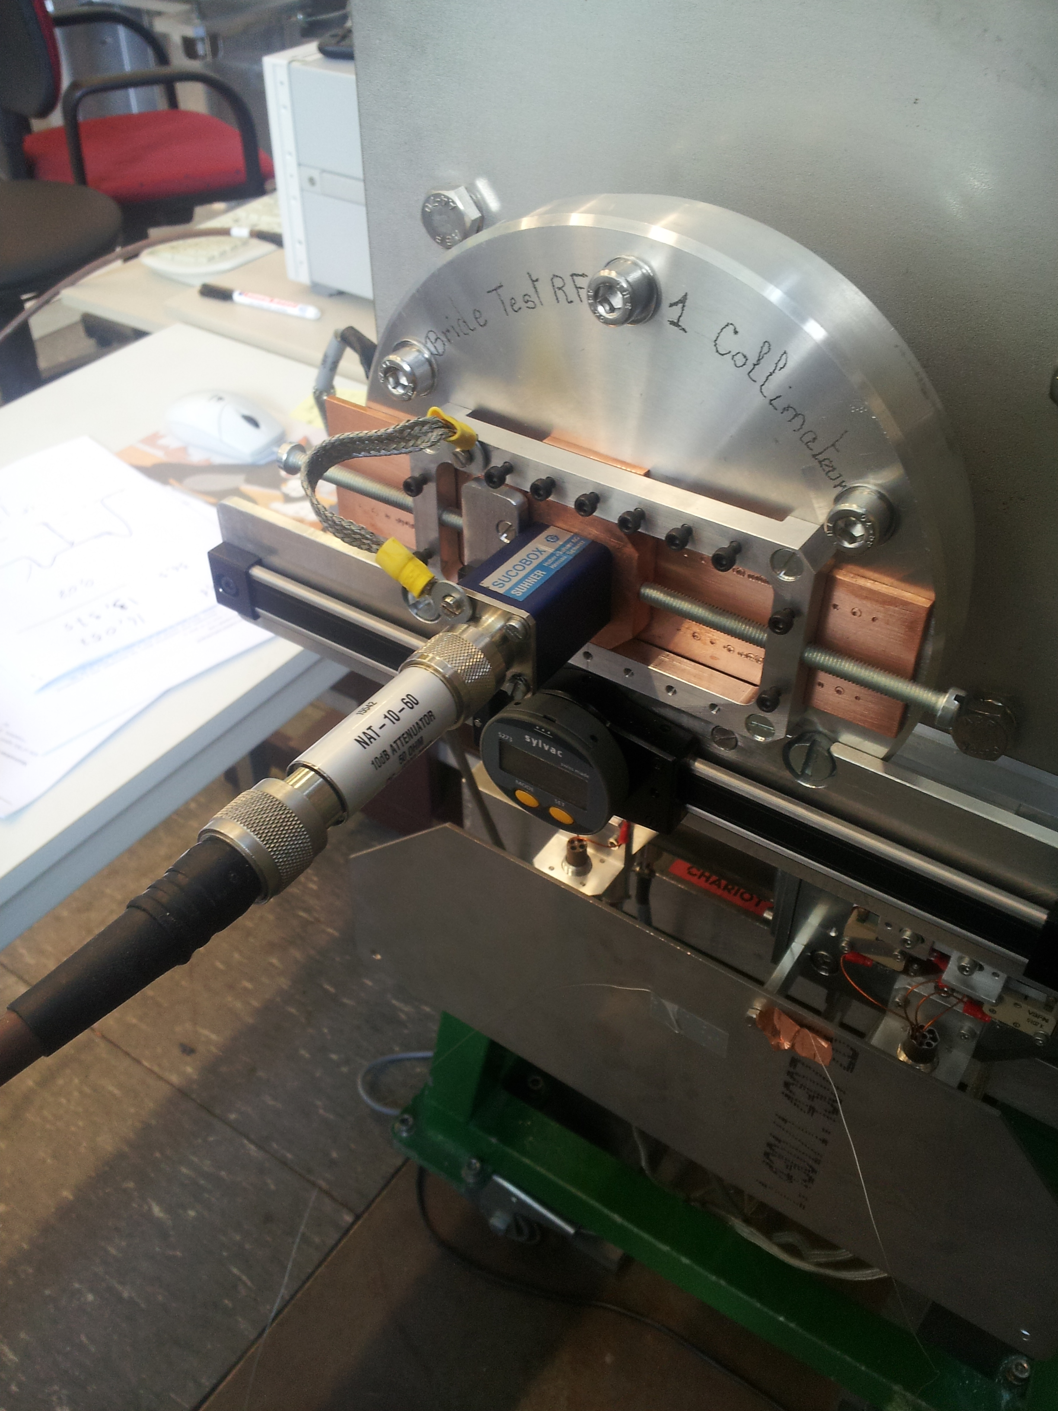
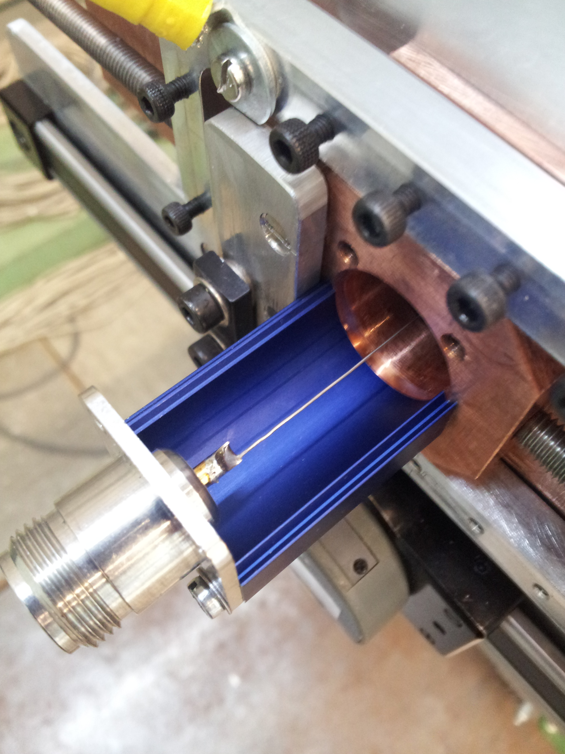
LHC TCTP collimator wire Measurement
Wire (0.5mm)

Slide 24
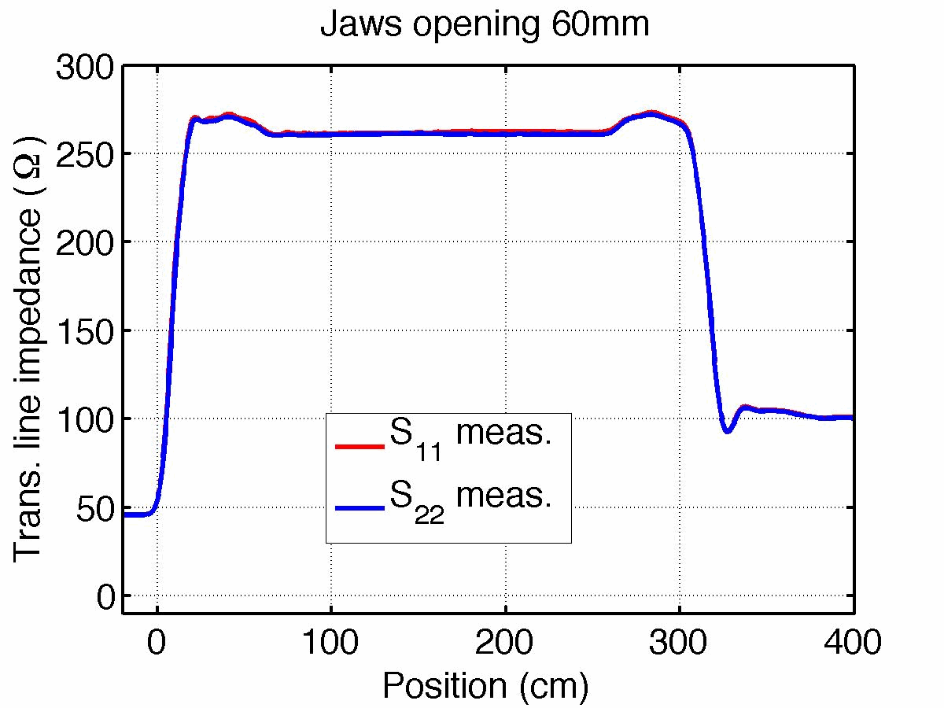
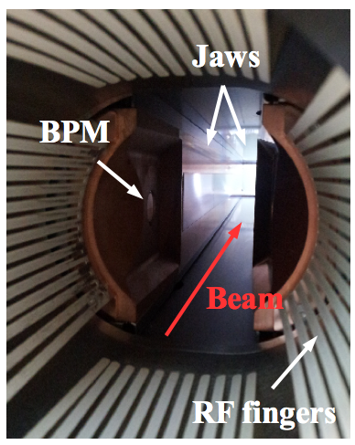
Coaxial transmission line properties
Matching in impedance measurement is critical.
N. Biancacci et al., TCTP collimator meas., 2014

