Slide 1
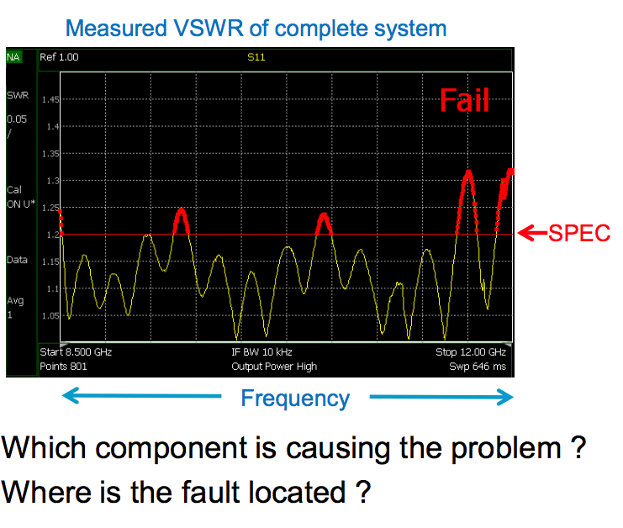

Slide 2
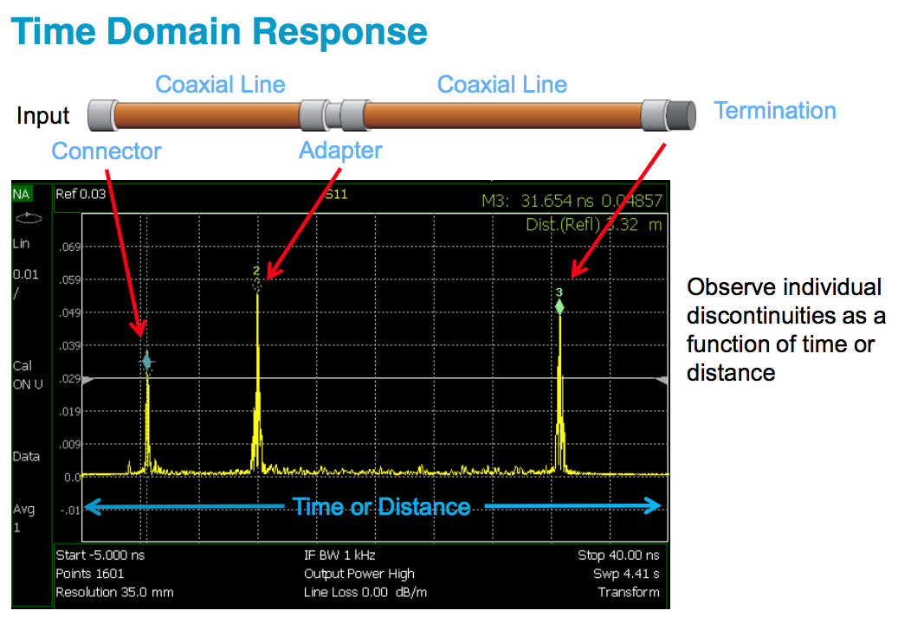
Fault locations
Identify impedance variation of connectors
Remove unwanted discontinuities
Simplify filter tuning

Slide 3
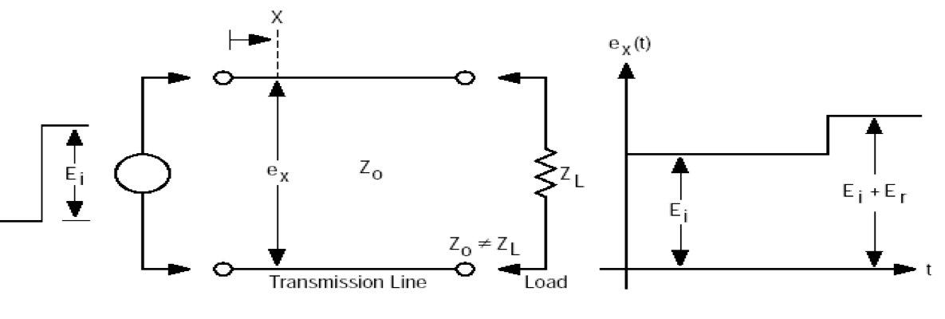
Time domain reflectometry
Echo measurement (similar to a radar)
Different (arrival) times correspond to
different positions
Time domain measurement
I
0
I
I
0
L
Nature and amplitude of the mismatch
Localization of the mismatch

Slide 4
Matched Termination (Z_{L}=Z₀)
Examples of Devices Under Test (DUTs)
T
e_{x} (t)
Γ=0
E_{i}
Z₀
Z₀
E_{i}
0
t
Open Circuit Termination (Z_{L}=∞)
T
e_{x} (t)
E_{i}
Z₀
E_{i}
Γ=1
E_{i}
0
2T
t

Slide 5

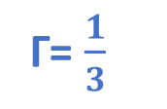
Short Circuit Termination (Z_{L} = 0)
Examples of Devices Under Test (DUTs)
T
e_{x} (t)
Γ=-1
E_{i}
Z₀
E_{i}
-E_{i}
0
2T
t
Line Terminated in Z_{L} = 2Z₀
T
Z₀
2Z₀
e_{x} (t)
$$\frac{1}{3}E_{i}$$
E_{i}
E_{i}
Γ= $\frac{1}{3}$
0
2T
t

Slide 6


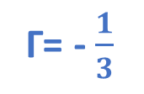
Line Terminated in Z_{L} = $\frac{1}{2}$Z₀
Examples of Devices Under Test (DUTs)
T
e_{x} (t)
- $\frac{1}{3}E_{i}$
E_{i}
Z₀
$\frac{1}{2}$Z₀
E_{i}
Γ= - $\frac{1}{3}$
0
2T
t

Slide 7
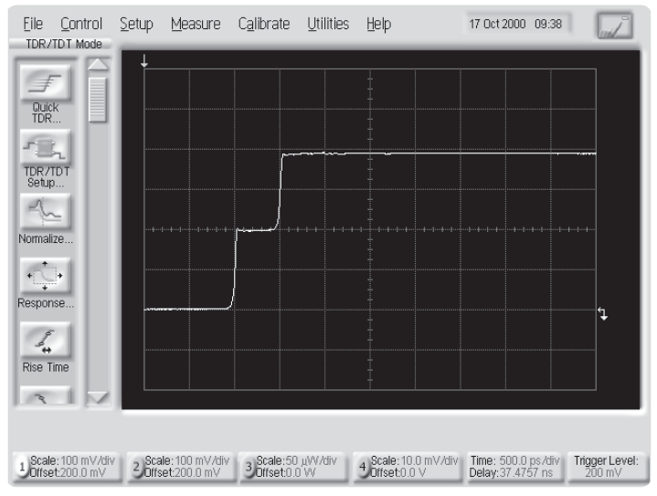
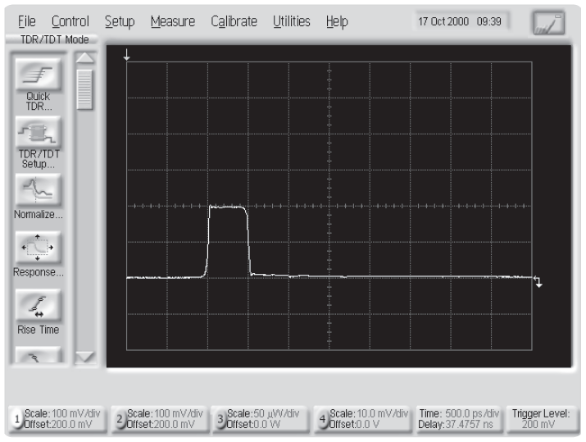
Measurements
Z₀
Z₀
Examples of open and short circuit terminations (Screen captures from the 86100B)

Slide 8
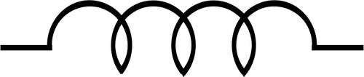

Line Terminated with a Capacitor (Z_{L} = C)
Examples of Devices Under Test (DUTs)
2E_{i}
T
e_{x} (t)
τ = Z₀ C
E_{i}
Z₀
C
E_{i}
0
2T
t
Line Terminated with a Inductor (Z_{L} = L)
2E_{i}
T
e_{x} (t)
τ =$\frac{L}{\text{Z}\text{0}}$
E_{i}
Z₀
L
E_{i}
0
2T
t

Slide 9
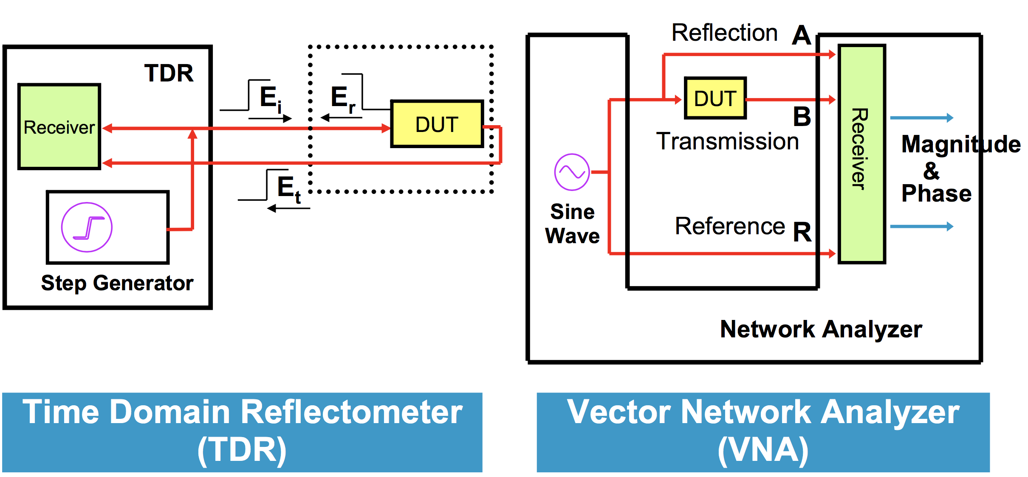

Slide 11
Synthetic pulse with VNA
(Time Domain Option)
Convenience: VNA’s outstanding dynamic range compared to the traditional TDR.
Time Response Transfer Function
The VNA operates the FFT of the Transfer Function, to obtain the Time Response.
FOURIER

Slide 12
Step Response
T
Γ
Z₀
Z₀
0
Γ
0
t
Γ
1
Z₀
0
Γ
0
t
2T
Γ
0
Z₀
-1
t
Γ
0
2T

Slide 13

Step Response
Γ
Z₀
2Z₀
$$\frac{1}{3}$$
0
Γ
0
2T
t
Γ
1
Z₀
0
C
-1
t
Γ
0
2T
Γ
1
0
Z₀
L
-1
t
Γ
0
2T

Slide 14
1
Open termination
0
-1
I
I
0
2T
time

Slide 15
1
Short termination
0
-1
I
I
0
2T
time

Slide 16
1
Z₀/2 termination
0
-0.3
-1
I
I
0
2T
time

Slide 17
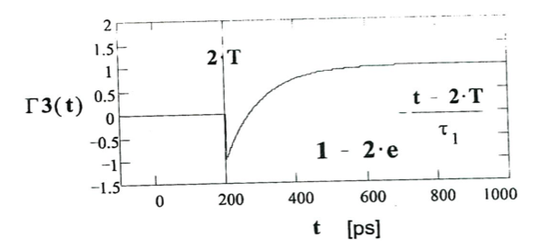
Capacitor

Slide 18
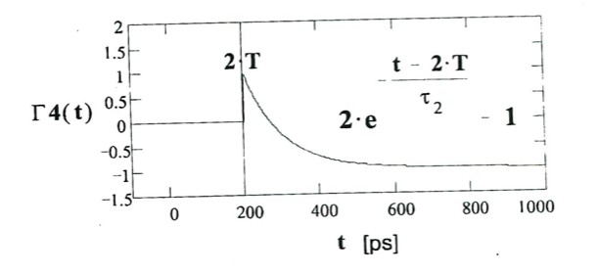
Inductor

Slide 19
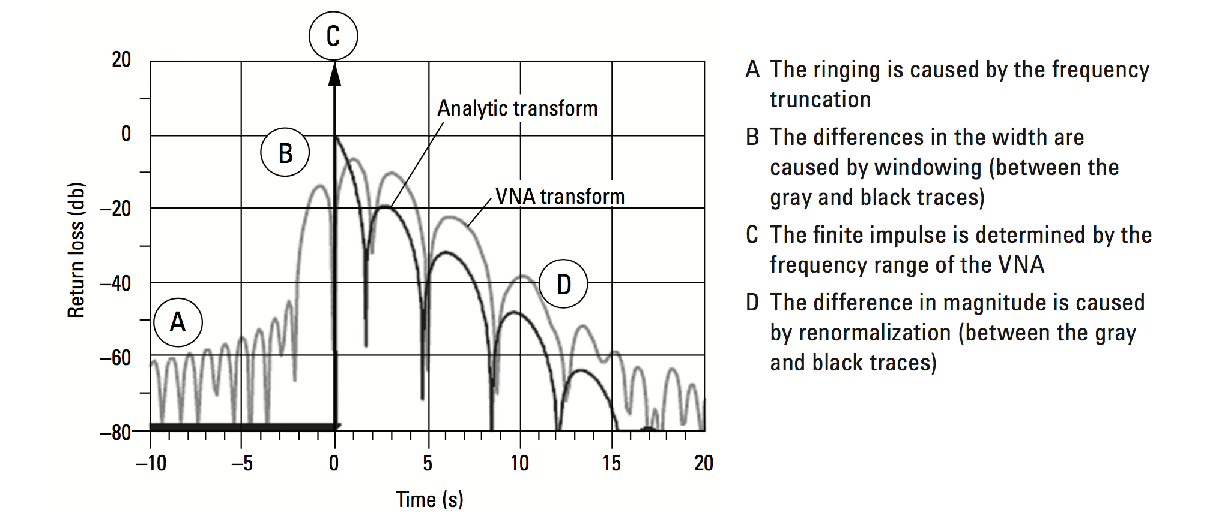
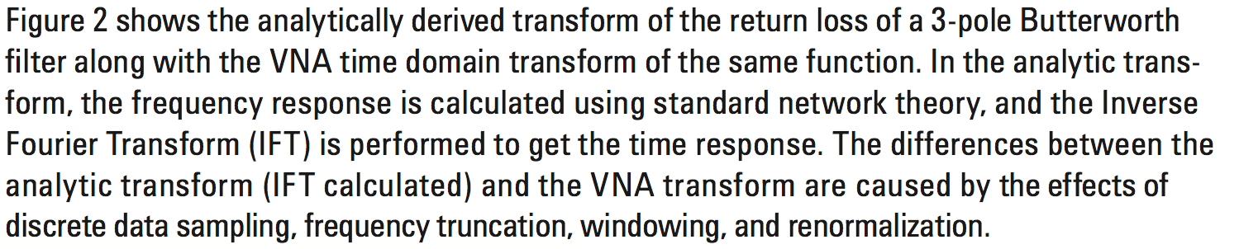
Analytic versus VNA transform

Slide 20

The Time Domain Reflectometry in the VNA is a mathematical operation
(Chirp Z Transform)
1)
response to response to $\frac{d}{dt}$ =
Step Response Pulse Response

Slide 21
The Time Domain Reflectometry in the VNA is a mathematical operation
(Chirp Z Transform)
2) FFT algorithm requires symmetric frequency samples (with respect to the zero).
f_{min} ≠ 0 zero frequency sample MUST be extrapolated.
f_{min} = Δf
f_{min} depends by f_{max} and by the number of samples (number of points).
SET LOW FREQUENCY PASS before calibration!
Δf
Δf
Δf
0
f_{max}
f

Slide 22
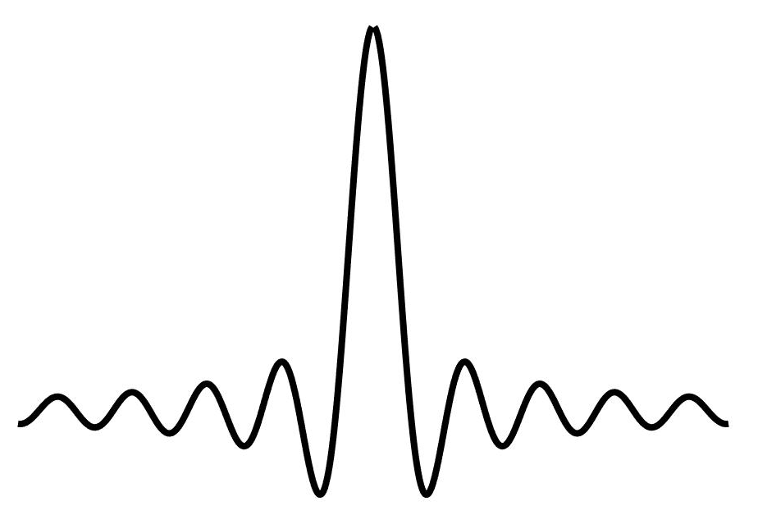

The Time Domain Reflectometry in the VNA is a mathematical operation
(Chirp Z Transform)
3) The slope of the simulated signal depends by f_{max} :
RISE TIME $∝\frac{1}{\text{f}\text{max} }$
f_{max1} > f_{max2} > f_{max3}
The spatial resolution is related to f_{max .}
The f_{max} is finite.
The Pulse Response isn’t but sinc(t) :

Slide 23
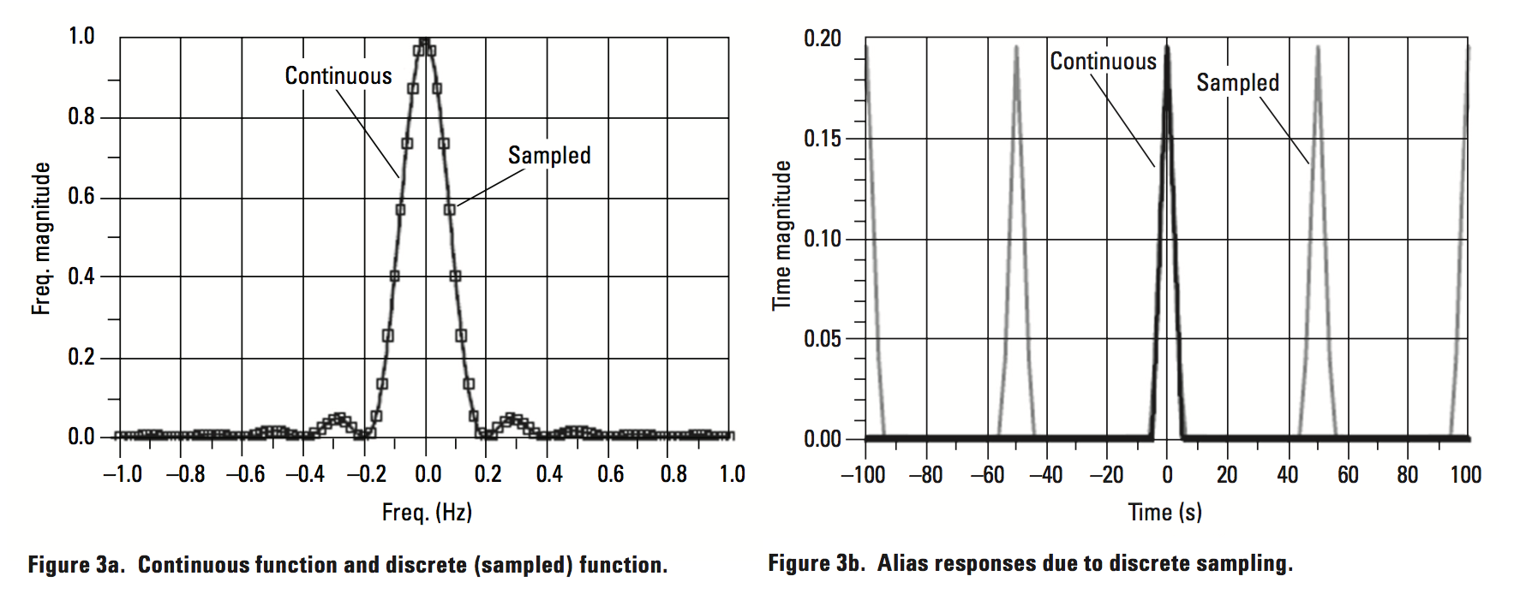
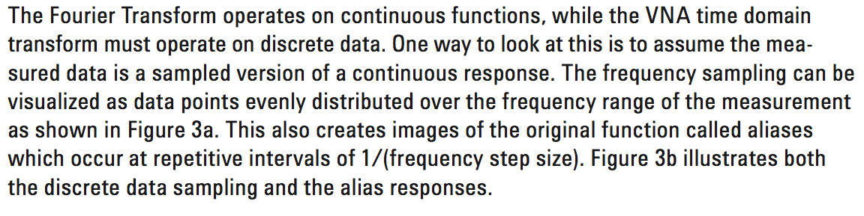
The Time Domain Reflectometry in the VNA is a mathematical operation
(Chirp Z Transform)
4) Discrete sampling of frequency:
T_{max}=1/2Δf
Notes:
Nyquist bandwidth

Slide 24
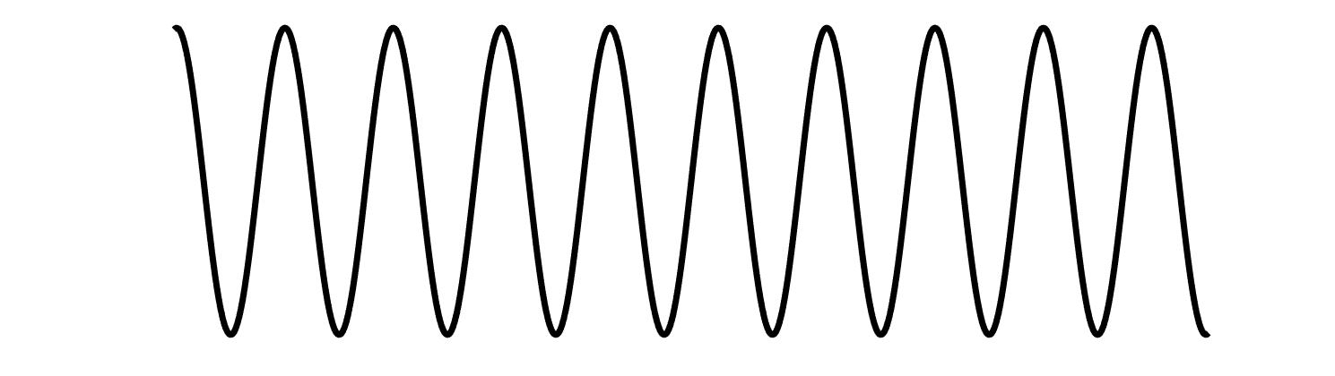
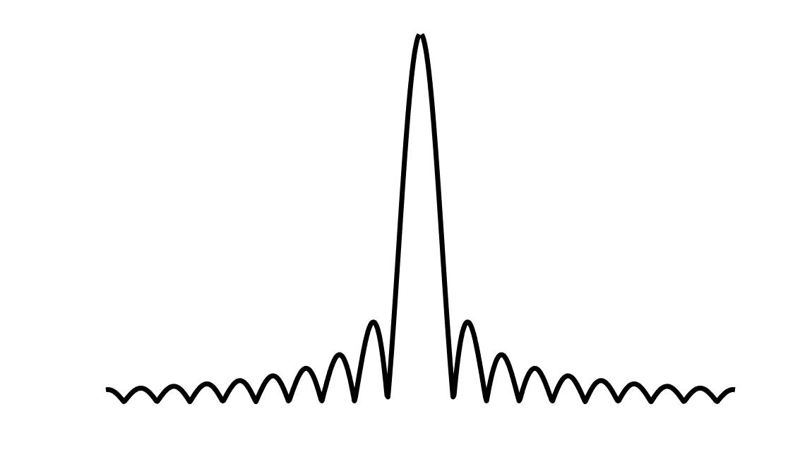
The Time Domain Reflectometry in the VNA is a mathematical operation
(Chirp Z Transform)
5) TIME DOMAIN FREQUENCY DOMAIN
(SYNTHETIC) (MEASUREMENT)
The FFT is influenced by the limited number of samples.
FFT
t/f
t/f
Rectangular window:
Δ= -13dB
BW depends on the number of samples
Δ
BW
f/t
f₀/ t₀
f₀/ t₀
f/t

Slide 25
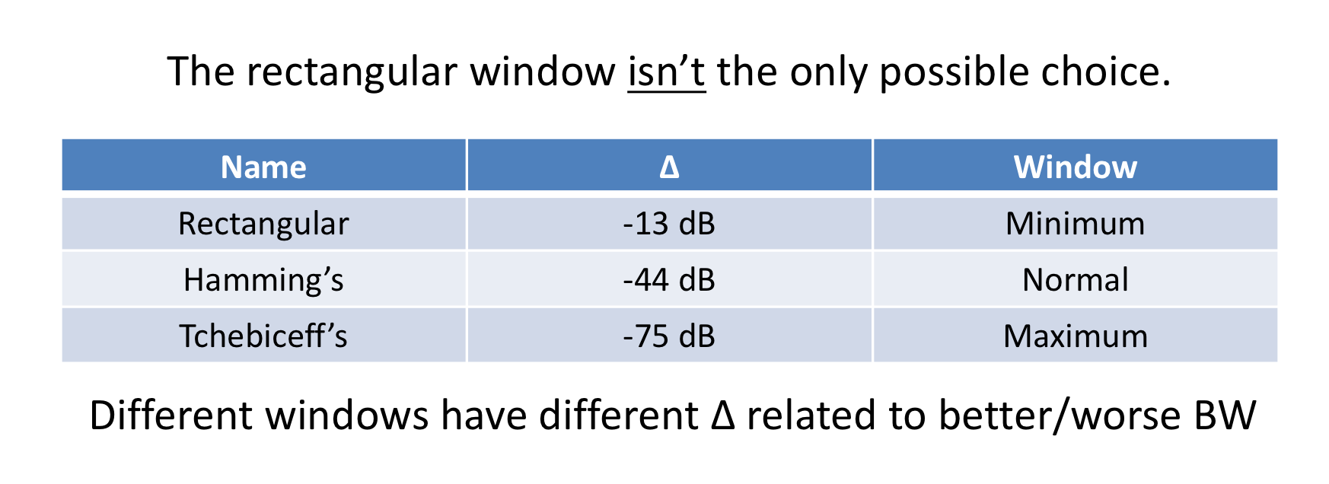
The Time Domain Reflectometry in the VNA is a mathematical operation
(Chirp Z Transform)
5) TIME DOMAIN FREQUENCY DOMAIN
(SYNTHETIC) (MEASUREMENT)
The FFT is influenced by the limited number of samples.
FFT
f/t
t/f
f/t
Rectangular window:
Δ= -13dB
BW depends on the number of samples
Δ
BW
f/t
f₀/ t₀
f₀/ t₀
f/t

Slide 26
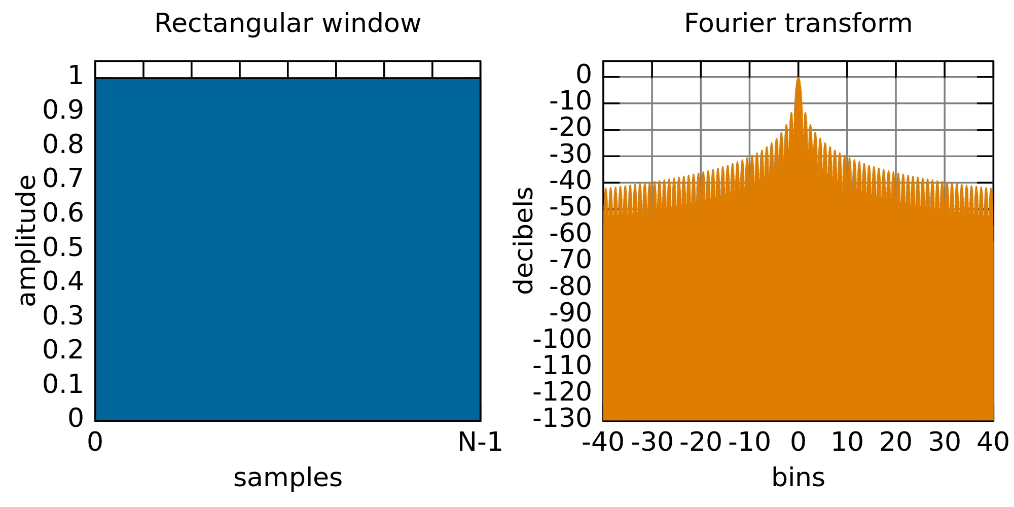
The Time Domain Reflectometry in the VNA is a mathematical operation
(Chirp Z Transform)

Slide 27
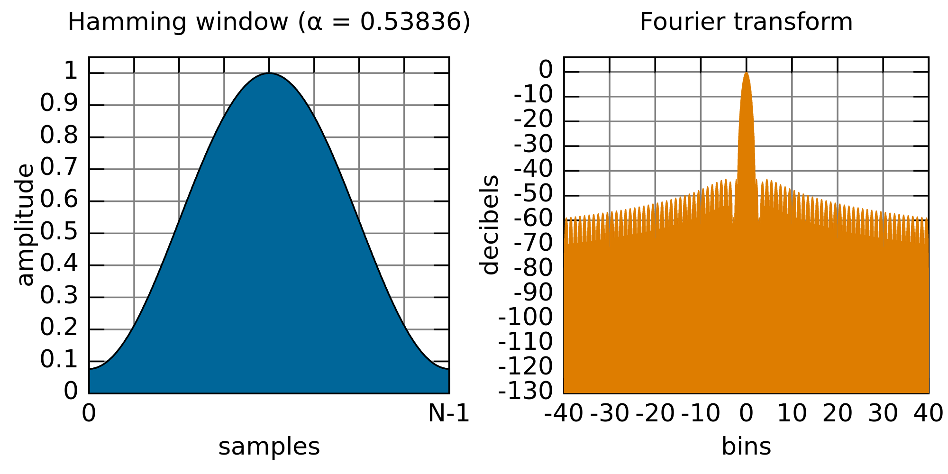
The Time Domain Reflectometry in the VNA is a mathematical operation
(Chirp Z Transform)

Slide 28
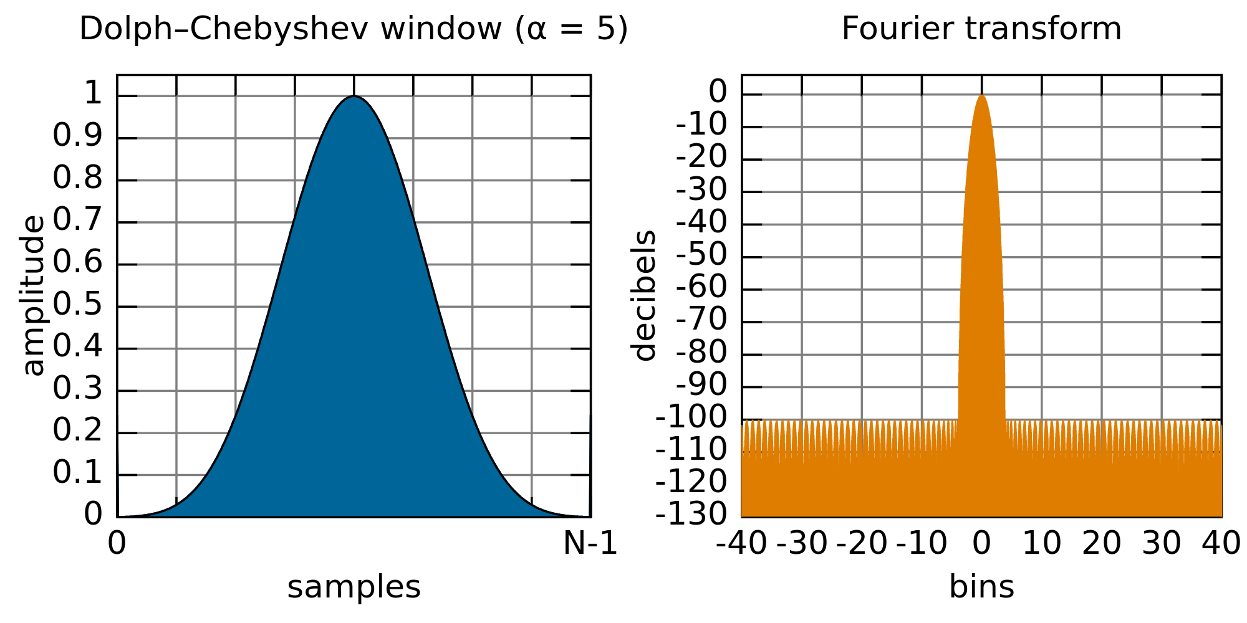
The Time Domain Reflectometry in the VNA is a mathematical operation
(Chirp Z Transform)

Slide 29
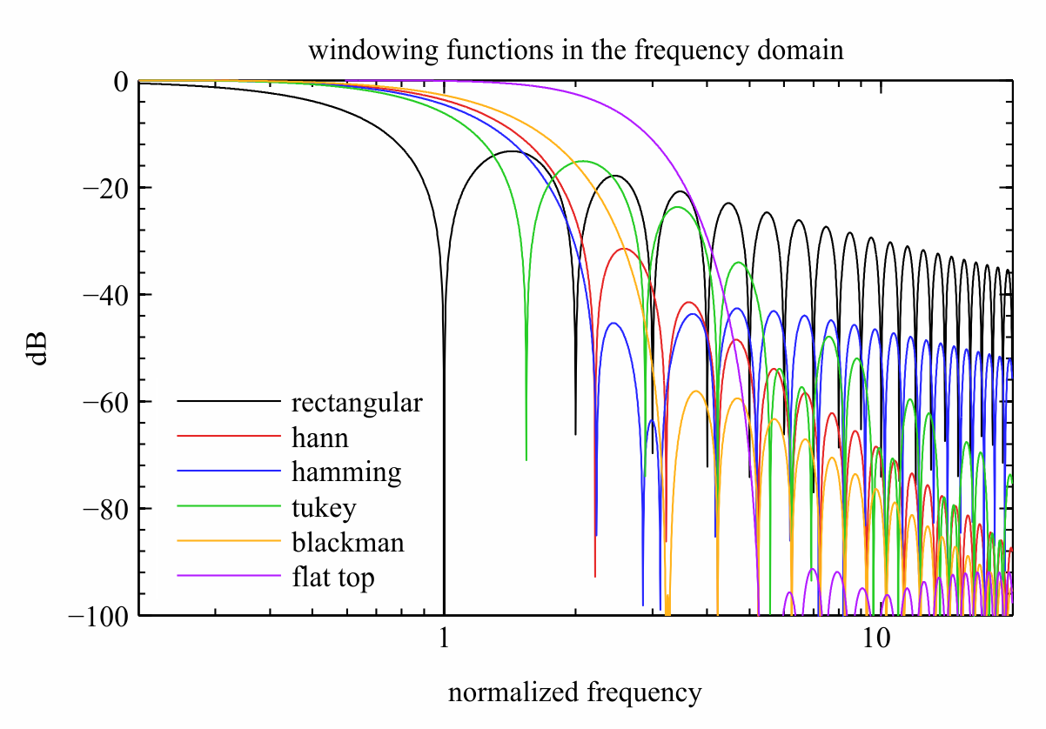

Slide 30
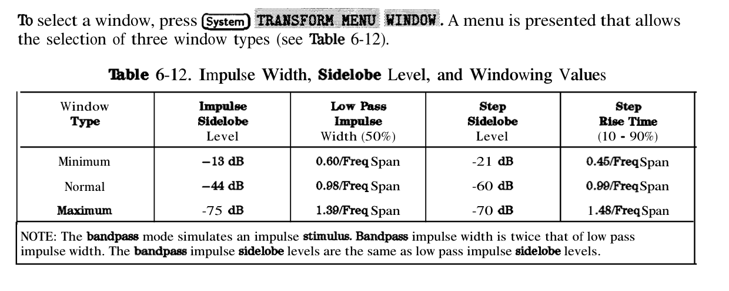

Slide 31
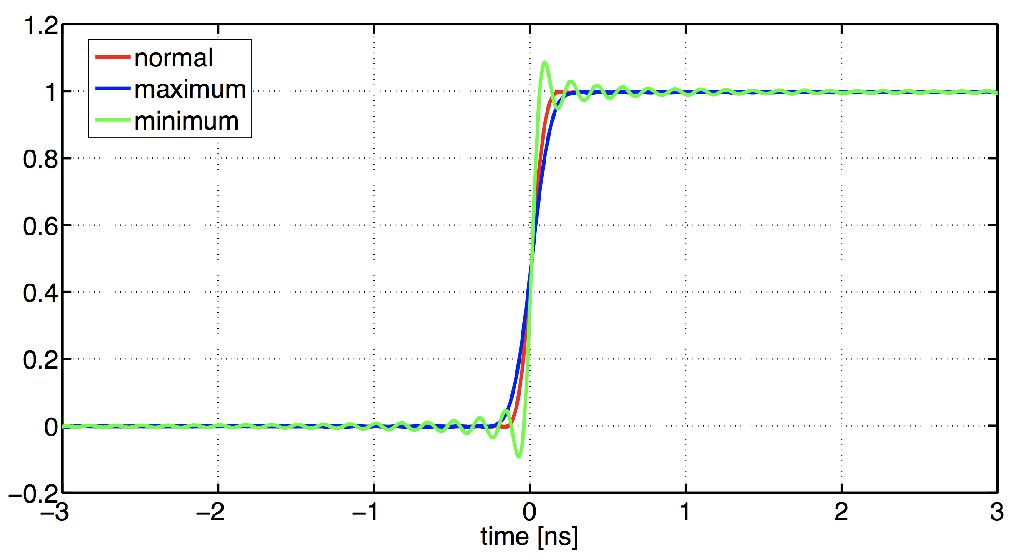

Slide 32
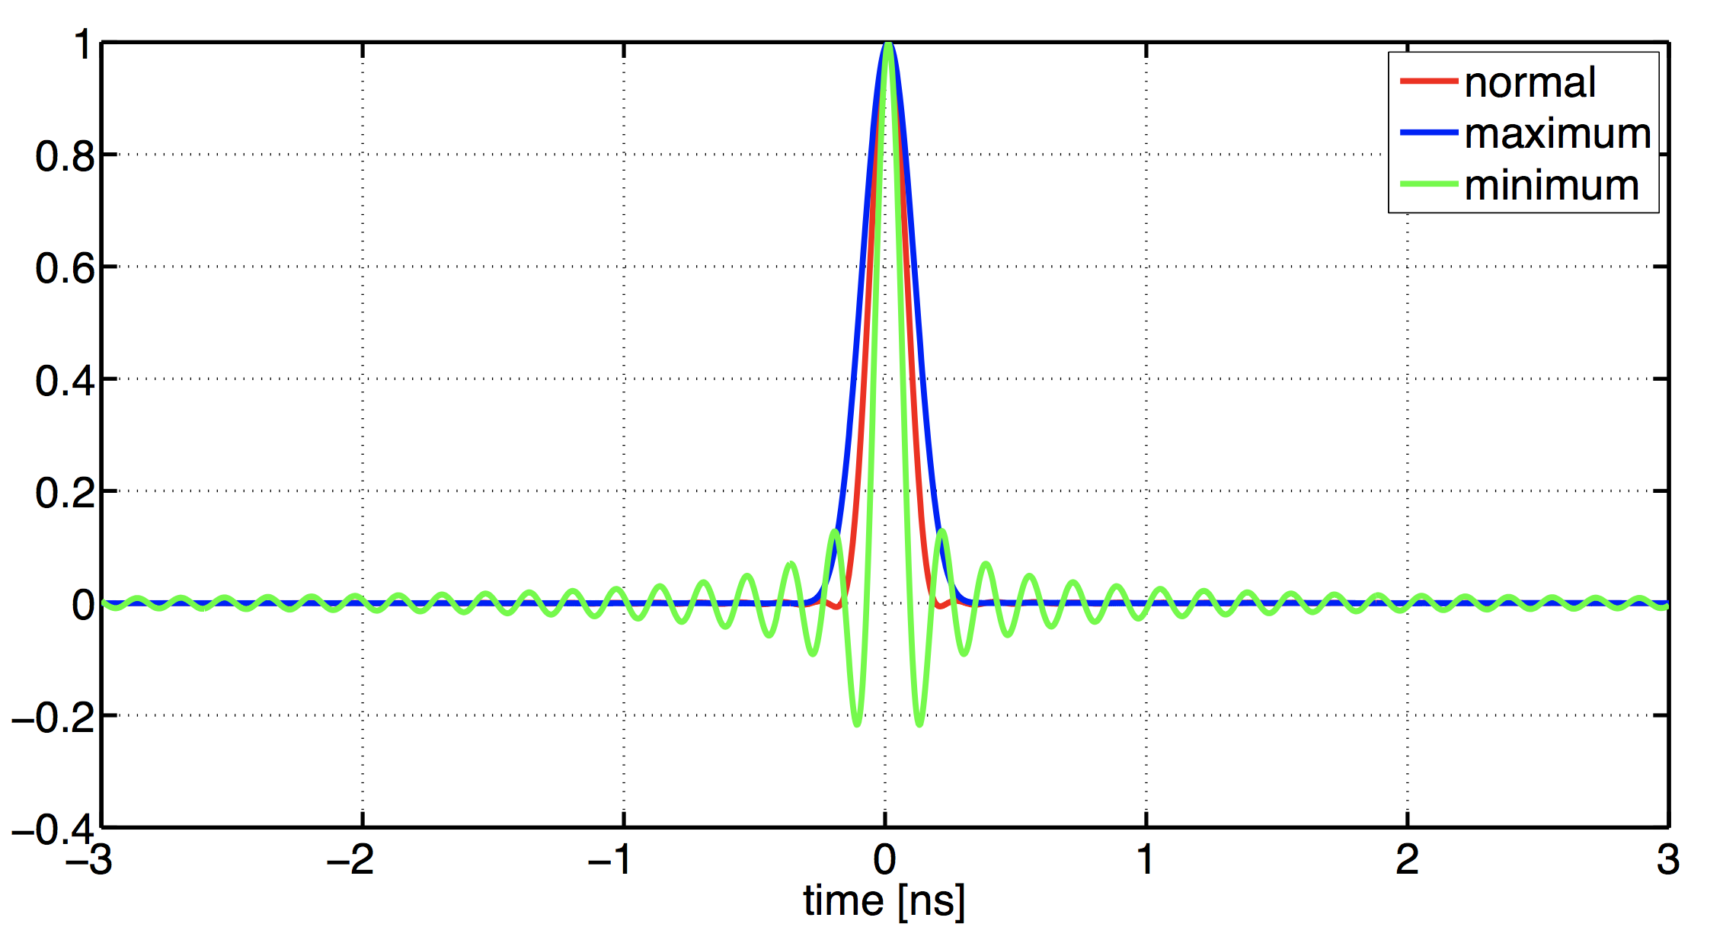

Slide 33
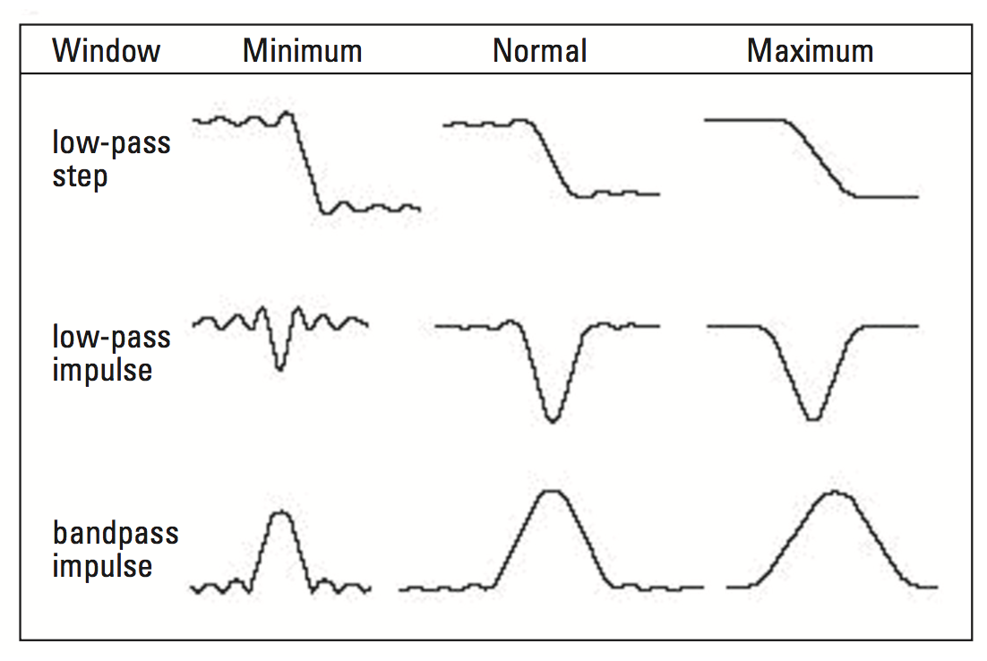
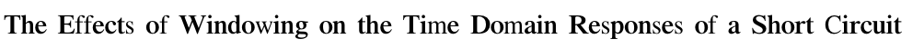
0
time
0
time
0
time
0
time
0
time
0
time
0
time
0
time
0
time
?

Slide 34
Can we measure the window used?
The pulse response to open or short loads (full reflection)
is the FFT of the window being used

Slide 35
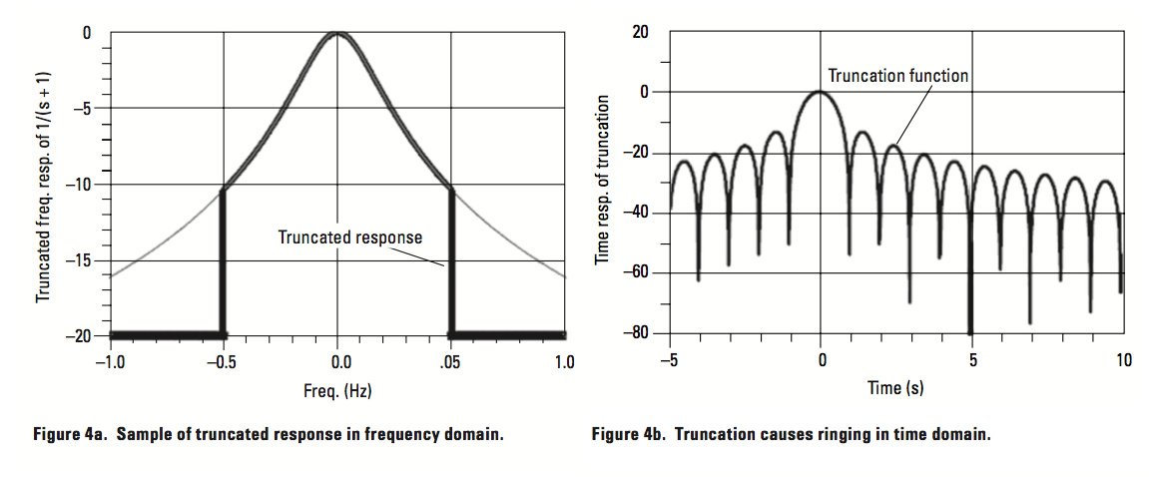
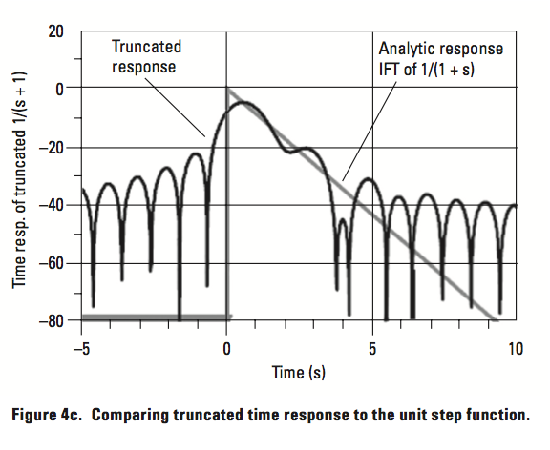
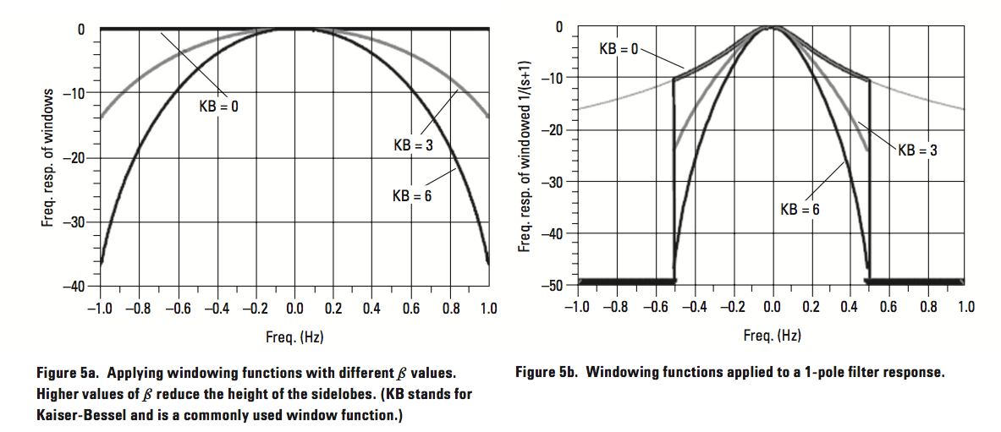
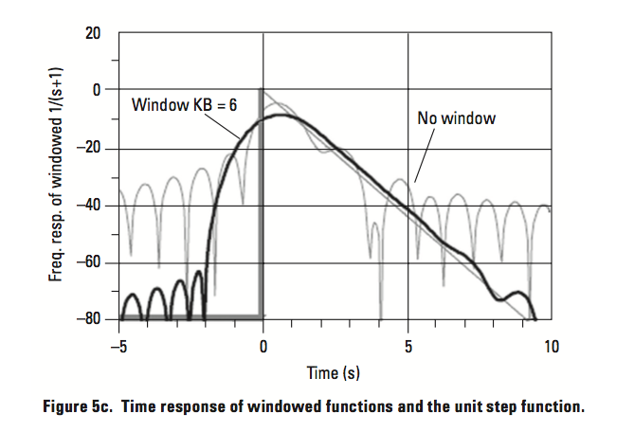
Summary

Slide 36
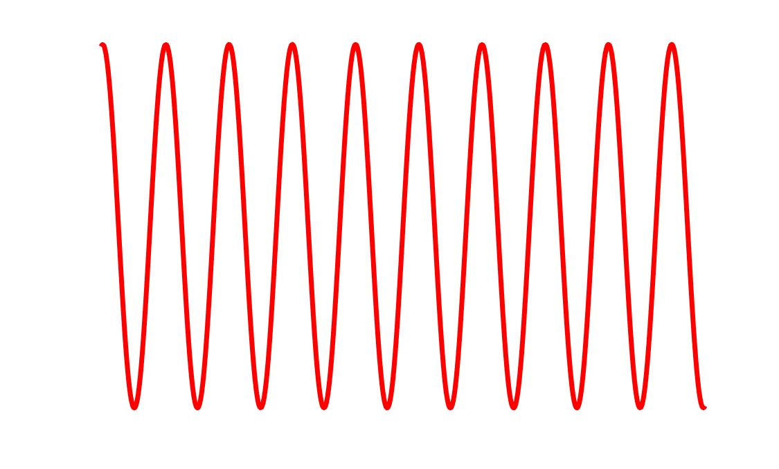
6) it’s possible to identify, in time domain, the part of response I’m iterested in.
GATING (time domain filter)
Example
Γ
Z₀
Z₁
Z₀
DUT
Γ
Time Domain
(Pulse Response)
t

Slide 37
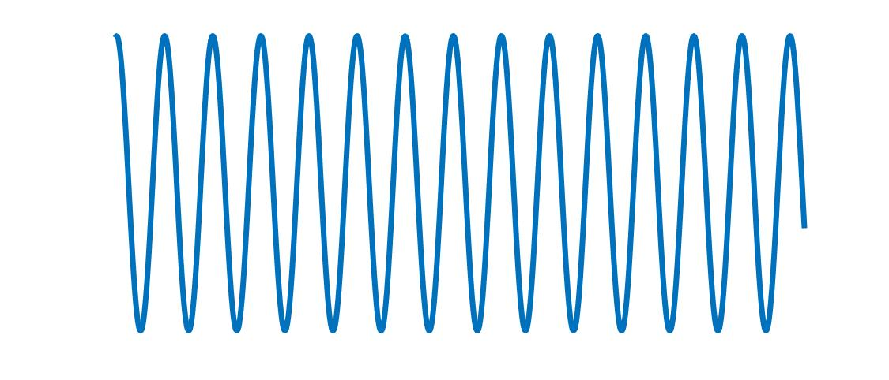
Γ
Gating
time
Γ
Only DUT
Frequency Domain
frequency
Inconvenience:
Gating decreases signal’s power Lower SNR
General example: an attenuator will attenuate more than expected

Slide 38
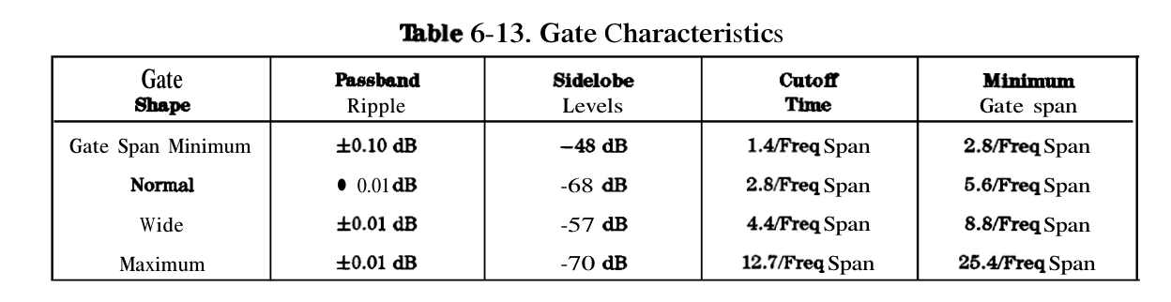

Slide 39
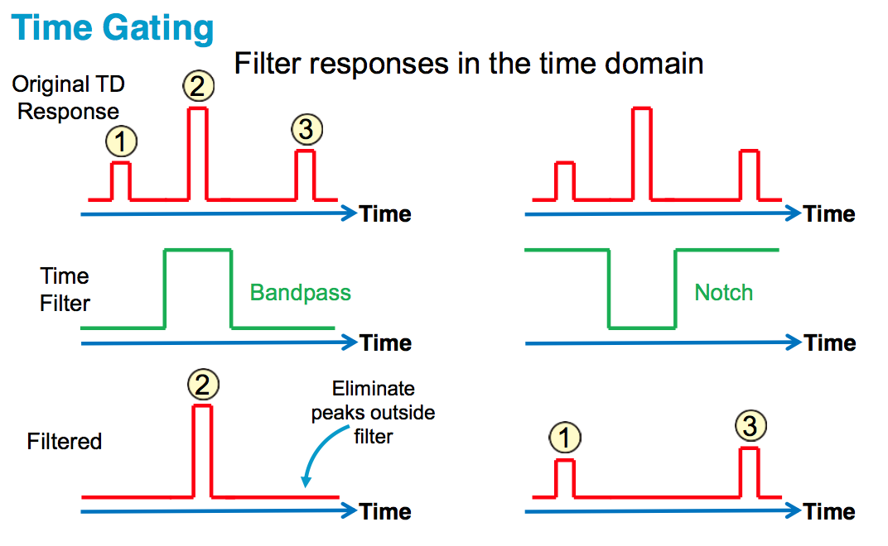

Slide 40
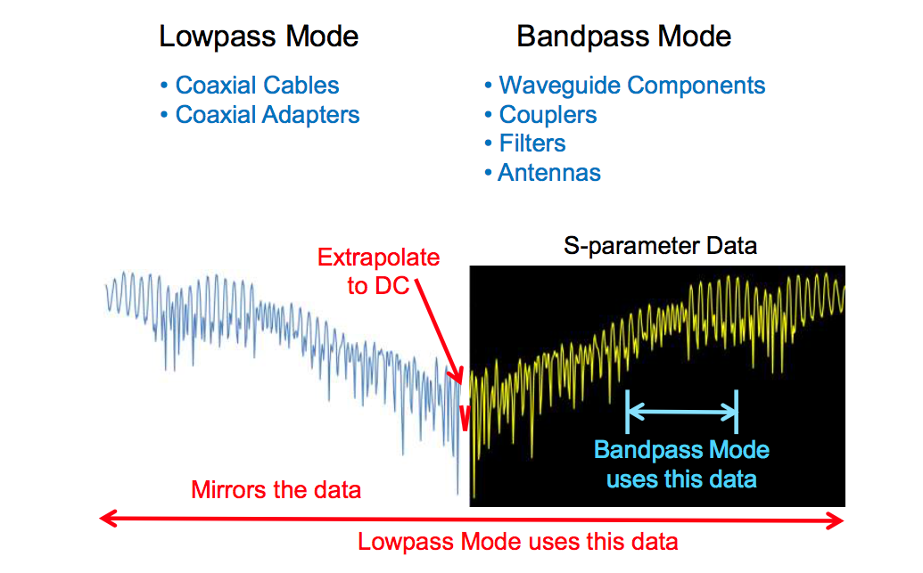
… i.e. double resolution!!

Slide 41
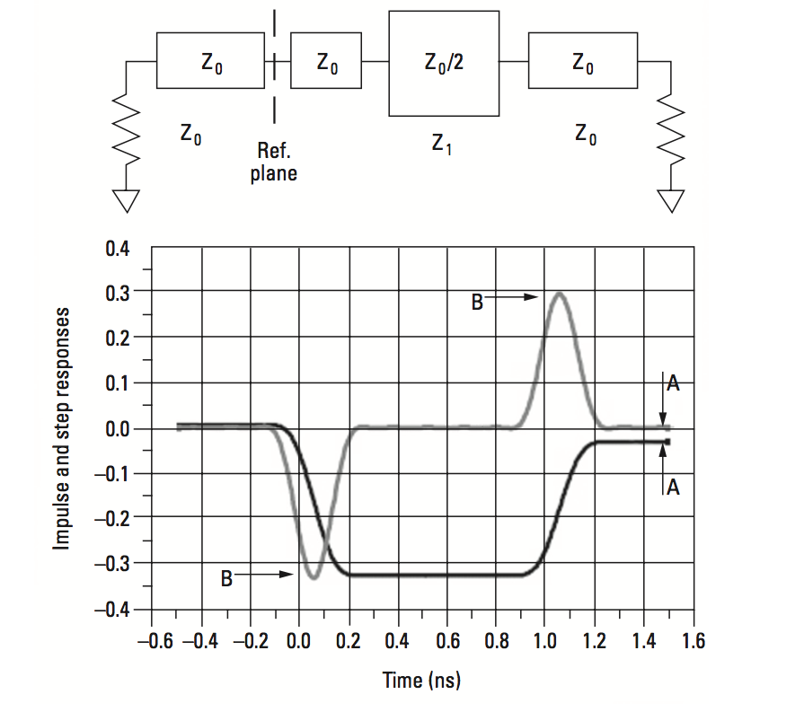
Problem: MASKING in multiple reflection (measuring line impedance)

Slide 42
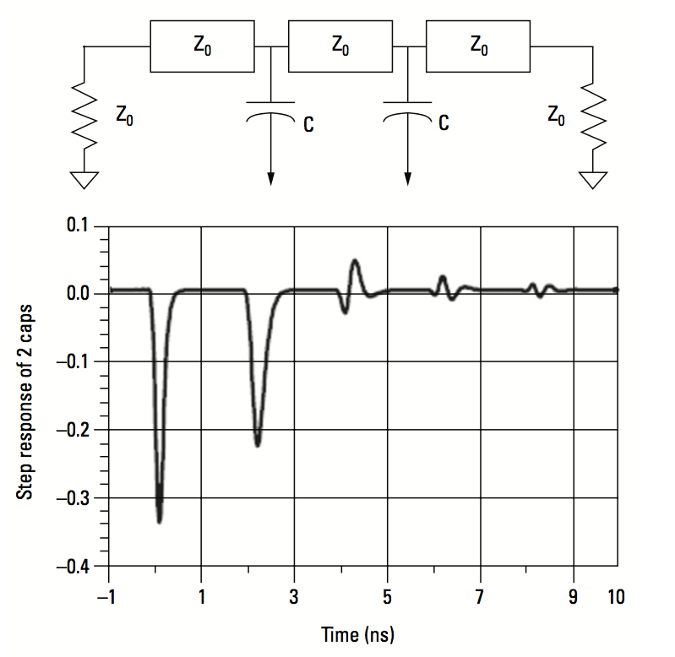
Problem: MASKING in multiple reflection (measuring discrete discontinuites)

Slide 43
LOW PASS STEP
LOW PASS PULSE
BAND PASS
Used for band pass devices
Sign and amplitude of ρ isn’t always easy to understand
Used for gating

Slide 44
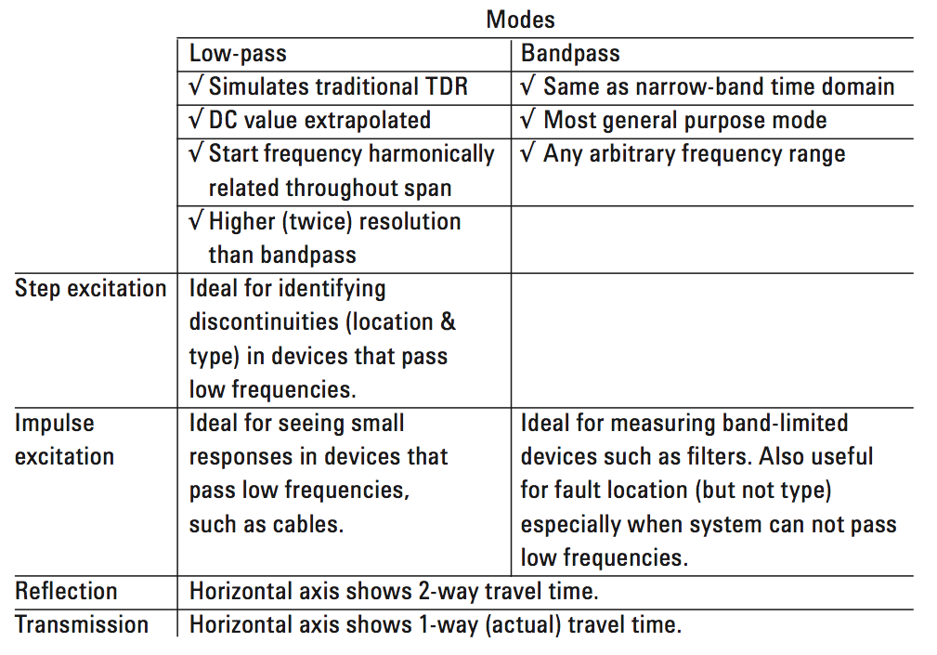

Slide 45
Ten Steps for Performing TDR (Low Pass Step)
Set up desired frequency range (need wide span for good spatial resolution)
2. Under SYSTEM, transform menu, press "set freq low pass“
3. Perform one- or two-port calibration
4. Select S11 measurement *
5. Turn on transform (low pass step) *
6. Set format to real *
7. Adjust transform window to trade off rise time with ringing and overshoot *
8. Adjust start and stop times if desired
9. For gating:
  set start and stop frequencies for gate
  turn gating on *
  adjust gate shape to trade off resolution with ripple *
10. To display gated response in frequency domain
  turn transform off (leave gating on) *
  change format to log-magnitude *
* If using two channels (even if coupled), these parameters must be set independently for second channel
Notes:
Slide 89
Here is a summary of how to perform TDR measurements. Without such a checklist, it is easy to overlook some of the more subtle steps, resulting in confusing or misleading measurements. A one-port calibration is all that is needed when characterizing connectors and the open, short and load standards. A two-port calibration is needed to characterize the reflection or line impedance of the thru standard.

Slide 46
EXERCISES

Slide 47
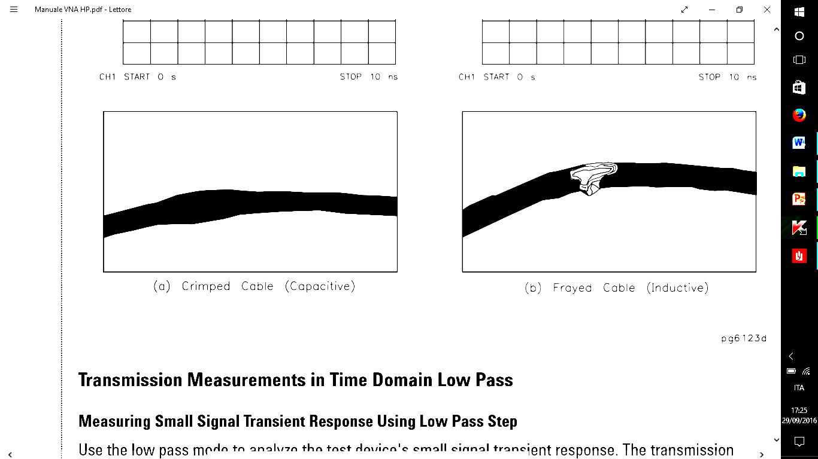
Fault location
Capacity variation (Folded cable)
T
Z₀
C
Z₀
LOW PASS
STEP RESPONSE
Γ
LOW PASS
PULSE RESPONSE
Γ
Γ
2T
t
2T
t
Inductance variation (Frayed cable)
T
L
Z₀
Z₀
LOW PASS
STEP RESPONSE
Γ
LOW PASS
PULSE RESPONSE
Γ
Γ
2T
t
2T
t

Slide 48
Inductance variation (Frayed cable)
T
L
Z₀
Z₀
Γ
LOW PASS
STEP RESPONSE
LOW PASS
PULSE RESPONSE
Γ
Γ
2T
t
2T
t

Slide 49
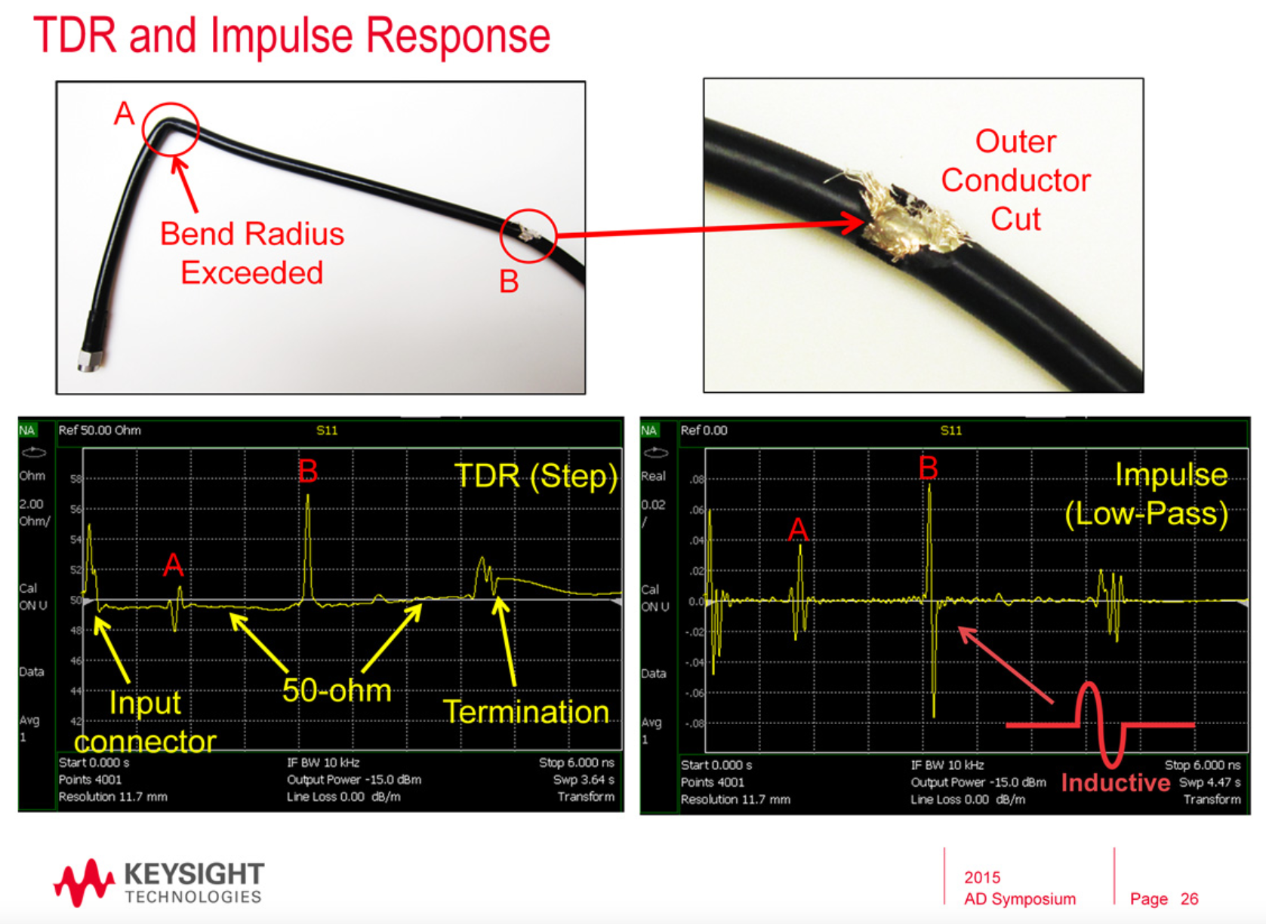

Slide 50
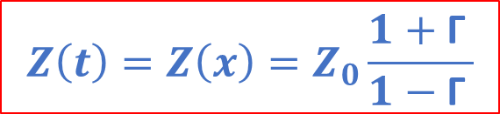
Impedance measurement as a function of Z
Z₀
Z₁
Z₀
Z₂
Z₀
T₁
T₂
T₃
T₄
$$Z\left(t\right)=Z\left(x\right)=Z_{0}\frac{1+\text{Γ} }{1−\text{Γ} }$$
Γ
Z₂ > Z₀
2T₁
2T₂
2T₃
2T₄
t
Z₁ < Z₀

Slide 51
Example: Microstripes
2T₁
2T₂
T₁
T₂
Nonideality:
The function doesn’t end at zero (attenuation, energy loss, reflections)
Second rise time is slower (dispersion, sharp corners are capacitive and cut high frequencies)
Masking
To have Z(x) you need to calculate the velocity

Slide 52
Gating
DUT

Slide 53

Microstipes
W
h
Impedances Various $\frac{W}{h}$
Taper
Cross-Talk
50Ω
25Ω
50Ω
Differences?
100Ω
50Ω
100Ω
50Ω

Slide 54
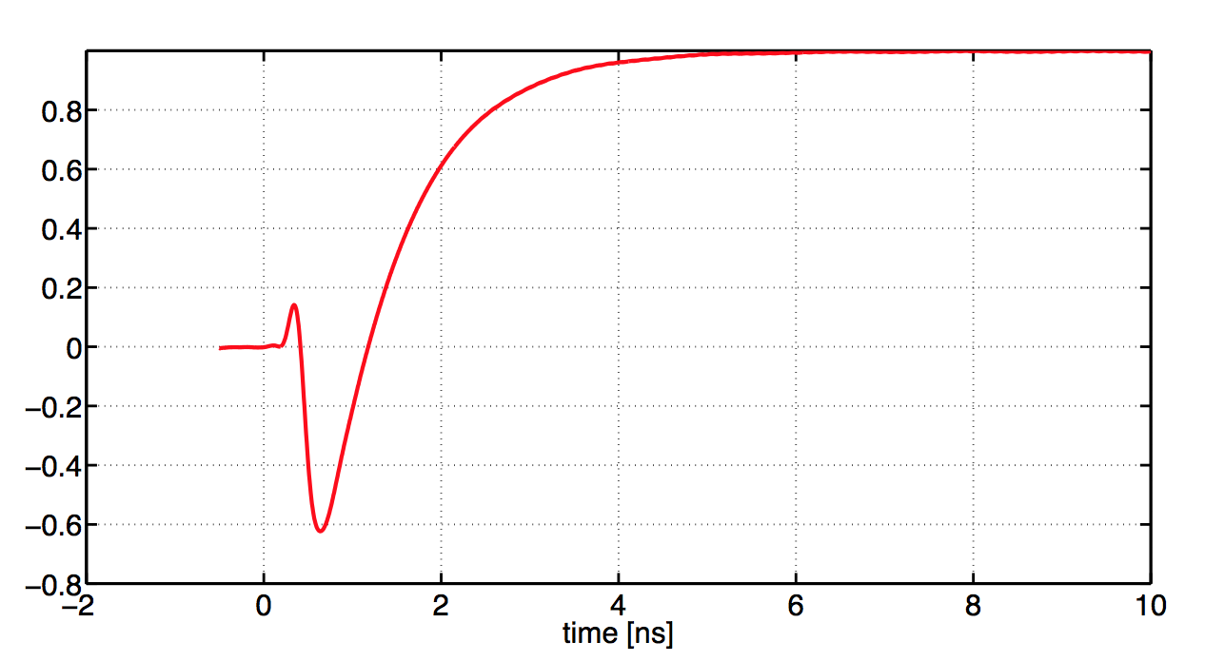
20 pF capacitor

Slide 55
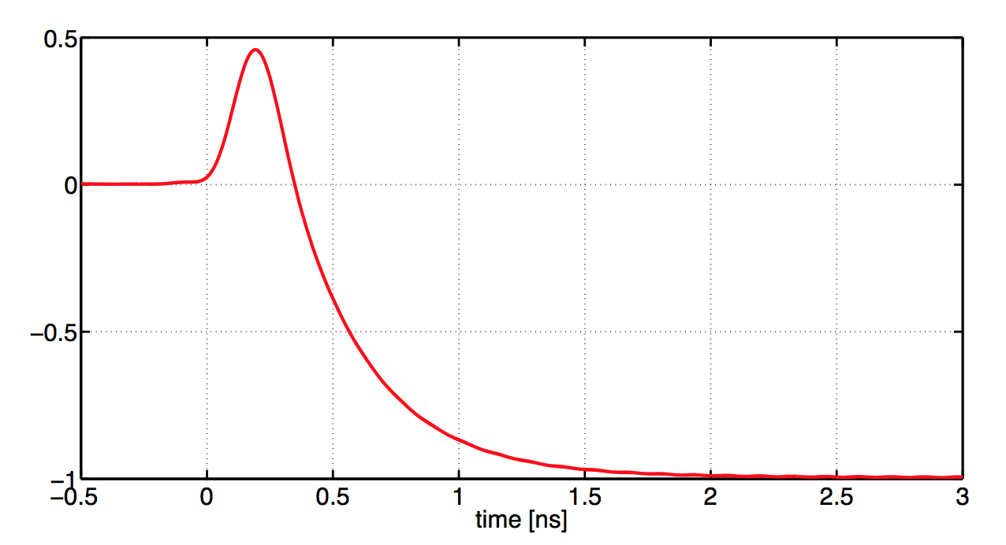
19 nH inductance

Slide 56
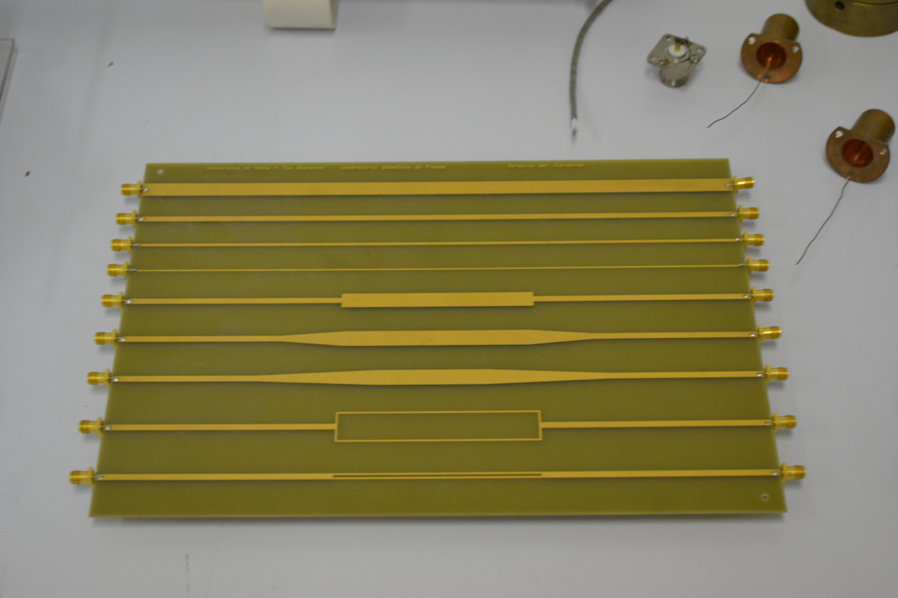

Slide 57
APPLICATIONS

Slide 58
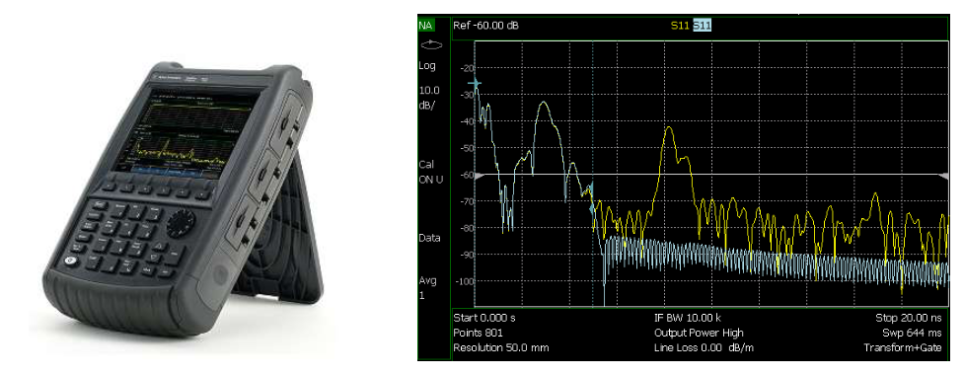
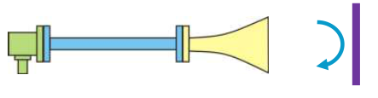

Slide 59


Slide 60


Slide 61


Slide 62


Slide 63


Slide 64


Slide 65


Slide 66


Slide 67


Slide 68




LHC TCTP collimator wire Measurement
Wire (0.5mm)

Slide 69


Coaxial transmission line properties
Matching in impedance measurement is critical.
N. Biancacci et al., TCTP collimator meas., 2014

Slide 70


Why Time Domain Reflectometry?
In a frequency measurement (see Fig.1) is clearly impossible to locate eventual faults in a system. The measurement doesn’t give any information about space indeed.
If we transform the information given in the frequency domain to the time domain using FFT (Fig.2) it’s now possible to see the faults’location in time.
Presuming that our interest is in the space location of the faults, we can use the following equation:
$D=v_{p}∙\frac{T}{2}$
Where D is the fault’s distance, $v_{p}$ the velocity of propagation in the line and T the transit time from the monitoring point to the mismatch and back again.
Fig.1
Fig.2

Slide 71

Why Gating?
A
B
C
D
E
F
In this system we have faults A-F.
Let’s suppose that our interest is only in faults B and C, and we want to isolate the effects of those mismatches to study them in time or frequency domain.
Gating helps us in the following way: using a window pointed on B and C we can isolate the faults removing the effects of the other mismatches. We will obtain a time measurment with only the wanted faults. Now we can use inverse FFT to have frequency information about the mismatches.

Slide 72


A
B
C
D
E
F

Slide 73

INVERSE
FFT
We obtain frequency information about the only gated mismatches.
This can be helpful if we want to know, for example, the magnitude or the nature of the mismatch.

Slide 74


