Slide 1

Back to Basics: Signal Generation
Notes:
This presentation addresses the basics of signal generation, key signal specifications, and applications of test signals.
We will also show how signal generators are taken beyond general purpose applications to simulating advanced signals with impairments, interference, signal capture, and waveform correction.

Slide 2
Agenda
The need for creating test signals
      Aerospace Defense to Communications
Generating Signals
      No modulation
      Analog Modulation
      Composite Modulation
Signal Generator Architecture
Signal Simulation Solutions
Summary
Notes:
Slide 2
This paper first takes a brief looks at the historical and current factors driving the need to create test signals.
From there, the subject of signal sources is divided into these sections: Generating and Simulating signals, Signal Generators, and Signal Simulation Solutions. In the Generating Signals sections, the basics of analog and vector modulation will be discussed. The Signal Generator section will delve into the block diagram, specifications, and applications.
The Signal Simulation Solutions sections will show how signal generators simulate advanced signals with impairments, interference, signal capture and playback, and waveform correction.
Let’s begin!

Slide 3


From Movies ….
Nov. 1940 - News Flash
Disney releases Fantasia with “Fantasound”, a new audio stereophonic sound system
  Walt Disney orders eight audio oscillators (HP 200B) for the sound production of the movie Fantasia.
The 200B was used to calibrate the breakthrough sound system of Walt Disney's celebrated animated film, Fantasia
Stimulus/Response Testing
Input
Output
Equalizer
Tone/volume
Power
Notes:
Slide 3
One of the earliest uses of a “modern” signal generator was in 1939/40 to calibrate the breakthrough sound system that Disney developed for the movie “Fantasia”. This use also helped launch the instrument maker - Hewlett Packard Inc. (now known as Agilent Technologies).

Slide 4


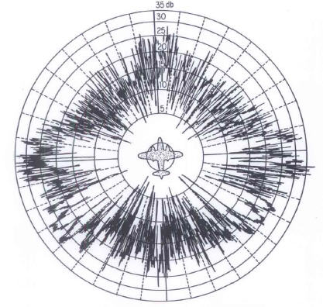
Aerospace Defense ….
TESTING RADAR TRANSMITTERS and RECEIVERS
RF Signal
Injection
ANTENNA
IF Signal
Injection
LNA
1st LO
Signal
Processor
(range and Doppler)
2nd
IFA
IF
BPF
1st
IFA
IF
BPF
2nd
LO
LO
Substitution
Notes:
Slide 4
Today’s use of signal generators includes the design, testing and maintenance of radar transmitters and receivers. The signal generator’s functionality and wide frequency range makes it possible to inject signals at various points in the RF or IF sections of the radar system.

Slide 5
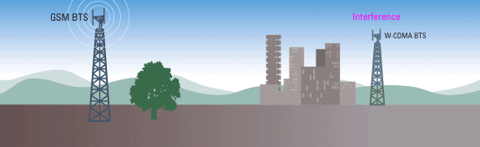


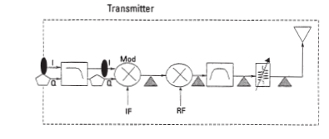
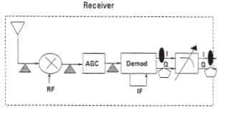
To Mobile Communications….
TESTING DIGITAL TRANSMITTERS and RECEIVERS
1011001110001010001
1011001110001010001
RF Signal injection
IF Signal Injection
Baseband Signal Injection
Notes:
Slide 5
Even though communication devices have gone digital, the need to test the transmitters and receivers remains, and the requirements become more complex. Modern signal generators must be able to provide a variety of digital modulation formats to properly test modern wireless communication systems.

Slide 6
Agenda
The need for creating test signals
      Aerospace Defense to Communications
Generating Signals
      No modulation
      Analog Modulation
      Composite Modulation
Signal Generator Architecture
Signal Simulation Solutions
Summary
Notes:
Slide 6
We will first review basic signal generation and modulation.

Slide 7
Generating Signals – No Modulation
Continuous Wave (CW)
Voltage
Time
Voltage
Frequency
Spectrum Analyzer
Oscilloscope
The sine wave is the basic, non-modulated signal: It is useful for stimulus/response testing of linear components and for Local Oscillator substitution. Available frequencies range from low RF to Millimeter.
RF
Microwave
Millimeter
6 GHz
20-70 GHz
300 GHz
Notes:
Slide 7
A basic signal with no modulation is that of a sine wave and is usually referred to as a continuous wave (CW) signal. A basic signal source produces sine waves.
Ideally, the sine wave is perfect. In the frequency domain, it is viewed as a single line at some specified frequency. Specifications tend to deal with deviations from this perfect sine wave in both amplitude and frequency of the signal.
We generally refer to CW signals that are less than 6 GHz to be RF signals, those from 6 GHz to less than 70 GHz to be microwave signals, and those greater than 70 GHz to millimeter signals.

Slide 8
Generating Signals – Analog Modulation
Modulation: Where the Information Resides
V(t) = A(t)*cos[2πf_{c}t + Φ(t)]
AM, Pulse
FM, PM
Notes:
Slide 8
While CW signals are needed today, they cannot carry information. At best, they can act as a beacon. Modulated signals are the ones that carry the information we need.
Consider the basic equation of a sine wave. There are three parameters that can be varied: Amplitude, frequency, and phase.
Amplitude and pulse modulation are achieved by varying the amplitude of a sine wave. Varying the frequency or phase of the sine wave generates frequency modulation (FM) and phase modulation (PM). Both FM and PM vary the angle of the sine wave, when viewed in polar coordinates, and may be referred to more generally as angle modulation.

Slide 9
Generating Signals - Analog Modulation
Amplitude Modulation
Important Characteristics for Amplitude Modulation
Carrier
Modulation depth %, dB
Modulation frequency (rate)
Depth of modulation (Mod Index)
Linear AM (%)
Log AM (dB)
Sensitivity (depth/volt)
Distortion %
Voltage
Time
Modulation frequency
Where are AM signals used?
AM Radio
Antenna scan
ASK (early digital 100101)
Notes:
Slide 9
In amplitude modulation, the modulating signal varies the amplitude of the carrier. The modulating signal carries the information. Amplitude modulation can be represented by this equation where fc is the carrier, f_{m} is the modulation frequency and m is the depth of modulation, also referred to as the modulation index. The depth of modulation is defined as the ratio of the peak of the modulating signal to the peak of the carrier signal. When the depth of modulation is expressed as a percentage, the modulation is referred to as linear AM. When the depth of modulation is expressed in "dB", the modulation is referred to as logarithmic AM.
The spectrum of an AM signal contains several sidebands. These sidebands are created from the sum and difference of the carrier frequency and the modulation frequency.

Slide 10
Generating Signals – Analog Modulation
Frequency Modulation
V(t) = A cos[2πf_{c}t + βsin2πF_{m}t]
Important Characteristics for Frequency Modulation
β is the modulation index, where β = ΔFdev /Fm
Frequency Deviation (ΔFdev)
Modulation Frequency (Fm)
Accuracy
Resolution
Distortion (%)
Sensitivity (dev/volt)
Voltage
Time
Notes:
Slide 11
In frequency modulation, the modulating signal changes the frequency of the carrier. The amplitude of the modulating signal determines how far (in frequency) the carrier signal will shift; this is referred to as the frequency deviation or ΔFdev. The frequency of the modulating signal determines how quickly the carrier will shift from one frequency to another; this is referred to as the modulation frequency of Fm.
The modulation index, called β, is defined as ΔFdev/Fm.
Frequency modulation, depending on the modulation index, can create an infinite number of sidebands around the carrier. A mathematical solution to frequency modulation requires Bessel functions. The Bessel functions provide an indication of the number and relative strength of the sidebands. The interesting thing about FM is that as the modulation index is increased, the number of sidebands increases then the carrier or sidebands can completely disappear in a known sequence.

Slide 11
Generating Signals – Analog Modulation
Phase Modulation
Important Characteristics for Phase Modulation
Voltage
Phase deviation (Δθ)
Modulation Rate (Fm)
Accuracy
Resolution
Distortion (%)
Sensitivity (dev/volt)
Time
V(t) = A cos[2πf_{c}t + β2πF_{m}t]
Where are Phase Modulated signals used?
Where β =Δθ, the peak phase deviation
PSK (early digital 1010)
Radar (pulse coding)
Notes:
Slide 13
Phase modulation is very similar to frequency modulation. The modulating signal causes the phase of the carrier to shift. The amplitude of the modulating signal determines the phase deviation. The modulation index, β, is defined as the phase deviation of the carrier. Notice that the rate of the phase modulation does not enter into a calculation of β. The spectrum modulation components are spaced as with FM and are determined by the rate of phase modulation, but β will not change if the rate of phase modulation is varied. If β doesn't change, the shape of the spectrum doesn't change: only the component spacing changes. This is really the only way of differentiating analog FM from analog PM.

Slide 12
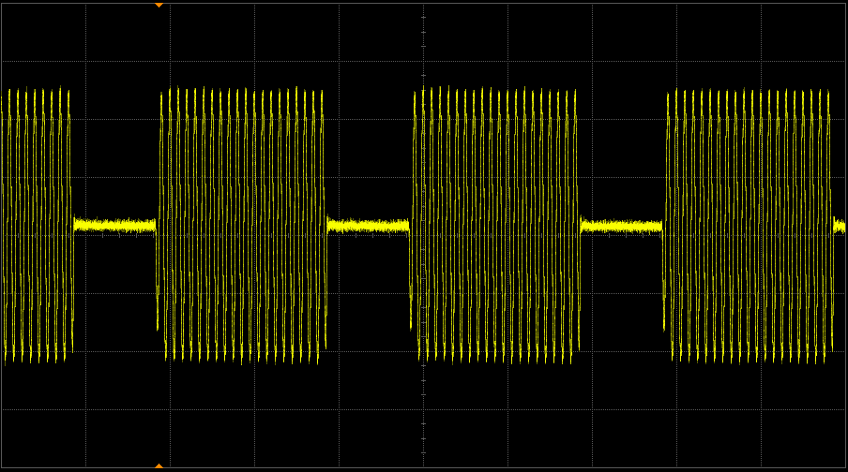
Generating Signals – Analog Modulation
Pulse Repetition
Interval (PRI)
Pulse Modulation
Rise time
Important Characteristics for Pulse Modulation
T
Pulse width (t)
PRF (1/T)
Duty cycle (t/T)
On/Off ratio (dB)
Rise time (ns)
Voltage
On/Off ratio
t
Time
Pulse Width
2/t
Where are Pulse Modulated signals used?
1/T
1/t
Radar
High Power Stimulus/Response
Communications
Power
Frequency
Notes:
Slide 15
In pulse modulation, the signal is either at full amplitude or it is at zero amplitude – essentially it is ON or OFF. The most important parameters for pulsed RF signals are the pulse rise and fall times, pulse repetition frequency (PRF), pulse period, and pulse width. The line spacing in a pulsed spectrum are separated by the reciprocal of the pulse period. The nulls occur at 1/t where t is the pulse width. The overall shape is a sin(x)/x.

Slide 13
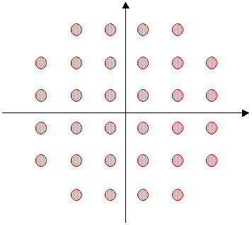
Generating Signals – Composite Modulation
Simultaneous modulation of two Mod Types
Independent Amplitude and Phase Modulation
Integrated IQ Modulator
Q
I
Independent FM and
Pulse Modulation
32 QAM Constellation Diagram
FM during the pulse = chirp
Notes:
Slide 17
Composite modulation is when two or more modulation types are used to create a composite modulated signal. For example, AM and PM can be combined to create various magnitude and phase values. In addition, a variety of communications, satellite, and radar signals can be generated using a combination of pulse and either PM or FM.
While it is possible to coordinate analog AM and PM to generate basic digital QAM signals, in reality, this is very difficult and usually requires very specialized phase modulators that have limited bandwidths. It is much easier to use an integrated IQ modulator to accomplish the coordination of AM and PM for digital communication purposes. In the case of complex digital communications such as 32 QAM, these digital modulation states are restricted to discrete states (discrete values of magnitude and phase values) and are easily created with IQ modulators.
An example of a composite pulse and FM signals is a chirp signal. Radar signals often marry FM and Pulse modulation in an effort to overcome the difficulty of creating very high power in ultra-narrow pulse widths. Chirped signals are easier to produce - having a much wider pulse width and lower average power level – and can be signal processed to yield radar return signals that have the very narrow pulse widths that are desired.

Slide 14
Vector Signal Changes or Modifications
Generating Signals – Composite Modulation
Mag
Phase
0 deg
Phase
0 deg
Magnitude Change
Phase Change
0 deg
0 deg
Both Change
Frequency Change
Notes:
Slide 19
Vector (phasor) notation can be used to represent all types of modulation. Amplitude modulation is represented by a magnitude change with no rotation. Phase modulation is represented by a vector that rotates along an arc; the length of the arc indicates the maximum phase deviation. Simultaneous amplitude and phase modulation is indicated by a vector whose length and phase change with time. Frequency modulation results in a vector that rotates clockwise or counterclockwise.
When vector modulation is viewed on the polar display it is easy to see why we like to view it this way.

Slide 15
Polar Versus I-Q Format
Generating Signals – Composite Modulation
Q
Project Signals to “I” and “Q” Axes
Polar to Rectangular Conversion
IQ Plane Shows 2 Things:
  What the modulated carrier is doing relative to the unmodulated carrier.
  What baseband I and Q inputs are required to produce the modulated carrier
{
Mag
{
Q-Value
Phase
0 deg
I
I-Value
Notes:
Slide 20
When we describe the vectors in digital modulation, we typically don’t use magnitude and phase values. The polar plane can very easily be mapped to a rectangular format (with horizontal and vertical axis) called the I-Q plane: I (In-phase) and Q (Quadrature). The I axis lies on the zero degree phase reference, and the Q axis is rotated by 90 degrees. The signal vector’s projection onto the I axis is the “I” component and the projection onto the Q axis is its “Q” component.
I/Q diagrams are particularly useful because they mirror the way most digital communications signals are created using an I/Q modulator. Independent DC voltages (I and Q components) provided to the input of an I/Q modulator correlate to a composite signal with a specific amplitude and phase at the modulator output. Conversely, the amplitude and phase of a modulated signal sent to an I/Q demodulator, will correspond to discrete DC values at the demodulator’s output.

Slide 16
Generating Signals – Composite Modulation
Transmitting Digital Data -- Bits vs Symbols
Binary Data bit = 0,1
Transmitting Digital Bits (f 1 = 0, f 2 = 1 )
Transmission Bandwidth Required
f
1
f
(t) =
f
2
T
010101010
2/ T
Main lobe width is 2 × Sample rate
Symbol = Groups/blocks of Bits
2 bits/symbol (00 01 10 11) 3 bits/symbol (000 001 …..) 4 bits/symbol (0000 0001 ..)
Symbol Rate = Bit rate
# bits per symbol
Symbol 1 (00)
f
Symbol 2 (01)
(t) =
Symbol 3 (10)
Symbol 4 (11)
2/ S
S
Main lobe width is 2 × Symbol rate
Notes:
Slide 21
Transmitting large amounts of binary bits quickly requires large information bandwidths: 10k bits/ sec needs 20 kHz bandwidth, 100k bits/sec needs 200 kHz bandwidth, etc. The faster the data rate, the wider the bandwidth.
There is a way to make a more efficient use of the bandwidth available but increases the complexity of the signal. This requires grouping blocks of digital data (1s, 0s) into symbols. The number of bits/symbol varies, depending upon the specific format. Transmitting digital data via symbols requires less bandwidth. For 2 bits/symbol, the symbol rate is ½ the bit rate, and for 4 bits/symbol, the symbol rate is ¼ the bit rate, etc. Symbols can vary from 1 bit/symbol (binary) to 2n bits/symbol, where n is any positive integer.

Slide 17
Generating Signals – Composite Modulation
Digital Modulation Characteristics
Modulation format
Number of bits per symbol
Constellation
Transmission bandwidth
Q
BPSK
1
1
0
I
F
01
Q
00
QPSK
2
I
11
10
F/2
Q
0000
16 QAM
4
I
Symbol Rate = #symbols/sec. (Hz)
F/4
Notes:
Slide 22
Symbol rate is the number of symbols sent per second (in Hz). The reciprocal of the symbol rate is the approximate bandwidth necessary to transmit the signal. Since more bits per symbol are modulated, 16QAM can fit the same data into half the bandwidth of QPSK. Similarly, the same bandwidth could be used to send data at twice the rate.

Slide 18
Vector Modulation - Important Characteristics
Generating Signals – Composite Modulation
Q
IQ Modulation Bandwidth
Frequency Response/flatness
IQ quadrature skew
IQ gain balance
Mag
Phase
0 deg
I
flatness
F_{bw}
Notes:
Slide 23
Some important characteristics of vector modulation to remember are shown here.
Modulation bandwidth is the maximum effective bandwidth of the IQ modulator. Like the characteristic of a bandpass filter, The amplitude flatness is how much the IQ modulator changes (or doesn’t) change the information being transmitted.
IQ quadrature skew is a measure of how orthogonal (close to 90 degrees) the I and Q planes are to each other.
IQ gain balance is a measure of how closely the I channel and Q channel are in gain.
When the IQ characteristics are not ideal, magnitude and phase errors of the digital state will occur and may cause incorrect digital information to be transmitted. Digital errors are referred to as bit errors or as bit error rate.

Slide 19
Vector Modulation - Where Used
Generating Signals – Composite Modulation
Q
Mobile Digital Communications
Modern Radars
I
Notes:
Slide 24
The most common use of IQ or vector modulation is in modern digital communications. Because of the large modulation bandwidths and the ease of creating composite modulated signals, it is also used in modern radar systems.

Slide 20
Agenda
The need for creating test signals
      Aerospace Defense to Communications
Generating Signals
      No modulation
      Analog Modulation
      Composite Modulation
Signal Generator Architecture
Signal Simulation Solutions
Summary
Notes:
Slide 28
Now we are going to examine signal generator block diagrams, specifications, applications.

Slide 21
Signal Generator Architecture
Basic CW Signals
  Block Diagram (RF and Microwave)
  Specifications
  Applications
Analog Signals
  Block Diagram (AM, FM, PM, Pulse)
  Applications
Vector Signals
  Block Diagram (IQ)
  Applications
Notes:
Slide 29
We’ll start with the simplest block diagram for a CW signal generator and the performance attributes that determine the specifications. Then we’ll look at the additional complexity required to generate more sophisticated analog and vector modulated signals. For each type of signal generator, We’ll also examine the applications where each type of signal generator is often used.

Slide 22
Basic CW Signals – Block Diagram
RF Source
Synthesizer Section
Output Section
Frac-N
ALC Modulator
Output
Attenuator
Phase
Detector
f
VCO
ALC
Driver
divide
by X
Reference
Oscillator
ALC Detector
Reference Section
ALC = automatic level control
Notes:
Slide 30
The above block diagram provides greater detail for an RF CW source.
The reference section’s reference oscillator determines the accuracy of the Source’s output frequency. The important characteristics are the short term stability (phase noise) and the long term stability (or the aging rate). The reference section supplies a sine wave with a known frequency to phase-locked loop (PLL) in the synthesizer section.
The synthesizer section is responsible for producing a sine wave at the desired frequency. The VCO (voltage controlled oscillator) produces the less accurate sine wave. The PLL maintains the output frequency at the desired setting which translates the frequency accuracy of the reference oscillator to the output of the VCO.
The synthesizer section supplies a stable frequency to the output section. The output section determines the overall amplitude range and accuracy of the source. Amplitude range is determined by the available amplification and attenuation. Amplitude accuracy, or level accuracy, is maintained by monitoring the output power and continuously adjusting the power as needed.
Let's take a look at each section in more detail.

Slide 23
Basic CW Signals – Block Diagram
Reference Section
To synthesizer section
Phase
Detector
f
Divide
by X
Optional External Reference Input
Reference Oscillator (TCXO or OCXO)
  TCXO
  OCXO
  Aging Rate
  +/- 2ppm/year
  +/- 0.1 ppm /year
  Temp.
  +/- 1ppm
  +/- 0.01 ppm
  Line Voltage
  +/- 0.5ppm
  +/- 0.001 ppm
Notes:
Slide 31
The heart of the reference section is the reference oscillator. The reference oscillator must be inexpensive, extremely stable and adjustable over a narrow range of frequencies. A stable reference oscillator will ensure that the frequency output of the source remains accurate in between calibrations. By comparing the reference oscillator to a frequency standard, such as a Cesium oscillator, and adjusting as needed, the source can be calibrated with an output that is traceable.
Of all materials today, crystalline quartz best meets these criteria. The fundamental frequency of quartz is affected by several parameters: aging, temperature, and line voltage. Over time, the stress placed on a quartz crystal will affect the oscillation frequency. Temperature changes cause changes in the crystal structure which affect the oscillation frequency. The piezoelectric nature of quartz is also affected by the electric fields created inside the source by the line voltage.
To improve the performance of quartz, temperature compensation circuitry is used to limit the variations in output frequency that result from variations in the operating temperature. Crystals with such compensation are referred to as Temperature Compensated crystal oscillators or TCXO's. OCXO's are crystals that have been placed in an Oven Controlled environment. This environment maintains a constant temperature and provides shielding from the effects of line voltage. The stability for both TCXO's and OCXO's is tabulated above.
Many sources also provide an external input that may be used to lock the oscillator to an external or house reference. The source, however, does not require an external reference.

Slide 24
Basic CW Signals – Block Diagram
Output Section
ALC
  maintains level output power by adding/subtracting power as needed
Output Attenuator
  mechanical or electronic
  provides attenuation to achieve wide output range (e.g. -127 dBm to +23 dBm)
ALC Modulator
Output
Attenuator
From synthesizer section
Source output
ALC
Driver
ALC Detector
Notes:
Slide 34
The output section maintains amplitude or level accuracy by measuring the output power and compensating for deviations from the set power level. The ALC driver digitizes the detector output and compares the digitized signal to a look-up table to provide the appropriate modulator drive such that the detected power becomes equivalent to the desired power. Frequently, external losses from cabling and switching between the output of the signal source and the device under test (DUT) attenuate the signal. Another look-up table that compensates for external losses can be input to extend the automatic leveling to the input of the DUT.
With no output attenuation applied, the source amplitude is at a maximum determined by the power amp and the loss between the output of the amp and the output connector. The main source of loss is the output attenuator. The output attenuator will introduce a finite amount of loss even when the attenuation is set to 0 dB. The purpose of the output attenuator is to reduce the output power in a calibrated and repeatable fashion. Today attenuators are available that provide output ranges from +23 dBm (no attenuation applied to the source) to -127 dBm (maximum attenuation applied). There are two types of attenuators that are commonly used: mechanical and solid state.
Mechanical attenuators introduce very little loss between the output of the power amp and the output connector. Thus a high output power can be achieved without over-driving the output amplifier. Operating at low drive levels reduces the level of harmonics generated by the source. Mechanical attenuators do, however, have finite lifetimes. A typical mechanical attenuator will live for five million cycles. For an ATE application in which the power level is changed every two seconds, the attenuator will fail after about a year.

Slide 25
Basic CW Signals – Block Diagram
Synthesizer Section
Front panel
control
N = 93.1
Error signal
Frac-N
5MHz
f
To output section
Phase
Detector
X 2
931 MHz
VCO
Multiplier
5MHz
From reference section
465.5 MHz
Notes:
Slide 32
In the synthesizer, a VCO produces an output frequency for an input voltage. A simple VCO can be constructed from a varactor, a voltage-variable capacitor commonly made from a reverse-biased pn junction diode. The capacitance across the diode decreases as the reverse bias to the diode increases. When placed in an oscillator circuit, the tunable capacitor enables the output oscillation to be tuned. This output is inherently unstable so a PLL is required to maintain frequency stability.
Most of the VCO output is sent to the output section of the source. A portion of the VCO output is divided to a lower frequency and compared to the signal supplied by the reference section using the phase detector. The output of the phase detector will be a dc offset with an error signal. The dc offset represents the constant phase difference between the 5 MHz signal from the reference and the 5 MHz signal from the Frac-N divide circuit. The error signal represents unwanted frequency drift. The output of the phase detector is filtered and amplified to properly drive the VCO. If the VCO does not drift, there will be (almost) no error signal at the output of the phase detector and the control voltage to the VCO will not change. If the VCO drifts upwards (or downwards), the error signal at the output of the phase detector will adjust the VCO output downwards (or upwards) to maintain a stable frequency output.

Slide 26
Basic CW Signals – Block Diagram
PLL/Fractional-N…suppress phase noise
Overall phase noise of signal
Phase-locked-loop (PLL) bandwidth selected for optimum noise performance
noise
Reference
oscillator
Phase detector noise
20logN
Broadband noise floor
VCO noise
frequency
Notes:
Slide 33
Within a source, there are four main contributors to phase noise: The reference oscillator, the phase detector, the VCO, and the broadband noise floor. The broadband noise floor results primarily from the thermal noise present in the source. In general, this noise does not greatly limit the performance of the source.
The phase noise of the reference oscillator and the VCO both fall off initially as 1/f³ and transitions to a 1/f² dependence which on a log-log plot is a slope of 20 dB per decade. The phase noise contribution of the phase detector is dominated by thermal noise and hence exhibits the same spectral dependency (or lack of spectral dependency) as the broadband noise floor. In addition, the Frac-N divide in the PLL degrades the phase noise performance by 20logN where N is the divide by number.
The bandwidth of the PLL determines the point at which the VCO contribution to the overall phase noise becomes suppressed. For frequency offsets inside the PLL bandwidth, the overall phase noise of the source is dependent mainly upon contributions from the phase detector and the reference oscillator.

Slide 27
Basic CW Signals – Block Diagram
Microwave Source
Reference Section
Frac
N
Output Section
Phase
Det
ALC Modulator
Output
Attenuator
f
VCO
Ref Osc
Sampler
YIG
Oscillator
Phase
Detector
f
ALC
Driver
Frac-N
Synthesizer Section
ALC Detector
f
Notes:
Slide 35
The block diagram of a microwave CW source is similar to that of an RF CW source; each has the same three basic sections. There are differences, however. Although the reference section only has one reference oscillator, two signals are supplied to the synthesizer section from the reference section.
The output frequency of the synthesizer section is generated from a Yttrium-iron-garnet (YIG) oscillator which is tuned with a magnetic field. The feedback mechanism that ensures frequency stability is a phase locked loop; however, in addition to the fractional-N divide, harmonic sampling is used to divide the output frequency.

Slide 28
Basic CW Signals – Specifications
Frequency
Range F_{min} to F_{max}
Resolution Smallest frequency increment
Accuracy How close is the indicated frequency to the actual frequency?
Switching Speed How quickly can you change from one frequency to another?
Accuracy =
= CW frequency = 1 GHz
  = aging rate = 0.152 ppm/year
= time since last calibrated = 1 year
Uncertainty
t
t
±f
CW
*
aging
*
cal
Power
f
CW
t
aging
t
cal
Frequency
Accuracy = ±152 Hz
Notes:
Slide 36
Understanding source specifications is critical when determining the appropriate source for an application. For CW sources, the specifications are generally divided into three broad categories: Frequency, amplitude (or output), and spectral purity.
Range, resolution, and accuracy are the main frequency specifications. Range specifies the range of output frequencies that the source can produce. Resolution is the smallest frequency increment. The accuracy of a source is affected by two parameters: The stability of the reference oscillator and the amount of time that has passed since the source was last calibrated.
A typical (but very good) reference oscillator may have an aging rate of 0.152ppm (parts-per-million) per year. The aging rate indicates how far the reference will drift (either up or down) from its specified value. At 1 GHz, a source that has not been calibrated for one year with an aging rate of 0.152ppm per year will be within 152 Hz of its specified output frequency.

Slide 29
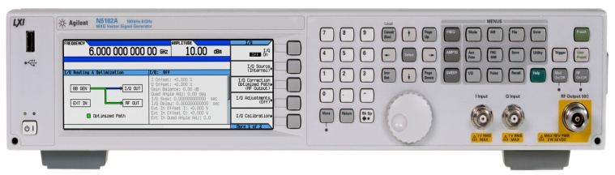
Basic CW Signals – Specifications
Amplitude
Range P_{min} to P_{max}
Resolution Smallest amplitude increment
Accuracy How close is the indicated amplitude to the actual amplitude?
Switching Speed How quickly can you change from one amplitude to another?
Reverse Power Protection Maximum safe power that can be applied to the RF output
Amplitude uncertainty
Source protected from accidental transmission from DUT
What is P out?
max
Voltage
What is P out?
min
DUT
Frequency
Notes:
Slide 37
Range, accuracy, resolution, switching speed, and reverse power protection are the main amplitude specifications. The range of a source is determined by the maximum output power and the amount of internal attenuation built into the source. The resolution of a source indicates the smallest amplitude increment. Switching speed is a measure of how fast the source can change from one amplitude level to another.
Sources are often used to test transceivers. Because transceivers have transmitters, the connection between a source and the transceiver could conduct a signal from the device being tested to the output connector of the source. Reverse power protection prevents transmitter signals from damaging the source.

Slide 30
Basic CW Signals – Specifications
Frequency Sweep
Step sweep
  accuracy
  number of points
  switching time
f4
f3
frequency
f2
f1
t1
t2
t3
t4
Ramp sweep
  accuracy
  sweep time
  resolution
f2
frequency
f1
t1
t2
time
Notes:
Slide 38
Sweep functionality adds the ability to move the CW tone in frequency. There are two types of frequency sweeps: ramp sweep and step (or arbitrary list) sweep. In ramp sweep, the output sine wave frequency is linearly increased vs time from a start frequency to a stop frequency. In step (or list) sweep, the output frequency is abruptly changed from one frequency to another. The source will then remain at each new frequency for a specified length of time.
For ramp sweep, the accuracy, sweep time, and frequency resolution of the source are usually specified. For step sweep, the accuracy, number of points, and switching time are specified. The number of points may be as few as two or as many as several hundred. The switching time is the time needed by the source to switch from one frequency to another.

Slide 31
Basic CW Signals – Specifications
Frequency Sweep - Amplitude
level accuracy spec
Frequency Sweep
Level Accuracy
Flatness
Source Match (SWR)
Power Sweep
Power Sweep Range
Power Slope Range
Source Match (SWR)
power
flatness spec
f1
f2
frequency
}
P2
power sweep range
power
P1
t1
t2
Notes:
Slide 39
Amplitude specifications also impacts the sweeping capability of the CW source. In a frequency sweep, the output power will vary by no more than the flatness specification throughout the sweep. In addition, the output power is also constrained to remain within the level accuracy specification of the source. For example, consider a source with a level accuracy of +/- 1.0 dB and a flatness specification of +/- 0.7 dB. If the output is set to 0 dBm, the actual output could really be as high a 1 dBm or as low as -1 dBm. If the actual output is 1 dBm, during the sweep, the power can only drift downward by the 0.7 dB, the flatness specification; the power cannot drift above 1 dBm because the ALC will constrain the power to remain within 1 dB of the set level of 0 dBm.
CW sources can also sweep its power level in addition to their frequency. When sweeping power, the sweep range will determine possible range of output powers. The slope range will determine how quickly the source can sweep from one power to another. In place of a power slope, some sources allow the user to specify the number of points in the power sweep and the dwell time.
Source match is generally specified in standing wave ratio (SWR) which is really just a measure of how close the source output is to 50 ohms. The value of SWR can range between one and infinity. Some of the power from a source with a SWR greater than one, when connected to a 50 ohm load, will be reflected back to the source which sets up the standing waves.

Slide 32
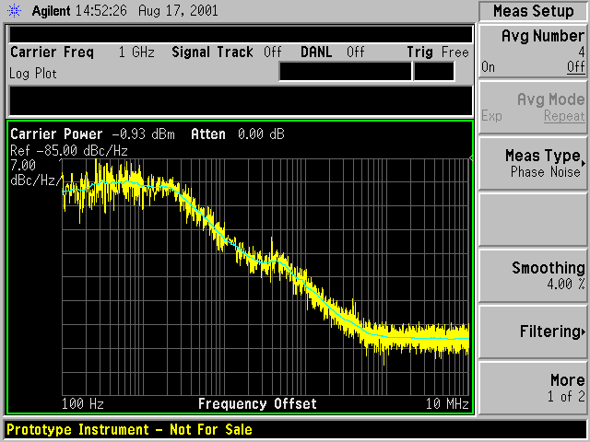
Basic CW Signals – Specifications
Spectral Purity
Phase Noise
Spurious
Harmonics
Sub-harmonics
CW output
Phase noise,
dBc/Hz
Harmonic spur
~30dBc
Non-harmonic spur
~65dBc
Sub-harmonics
0.5 f0 f0 2f0
Notes:
Slide 40
The specifications associated with spectral purity are often the most difficult to understand. The ideal CW output is a sine wave at a single frequency. Unfortunately, their are no ideal CW sources: All sources are made with non-ideal (i.e. real) components which introduce phase noise and unwanted distortion products.
Harmonic spurs are integer multiples of the CW output. Sources contain many non-linear components. These components are needed to provide a broad range of frequencies and output powers. The non-linear characteristics of an amplifier create second, third, and higher order harmonics. A typical second harmonic will be specified at <-30 dBc (better than 30 dB below the output of the fundamental frequency). Non-harmonic spurs come from a variety of sources (e.g. power supply) and are typically quite low (<-65 dBc).
Multipliers are often used in sources to extend the frequency output. This results in the presence of sub-harmonics.

Slide 33
Basic CW Signals – Applications
As a Local Oscillator
DUT
IF signal
transmitter output
Poor frequency accuracy and/or resolution will cause the transmitter output to be at the wrong frequency
LO signal
Key Specs:
poor phase noise spreads energy into adjacent channels
Frequency Range
Accuracy
Resolution
Output Power
Phase Noise
Notes:
Slide 42
Frequently during development, hardware sections of a prototype become available in stages. For example, in the development of transmitter, if all sections except the local oscillator section are finished, a CW source is often used as the local oscillator.
When using a CW source as a local oscillator, phase noise and frequency accuracy are critical. Poor frequency accuracy will cause a transmitter to transmit at the wrong frequency. In a channelized communication system, poor phase noise will spread energy into adjacent channels. This spread into adjacent channels could be incorrectly attributed to the power amp of a transmitter.

Slide 34
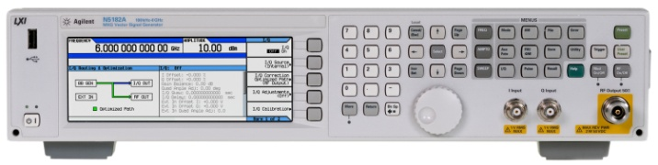
Basic CW Signals – Applications
In-Channel Receiver Testing
Receiver Sensitivity
IF signal
The smallest RF signal that will produce a desired baseband output from the receiver
DUT
in-channel signal
(cw signal)
source output
Key Specs:
IF Rejection Curve
Range (-127 dBm to +23 dBm)
Accuracy (+/- 0.7 dB)
Resolution (0.01 dB)
Level (dBm)
-116 dBm to –126 dBm
IF Channel
Frequency
Notes:
Slide 43
An analog(or channelized) receiver sensitivity is a measure of how small of an input signal will produce a desired baseband output signal from the receiver. The critical source specifications used in this test are amplitude range, resolution and accuracy. A less accurate signal generator might cause a good receiver to fail or even worse, a bad receiver to pass.

Slide 35
Basic CW Signals – Applications
Out-of-channel Receiver Testing
Receiver Selectivity
Spurious Response Immunity
in-channel signal
IF signal
isolator
DUT
out-of-channel interferer
source output
IF Rejection Curve
Key Specs:
Frequency Range
Output Power
Phase Noise
Broadband noise
Non-harmonic spurious
spur from source and/or high levels of phase noise can cause a good receiver to fail
Level (dBm)
Frequency
Notes:
Slide 44
Spurious immunity is a measure of the ability of a receiver to prevent unwanted signals from causing an unwanted response at the output of the receiver. To make this measurement, one source inputs a modulated test signal at the desired channel frequency at a level above the sensitivity of the receiver. The second source outputs an interfering signal over a broad range of frequencies. The interfering signal may be modulated or unmodulated depending upon the frequency range and the communication standard.
The non-harmonic spurious output of the interfering source must be at sufficiently low levels to ensure that the measurement is not affected. The non-harmonic spurious signals should be about 15 dB below the spurious immunity specification. At this level, spurs from the source will make only a minimal contribution to the overall in-channel noise floor.
An example will show how the level accuracy also effects the test. If the set level of the interferer is 0dBm and the set level of the test signal is -50dBm then the spurious immunity is 50dB. If the level accuracy of the two sources is +/-1dB, then the level of the interferer might actually be -1dBm and the level of the test signal might actually be -49dBm for an actual spurious immunity of 48dB; not quite as good. The level accuracy of the sources determines measurement uncertainty which in this case the measured spurious immunity is 50dB +/- 2dB. (The uncertainty is twice the level accuracy.)

Slide 36
Basic CW Signals – Applications
Non-linear Amplifier Testing - TOI
f1
DUT
output RF
isolator
f2
Two-tone Intermodulation Distortion
Key Specs:
Frequency Range
Frequency Accuracy
Frequency Resolution
Output Power
Non-harmonic spurious
f1
f2
test system third order products will also fall here
spurious signals from source can corrupt measurement
amplitude
fL = 2f1 - f2
fU = 2f2 - f1
frequency
Notes:
Slide 45
Third order intercept, or TOI, is a common amplifier measurement made by using two CW sources which are combined at the input of an amplifier (DUT). The frequencies of each source are slightly offset from each other and yet still inside the bandwidth of the amplifier. The non-linearities of an amplifier will produce third order mixing products: f_{L} = 2f₁ - f₂ and f_{U} = 2f₂ - f₁ where f₁ and f₂ are the output frequencies of the two sources.
Spurious signals from the CW sources can corrupt the measurement. When selecting an appropriate source, the non-harmonic spurious levels should be well below the third order products produced by the amplifier under test.
The test system can also introduce sources of error. Whenever two signals are input to a combiner, the non-linearities of the sources will create intermodulation products. The intermodulation products, when using a simple combiner, are created by the ALC of the source. The signal from the first source passes through the resistive combiner network and into the second source output with a 6 dB loss and the loss associated with the output attenuation of the second source. Because the two sources are at different frequencies, the sum of the two signals has an AM component equal to the difference frequency. For difference frequencies that are within the bandwidth of the ALC, the ALC of the second source sees this additional power and tries to level the output by adding AM. The intermodulation products created by the test system are at the same frequencies as those created by the amplifier under test.
Intermodulation products can be reduced either through better isolation of the signal sources or by suppressing the power that transfers from one source to the other wit a circulator.

Slide 37
Basic CW Signals – Applications
Out-of-channel Receiver Testing - IMD
f1
Intermodulation immunity
isolator
IF signal
f2
DUT
Fmod = nF1 + mF2
n= -1,2
m= 2,-1
Key Specs:
out-of-channel signals
Frequency Range
Frequency Accuracy
Frequency Resolution
Output Power
Non-harmonic spurious
sources output
IF Rejection Curve
F1
F2
Intermodulation product Fmod = 2F2 – F1
Level (dBm)
spur from source
Frequency
Notes:
Slide 46
Similar to IMD testing of amplifiers, IMD testing of receivers is testing the IMD immunity of the entire receiver. The same source specifications are important.

Slide 38
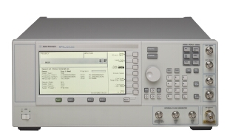
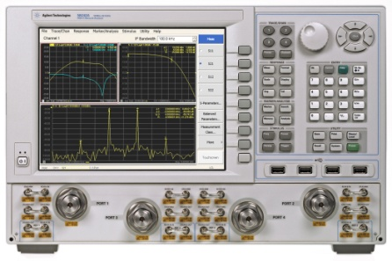
Basic CW Signals – Applications
Stimulus-Response Testing
Example DUT’s
Detector
F_{in}
F_{out}
Detector
DUT
F_{in}
F_{out}
Key Specs:
Frequency Range
Frequency Accuracy
Frequency Ramp/step sweep
Power sweep
Sweep speed
Output Power accuracy
Residual FM
LO
Notes:
Slide 47
The major application of sweeping CW generators is stimulus-response testing, or to find the swept response of the DUT. Frequency sweeps are done to determine the frequency response of devices. Power sweeps, typically done on amplifiers, measure linearity and saturation levels.
When measuring the frequency response of a device, the following sweeper specifications are important:
Specification Effect
Frequency Accuracy center frequency and bandwidth of the device under test (DUT)
Output Power (Level) gain or loss
Flatness flatness
Speed test cost
residual FM ability to test high Q devices
Frequency response measurements are made on many types of devices including amplifiers, filters, and mixers. For a more detailed explanation of these types of measurements, see the Network Analysis Back to Basics paper.

Slide 39
Signal Generators
Basic CW Signals
  Block Diagram (RF and Microwave)
  Specifications
  Applications
Analog Signals
  Block Diagram (AM, FM, PM, Pulse)
  Applications
Vector Signals
  Block Diagram (IQ)
  Applications
Notes:
Slide 48
Now we are going to examine the effect of adding analog modulation to the basic generator.

Slide 40
Analog Signals – Block Diagram
Add AM, FM, PM, and Pulse Modulation
ALC Modulator
Output
Attenuator
VCO
Pulse
Mod.
Freq.
Control
ALC
Driver
Reference
Oscillator
FM, PM input
AM input
Pulse Mod input
Notes:
Slide 49
The block diagram of an analog signal generator does not differ greatly from that of a CW generator. Instead of altering the blocks of the source, there are additional components that allow the source to modulate the carrier.
The FM and PM inputs are to the frequency control block of the synthesizer in order to modulate the carrier. To change the frequency or phase of the signal generator, this FM or PM input signal is applied to the VCO. This signal, in addition to the reference oscillator signal, creates the FM or PM signal.
To create AM, the AM signal needs to be applied to the ALC driver block. The ALC driver will convert the voltages from the AM input into amplitude changes in the carrier through the ALC modulator.
To create pulse modulation, a pulse input is added and that signal is applied to a pulse modulator, which is in the output path of the signal.

Slide 41
Analog Signals – Block Diagram
Add internal modulation generator
ALC Modulator
Output
Attenuator
VCO
Pulse
Mod.
Freq.
Control
ALC
Driver
FM, PM input
AM input
Pulse Mod input
FM
Source
AM
Source
Pulse
Source
Reference
Oscillator
Notes:
Slide 50
In addition to the AM, FM, PM and pulse modulation capability being added to the CW source, an internal modulation generator can also be added. Having an internal modulation generator provides convenience and simplifies test setups.

Slide 42
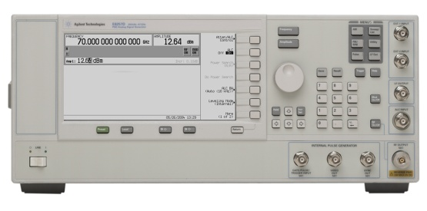
Analog Signals – Applications
Pulsed Radar Testing with Chirps
RF Signal
Injection
ANTENNA
FM during the pulse = chirp
Key Specs:
Frequency Range
FM Modulation rate/deviation
Pulse rate, width, rise time
LNA
1st LO
Signal
Processor
(range and Doppler)
2nd
IFA
IF
BPF
1st
IFA
IF
BPF
2nd
LO
Notes:
Slide 52
When creating a composite modulation signal such as a chirped pulse, the key signal generator modulation specifications are FM deviation and rate, pulse rate, pulse width and pulse rise time.

Slide 43
Signal Generators
Basic CW Signals
  Block Diagram (RF and Microwave)
  Specifications
  Applications
Analog Signals
  Block Diagram (AM, FM, PM, Pulse)
  Applications
Vector Signals
  Block Diagram (IQ)
  Applications
Notes:
Slide 53
Now we are going to examine the effect of adding vector modulation to the generator.

Slide 44
Vector Signals – Block Diagram
IQ Modulation
01
Q
I:
00
Carrier
I
π/2
Q:
11
10
Good Interface with Digital Signals and Circuits
Can be Implemented with Simple Circuits
Fast, accurate state change
Notes:
Slide 54
To create a vector signals, we need to take the I and Q signals that come from a baseband generator and create a combined IF signal from them. In the IQ Modulator, I and Q signals are mixed with the same local oscillator (LO) which in our case comes from the synthesizer section of the source. A 90 degree phase shifter is placed in one of the LO paths. Signals that are separated by 90 degrees are also known as being orthogonal to each other or in quadrature. Signals that are in quadrature do not interfere with each other. They are two independent components of the signal. When recombined, they are summed to a composite output signal.
This implementation of an IQ modulator is used almost exclusively today. It is very simple to implement and IQ modulators interface very well with digital circuitry (e.g. DAC’s, DSP processors). When generating a QPSK signal, controlling two voltage states for the I and Q inputs may be done more accurately than changing the phase directly between four different phase states.

Slide 45
Vector Signals – Block Diagram
Adding the IQ modulator
Synthesizer
I-Q Modulator
Output
90̊
VCO
Freq.
Control
ALC
Driver
Q
Reference
I
Notes:
Slide 55
A vector signal generator is created by adding an IQ modulator to the basic CW block diagram of a signal generator. In this configuration, the generation of the I and Q signals are done externally to the vector signal generator.

Slide 46
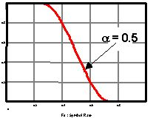
Vector Signals – Block Diagram
Baseband IQ signal generation
Analog Reconstruction Filters
DAC
I
Symbol Mapping and Baseband Filters
Pattern RAM
DAC
Q
00 -> 1+j1
01 -> -1+j1
10 -> -1-j1
11 -> 1-j1
110001011010100101110010101010
Notes:
Slide 56
A baseband generator takes binary data that contains the desired “information” to be transmitted, maps it to digital symbols and then to digital I and Q signals, converts the digital IQ signals to analog IQ signals and sends them to the IQ modulator to be coded onto the carrier signal.
The pattern RAM is where the digital data signals reside in the arbitrary waveform generator. The signal can be created and sent here in many different ways. Arb files can be created internally in the vector signal generator or can be created from external applications and stored here. Signals can also be created in real-time and streamed through the baseband generator.
When the data leaves the pattern RAM it undergoes symbol mapping. This is the process in which the 0’s and 1’s from the file are mapped to the proper constellation points for the digital modulation format that is being used. These digital signals are then digitally filtered. We will examine these filters on the next slide.
After the baseband filters, the I and Q signals are converted to analog signals and then filtered. The analog reconstruction filters are there to filter off the images of the signal produced by the DAC’s. Our data is then sent off to the IQ modulator.

Slide 47
Vector Signals – Block Diagram
Baseband Generator: Baseband Filters
Fast Transitions Require Wide Bandwidths
Frequency
Frequency
Filtering Slows Down Transitions and Narrows the Bandwidth
Notes:
Slide 57
In the baseband generator there are 2 sets of filters. These filters are sometimes confused with one another and so let’s take a brief look at the baseband filters. After the symbol mapping but before the DAC’s is a set of filters called the baseband filters. These filters reside here mainly to limit the bandwidth of the I and Q symbols. If no filters were placed in the path, the bandwidth of the symbols would be theoretically infinite. However, most of the relevant information can be had from the main lobe of the signal so we filter the signal to limit it’s bandwidth. Limiting the BW in the frequency domain also smooths the transitions in the time domain, as can be seen in the slide.
The baseband filters can be many types and have different attributes that must be set in a signal generator. You must first select the filter type. Common filter types are Root Raised Cosine, Gaussian, and Rectangular. Next you must select the filter Alpha. This determines the sharpness of the filter slope. For a "brick-wall" filter, alpha=0, and the estimated occupied bandwidth = symbol rate. A filter this sharp is not realizable in the physical world and will ring excessively. More common filters will range in alpha from .1 to .5.

Slide 48
Vector Signals – Block Diagram
Adding an internal Baseband Generator
I-Q Modulator
Output
Synthesizer
VCO
p/2
Freq.
Control
ALC
Driver
Q
DAC
Pattern RAM and Symbol Mapping
I
Reference
DAC
Baseband Generator
Notes:
Slide 58
For convenience, the I and Q signals can be generated by internally adding the baseband IQ generator to the signal generator.

Slide 49
Vector Signals – Applications
Format Specific Signal Generation
Receiver Sensitivity
Receiver Selectivity
Component Distortion
Notes:
Slide 59
There are numerous applications for vector signal generators and to go through them all would take much too long. We will take a look at four very common vector signal applications.

Slide 50
Vector Signals – Applications
Digital Format Access Schemes
Different time - different Users
One User
FDMA
Differ channel - different Users
TDMA
Different time - different Users
CDMA
Same channel – many users
OFDM
Notes:
Slide 60
Different digital standard formats have different schemes for accessing the data. Four commonly used schemes are shown here.
FDMA stands for Frequency Division Multiple Access. FDMA has been around longer and most standards employ FDMA in combination with one or more of the other access schemes. It is rare that a new standard will arise that only employs FDMA. In FDMA, one user is assigned a frequency at which he transmits and receives his data.
TDMA which stands for Time Division Multiple Access has also been in use for a long time and is an efficient way of transmitting data. TDMA is used in standards such as NADC, GSM, and EDGE. In TDMA, different users are assigned different frequencies on which to transmit but they also assigned timeframes in which they transmit. During the time in which you are not transmitting, another user will be using the bandwidth that you are using.
CDMA, or Code Domain Multiple Access is a more recent access scheme that has been developed. It has many flavors, depending on the standard, but what is constant is that all users are transmitting on the same frequency at the same time. The users data is separated by the receivers using Walsh Codes or Gold Codes. These Walsh Codes are specific to a particular user and so the receiver can tell what data belongs to what user. IS-95, CDMA200, and W-CDMA all use CDMA as their access scheme.
OFDM is the newest of the access schemes and stands for Orthogonal Frequency Division Multiplexing. OFDM is used in newer standards such as 802.11a and 802.16. In OFDM standards many carriers are used similar to FDMA, however these carriers are spaced extremely close together and so we get very efficient spectral use. OFDM is being used more now because DSP processors are finally powerful enough to process the large amounts of data necessary to separate the carriers and decode the data.

Slide 51
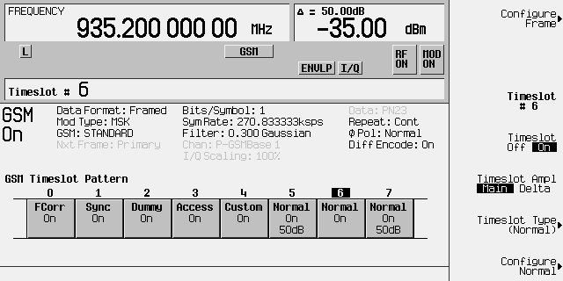
Vector Signals – Applications
Format Specific Modulation
GSM: A type of TDMA modulation
Multiple users, same frequency, different time slots
Notes:
Slide 61
In a signal generator, the combination of the baseband generator and the IQ modulator produce a digitally modulated signal. The filtering and modulation type are determined by the shape of the baseband waveforms.
To accurately simulate a digital modulated signal, however, the signal generator must do more than just output the proper modulation. Most digital communication formats, in an effort to conserve bandwidth, have some access scheme and the signal generator must be capable of simulating that access scheme.
For example, a GSM signal is a popular cellular technology that has multiple users on the same frequency. There are different timeslots that must be configured with the proper symbol rate, modulation type, and burst profiles. The timeslots themselves must also have the proper framing data so that a GSM receiver will recognize the incoming signal.

Slide 52
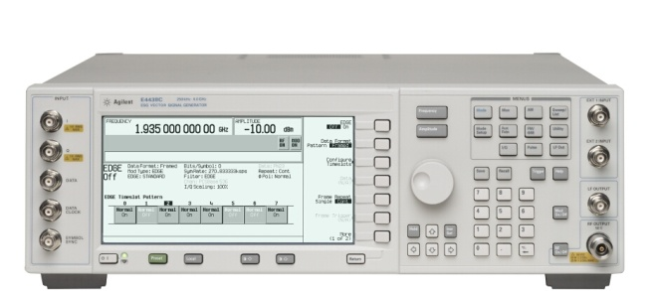

Vector Signals – Applications
Digital Receiver Sensitivity
The smallest modulated RF signal that will produce a specified BER from the receiver
DUT
RF
Baseband
DAC
ADC
DSP
RF LO
Payload Data
Amplitude
BER Spec Line
BER
frequency
Notes:
Slide 62
The sensitivity of a receiver is the lowest possible signal level that can be reliably detected and is one of the key specifications for a receiver. For digital receivers, sensitivity is defined as the level of the received signal that produces a specified bit error rate (BER) when the signal is modulated with a specified psuedo-random binary sequence (PRBS) of data. In R&D testing, they will actually determine what that level is. In manufacturing test, they will simply set the power of the signal generator to the specified power level and determine whether or not the BER passes or fails. This takes much less time.

Slide 53
Vector Signals – Applications
Digital Receiver Sensitivity
Testing a -110 dB sensitivity digital receiver:
X= Failed unit
Amplitude Accuracy Matters!
O=Passed unit
Power Out
-110 dB specification
Power Out
X
X
-110 dB specification
X
X
Set source to -111 dBm
X
X
X
Actual output power= -114 dBm
O
O
O
Actual output power= -112 dBm
O
Set source to -115 dBm
O
Frequency
Frequency
Case 1: Source has +/-5 dB of
output power accuracy at
-100 to -120 dBm output power.
Case 2: Source has +/-1 dB of
output power accuracy at
-100 to -120 dBm output power.
Notes:
Slide 63
When making a sensitivity measurement, the level accuracy of the signal generator is extremely important. For example, if a digital receiver has a specified sensitivity level of -110 dBm. The measurement system will introduce error. The amplitude level accuracy of the signal generator supplying the test signal is the main source of error. In order to ensure that no receivers are passed with sensitivities that do not meet -110 dBm, the amplitude of the signal generator must be set below the receiver specification by an amount equal to the level accuracy of the signal generator. In this example, for a signal generator with a level accuracy of +/-5dB, the maximum amplitude of the test signal is set to -115 dBm.
In this example, the maximum signal generator level of -115 dBm ensures that only good receivers pass. However, not all receivers that are good will pass (pass shown as x and fail shown as o). For example, with a level accuracy of +/-5dB at a nominal level of -115 dBm, the output of the signal generator may be as high as -110 dBm (the receiver spec) or as low as -120 dBm. A good receiver may not work at -120 dBm but, because of the signal generator uncertainty, may be tested at -120 dBm. Of the six receivers tested in this example, only one passed.
When tested with a signal generator that has a level accuracy of +/-1dB, the number of receivers that passed increases dramatically.

Slide 54
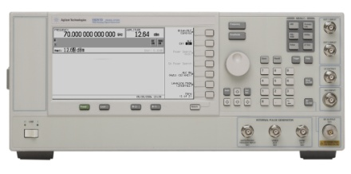
Vector Signals – Applications
Receiver Selectivity (Blocking Tests)
In-channel signal
(modulated signal)
RF
Baseband
DAC
ADC
DSP
RF LO
Out-of-channel signal
(CW or modulated signal)
IF Rejection Curve
Payload Data
Spur from source and/or high levels of phase noise can cause a good receiver to fail
Level (dBm)
Sensitivity specification
Frequency
Notes:
Slide 65
Adjacent and alternate channel selectivity measures the receiver's ability to process a desired signal while rejecting a strong signal in an adjacent channel or alternate channel. An adjacent or alternate channel selectivity test setup is shown above.
One signal generator inputs a test signal at the desired channel frequency at a level above the sensitivity of the receiver. The second signal generator outputs either the adjacent channel signal, offset by one channel spacing, or the alternate channel signal, offset by two channel spacings. The output of the out-of-channel signal is increased until the sensitivity is degraded to a specified level.
Frequency and amplitude (level) accuracy and the spectral characteristics of the test and interfering signal are important.
Poor frequency accuracy will cause the signals to be either too close or too far from each other and from the filter skirts. This can have the effect of appearing to improve or degrade the receiver performance.
We saw how level accuracy can affect the sensitivity measurement of a receiver. With two signals, the problems associated with inaccurate signals are compounded.
The SSB phase noise of the interfering signal is a very critical spectral characteristic. The test is a measure of the performance of the receiver's IF filters. As the signal in the adjacent-channel is increased, the rejection of the IF filter outside the passband is eventually exceeded. If the phase noise energy inside the passband is detected, the receiver may appear to fail the test.
High levels of spurs can also degrade the selectivity measurement of a receiver. Signal generator spurs that fall within the passband of the receiver will contribute to the overall noise level in the passband.

Slide 55

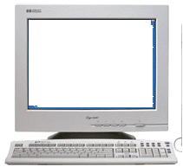
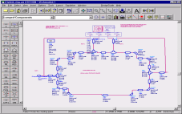
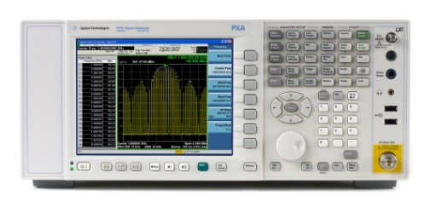
Vector Signals – Applications
Receiver Sensitivity – Connected Solutions
Simulated portion
RF
IF
I
A/D
Converter
Baseband
De-Coding
Demodulator
Q
DUT
RF/IF BER
Signal Analyzer
Signal Generator
Simulation Software
Notes:
Slide 64
Sometimes you need to measure the receiver sensitivity before all of the hardware blocks are available. Normally, BER measurements are only possible when the entire receiver is available because to measure the BER you need all of the baseband processing to enable you access to the payload data. Newer hardware and software development within test equipment now allows you to measure the BER when only portions of the receiver is available.
This new technique is called Connected Solutions. With this technique, simulation software and the test equipment must work together to be able to make the measurement. When making a BER measurement, you must know what is created in the signal generator and you must be able to compare that data to the data that is sent through the DUT. So the same simulation software that creates the input waveform must also accept the post-DUT waveform and make the measurement.
In this measurement, we create a signal with the simulation tool and send it to the arbitrary waveform generator (AWG) of the vector signal generator. This signal is played through the DUT and captured with a signal analyzer. This captured waveform is then sent back to the simulation tool to be analyzed. The interfaces that you use for this new kind of measurement can be RF, IF, Analog IQ, or Digital IQ.

Slide 56

Vector Signals – Applications
Component Distortion – Adjacent Channel Power Ratio
DUT
Spectral Output from amplifier
Input from Source
ACPR
Spectral regrowth
ACP Margin
Margin (dB) | 0 | 1 | 2 | 3 | 4 | 5 | 10 | 15
Error contribution (dB) | 3.0 | 2.5 | 2.1 | 1.8 | 1.5 | 1.2 | 0.4 | 0.2
Notes:
Slide 66
In a digital transmitter, adjacent channel power is mainly a function of the non-linear characteristics of amplifiers used in the design. The in-channel digitally modulated signal spans a certain bandwidth in frequency. Remember that amplifiers with multiple input signals can create intermodulation distortion products so that with the many frequencies present in a digitally modulated signal, these out-of-channel distortion products look like increased noise. This out-of-channel non-linear intermodulation distortion for a digitally modulated signal is often referred to as spectral re-growth.
Spectral regrowth for an digitally modulated signal is determined by measuring its adjacent channel power. Adjacent channel power ratio is the ratio of the power in the spectral regrowth sidebands to the power in the main channel.
When measuring an amplifier, the spectral regrowth, or ACPR performance, of the signal generator should be less than that of the amplifier under test. The lower the ACPR performance of the signal generator, the more accurately the ACP can be measured on the DUT. To minimize the contribution of the vector signal generator, choose one with ACP that is approximately > 10 dB lower in ACP than the ACP you are trying to measure.

Slide 57

Vector Signals – Applications
Component Distortion – Error Vector Magnitude
OFDM Signal - 400 MHz Bandwidth
DAC
Q
Q
Magnitude Error (IQ error mag)
Q
{
Error Vector Magnitude
I
Test Signal
I
Θ
Ideal (Reference) Signal
Phase Error (IQ error phase)
I
Notes:
Slide 67
Sometimes the components you are testing will distort the signal from the signal generator but it is not apparent from the spectral regrowth. The constellation of the signal can be distorted in many different ways depending on the device you are testing. Noise, IQ distortion, and compression can all affect the constellation so that the constellation points may start to blend in to one another. When this happens, bit errors will occur and the transmission of the digital data you are sending will be faulty.
The IQ constellation of our digitally modulated signal provides a wealth of information. Recall first the basics of digital modulation: Digital bits are transferred onto an RF carrier by varying the carrier's magnitude and phase such that, at each data clock transition, the carrier occupies any one of several unique phase and amplitude locations on the IQ plane. Each location encodes a specific data symbol, which consists of one or more data bits. A constellation diagram shows the valid locations at the decision time (i.e., the magnitude and phase relative to the carrier) for all permitted symbols, of which there must be 2^{n}, given n bits transmitted per symbol. Thus, to demodulate the incoming data, one must accurately determine the exact magnitude and phase of the received signal for each clock transition.
At any moment in time, the signal's magnitude and phase can be measured. These values define the actual or "measured" vector. At the same time, a corresponding ideal or "reference" vector can be calculated, given knowledge of the transmitted data stream, the symbol clock timing, baseband filtering parameters, etc. The differences between these two vectors provides both the signal Error Vector Magnitude (EVM) and the phase error.
Signal generators are depended on to provide a very clean constellation. Typically this is the case, however some measurements on high performance components could approach the performance of the signal generator.

Slide 58
Vector Signals – Applications
Component Distortion – EVM
OFDM Signal -
400 MHz Bandwidth
Measured EVM = -30 dB, 3.3%
Notes:
Slide 68
Using EVM as a metric, that same 400 MHz OFDM signal measured in the I/Q plane yields –30 dB (or 3.3%) EVM. Although the constellation appears quite clean visually, the poor performance is clearly visible in the error vector spectrum measurement. The performance increasingly degrades as the band edges are approached. By convention, EVM is reported as a percentage of the ideal peak signal level, usually defined by the constellation's corner states.
EVM and phase error are the two principal parameters for evaluating the quality of a digitally modulated signal.

Slide 59
Agenda
The need for creating test signals
      Aerospace Defense to Communications
Generating Signals
      No modulation
      Analog Modulation
      Composite Modulation
Signal Generator Architecture
Signal Simulation Solutions
Summary
Notes:
Slide 69
Now we are going to see how simulating real life signals will ease the testing burden.

Slide 60
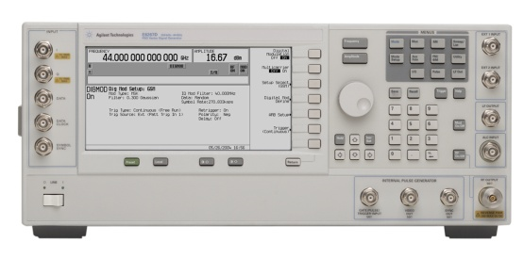
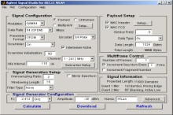
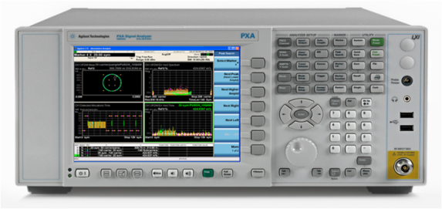
Signal Simulation Solutions
Remove Test Signal Imperfections
Add Predistortion (corrections)
Signal Software
LAN/GPIB
PSG
Measurement Results
Measure Modulated Signal
PXA
Sources of error – I/Q modulator, RF chain, IQ path
Result – passband tilt, ripple, and roll off
Notes:
Slide 71
Waveform correction requires that the uncorrected modulated waveform be measured by a vector signal analyzer, and the results are transferred to specific waveform correction software. The correction software will predistort the waveform in the baseband generator before it gets to the IQ modulator, with the net result being a waveform without the imperfection.
Let’s take a look as some examples of waveform correction.

Slide 61
Signal Simulation Solutions
Remove Test Signal imperfections – IQ flatness
Solution – measure vector signal generator and apply predistortion
Tradeoff – calculation time, valid calibration time
Typical application – wideband, multitone, and multicarrier
32 tones - 80 MHz
500 MHz UWB
2.4 dB
Before
6-8 dB
0.1 dB
After
< 3 dB
Notes:
Slide 73
One way to view IQ flatness is to create 32 equal magnitude test tones within an 80 MHz bandwidth. Notice that before waveform correction is measured and applied, the tones vary as much as 2.4 dB across the 80 MHz of interest. By measuring the vector signal generator in this mode and applying the appropriate waveform correction, tone amplitude variation has been reduced to less than .1 dB.
Another example is to view the amplitude flatness of a 500 MHz ultra wideband modulation waveform. Notice that before correction, it varies 6 to 8 dB, and after waveform correction is varies less than 3 dB.

Slide 62
Signal Simulation Solutions
Removing Test Signal Imperfections - IMD
Before Predistortion
Measured in-band IMD = -40 dBc
After Predistortion
Measured in-band IMD = -84 dBc
Notes:
Slide 74
In-band IMD refers to the intermodulation products that fall within the channel bandwidth of the generated signal. This type of distortion is particularly undesirable since it cannot be filtered and directly interferes with the signal of interest. Similar to removing carrier feedthrough, this predistortion technique generates a canceling tone at the IMD frequency that is 180 degrees out of phase with the distortion product. This approach uses a spectrum analyzer to measure the IMD of the original test stimulus. Then based on these measurements, a predistorted waveform is created to remove the in-band, as well as the out-of-band IMD products. As shown in the before and after predistortion measurements, exceptional distortion suppression is achievable. For this test stimulus, over 40 dB improvement was obtained.

Slide 63
Signal Simulation Solutions
Removing Test Signal Imperfections – Group Delay
Before Predistortion
EVM -30 dB, 3.3%
After Predistortion
EVM –34 dB, 2%
Notes:
Slide 75
Remember back in Slide 68, we viewed a spectral measurement of an OFDM signal that spanned 400 MHz? In this situation there are many frequency dependent components that will add or subtract from constant group delay over that bandwidth. In this example, we used EVM as a measure of how constant the group delay is. Before any correction is applied we measure 3.3% EVM and most of this variation is at the edges of the band. By measuring and applying corrections to the vector signal generator, EVM has been reduced (improved) from 3.3% to 2%. Notice that the majority of the improvement is around the band edges of the modulated signal.

Slide 64
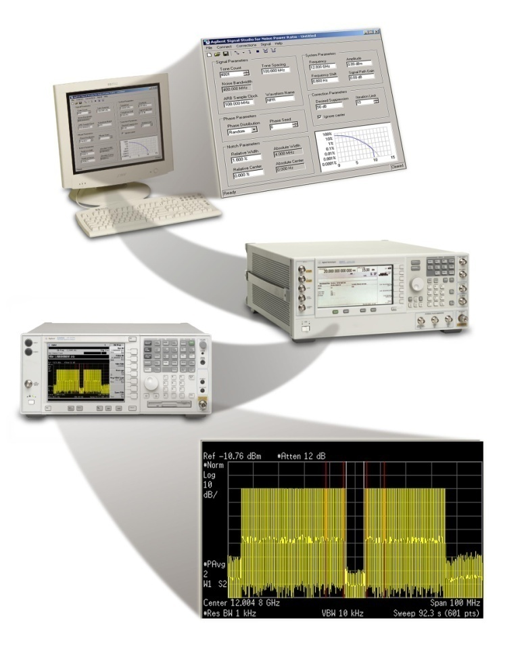
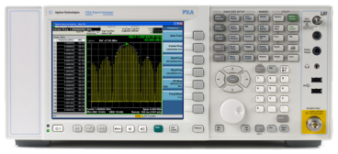
Signal Simulation Solutions
Non-linear Amplifier Testing
DUT
output RF
Intermodulation Distortion
Improved IMD suppression (typically > 80 dBc)
Correct generator with additional devices in the loop
Lower overall cost-of-test for large # tones
Same hardware for ACPR/NPR distortion tests
amplitude
Signal Studio – Enhanced Multitone
Up to 1024 tones Set relative tone power
Set relative tone phase 80 MHz correction BW
CCDF plot
Notes:
Slide 76
Remember when we discussed IMD testing earlier, and that we used two signal generators to create two tones? If you use that approach always, every time you need to expand your IMD testing to add more tones, you will need to add more signal generators.
Using the vector signal generator, along with waveform correction, IMD test can use basic two tones or many tones (up to 1024 tones), without adding any additional signal generators, thus saving time, and overall costs. And, since waveforms other than multitone are available – such as calibrated noise – even more receiver tests can be accomplished with the same hardware.

Slide 65
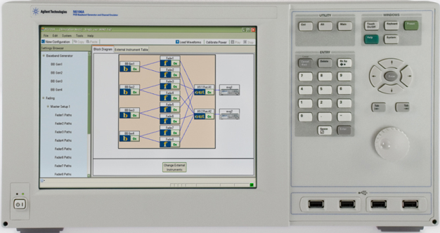
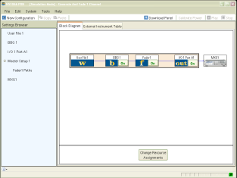

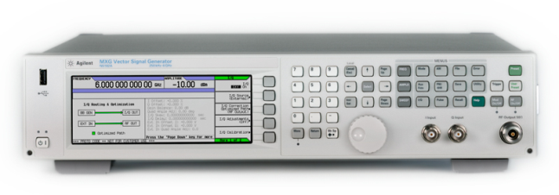
SISO BBG and Fading Test at RF/BB
Simulate one Tx, one Rx, and apply real-time fading
1
PXB generates single channel signals with long playback
2
PXB applies SISO real-time fading
Faded signal & Interferers
Output IQ or RF
Transmission channel
3
Analog I/Q
N5102A
Digital I/Q
Receiver
Vector MXG,ESG, or PSG used as an up converter
BER/PER analysis
No BBG required for MXG

Slide 66

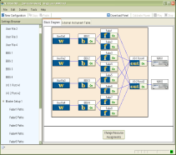
MIMO Receiver Test at RF/BB
Create MIMO signals with real-time fading for receiver test
1
PXB generates MIMO signals up to 4x2 with long playback
No BBG required for MXG
Rx0
Mobile
Station
Rx1
2
3
PXB applies flexible real-time fading to MIMO signals
Vector MXG or ESG used as RF up converters, one per receive antenna

Slide 67
Agenda
The need for creating test signals
      Aerospace Defense to Communications
Generating Signals
      No modulation
      Analog Modulation
      Composite Modulation
Signal Generator Architecture
Signal Simulation Solutions
Summary
Notes:
Slide 80

Slide 68
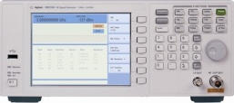
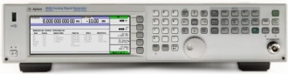
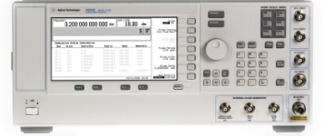
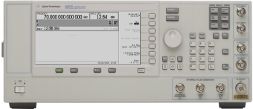
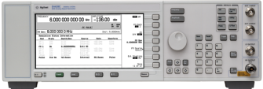

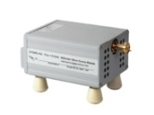
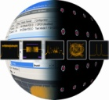





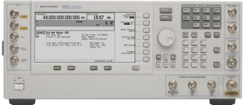
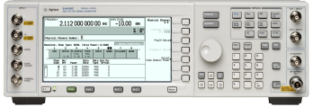

Agilent Portfolio of Signal Generators
Basic Performance
Mid- Performance
High Performance
Analog
N9310A
MXG
ESG
E8663D
PSG
3 GHz
1, 3, 6, 20, 32, 40 GHz
3, 6 GHz
3.2, 9 GHz
20, 32, 40, 50, 67 GHz
500 GHz
Signal Studio Software
Vector
N9310A
MXG
PXB
ESG
PSG
3 GHz
3, 6 GHz
Baseband
1, 2, 3, 4, 6 GHz
20, 32, 44 GHz

Slide 69
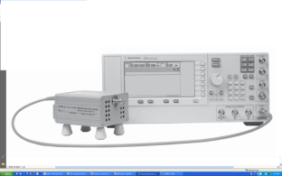
Millimeter Wave Signal Generation
E8257D has the widest specified frequency range of any signal generator on the market: 250 kHz to 67 GHz
E8257D offers 8 different models of mm source modules covering
50 to 500 GHz
  50 to 75 GHz
  60 to 90 GHz
  75 to 110 GHz
  90 to 140 GHz
  110 to 170 GHz
  140 to 220 GHz
  220 to 325 GHz
  325 to 500 GHz
Notes:
69

Slide 70




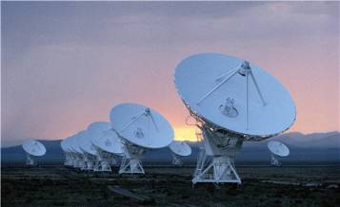
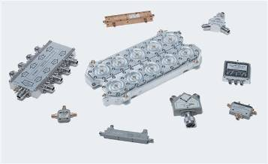
Agilent Signal Studio & Embedded Software
Application Portfolio
Mobile
Communications
Wireless
Connectivity
Audio/Video
Broadcasting
Detection, Positioning,
Tracking & Navigation
General
RF/MW
W-CDMA/HSPA (ARB)
HSPA+ (ARB)
Mobile WiMAX (ARB)
802.16e + MIMO
Digital Video (ARB):
DVB-T/H/C/S/S2
J.83 Annex A/B/C
ISDB-T
DTMB
ATSC
CMMB/STiMi
Digital Video (RT)
Pulse Building (ARB)
Toolkit (ARB)
NEW
NEW
Pulse Train
Jitter Injection (ARB)
W-CDMA/HSPA (ARB)
W-CDMA (RT)
Fixed WiMAX (ARB)
802.16d
NEW
GPS (RT)
1 to 8 satellites
Multitone Distortion (ARB)
(Enhanced Multitone & NPR)
HSPA (RT)
WLAN (ARB)
802.11 a/b/g/p/j
802.11n + MIMO
802.11ac
GPS (RT)
multi-satellite
Multitone (ARB)
LTE FDD (ARB, RT) + MIMO
LTE TDD (ARB,RT) + MIMO
NEW
NEW
NEW
GLONASS
Calibrated AWGN (ARB & RT)
TD-LTE (ARB)
TD-LTE (RT)
NEW
Phase Noise Impairments (RT)
IS-95-A & CDMA2000 (ARB)
1xEV-DO (ARB)
T-DMB (ARB)
Custom Modulation (ARB & RT)
Bluetooth (ARB)
V1.1
V2.1+EDR
Ultra Low Energy (Wibree)
S-DMB (ARB)
TD-SCDMA (ARB)
Broadcast Radio (ARB):
FM Stereo/RDS/RDBS
mono & stereo
DAB/DAB+
IS-95-A & CDMA2000 (ARB)
IS-95-A & CDMA2000 (RT)
MB-OFDM UWB (ARB)
802.15
Signal Studio
Flexible Licensing
Signal Generator Support
Channel Emulator
Support
GSM/EDGE (ARB)
EGPRS2 (ARB)
TDMA (RT):
GSM/EDGE/GPRS/EGPRS
NADC/PDC/PHS
DECT/TETRA
Fixed
- perpetual
- 1 month time-based
Vector Signal Generator
- N5182A MXG RF
- N5162A MXG-ATE RF
- E4438C ESG RF
- E8267D PSG MW
N5106A PXB
- Digital, RF, MW
- 1 to 4 Ch. BBG
- Single Channel Fading
- Multi-Channel Fading
- MIMO Fading
- RF to RF Fading
UPDATE
Legend
Signal Studio
Transportable
- perpetual
TDMA (ARB):
GSM/EDGE
NADC/PDC/PHS
DECT/TETRA
APCO/PWT/CDPD
Embedded SW
Wireless Test Set
- N8300A
RECENT INTRO
Waveform Licensing
- 5-pack perpetual
- 50-pack perpetual
UPCOMING INTRO
NEW
Logic Analyzer DigRF V3 - 16800/16900
Baseband Studio
- Digital, RF, MW
- Single Channel Fading
- Dual Channel Fading
Trial License
- 14-day time-based
Notes:
This slide shows the broad portfolio of signal creation applications from Agilent
Key Contributions
Offering most complete format coverage & meeting time-to-market window for Mobile Comms, Wireless Connectivity, and audio/video broadcasting.
Providing advanced solutions for detection, positioning, tracking and navigation.
Supporting general purpose signal creation for custom modulation, distortion test, additive impairments.
Recently introduced or updated applications are noted with an orange “NEW” indicator, while applications that will be introduced in the next few months are shown with green arrows.

Slide 71
For Additional Information
Sources: http://www.agilent.com/find/sources
Signal Analyzers: http://www.agilent.com/find/sa

Slide 72
The End
THANK YOU!

